Slide 1
My Life 3
Lesson 15
10 signs of an unhealthy relationship

Slide 2
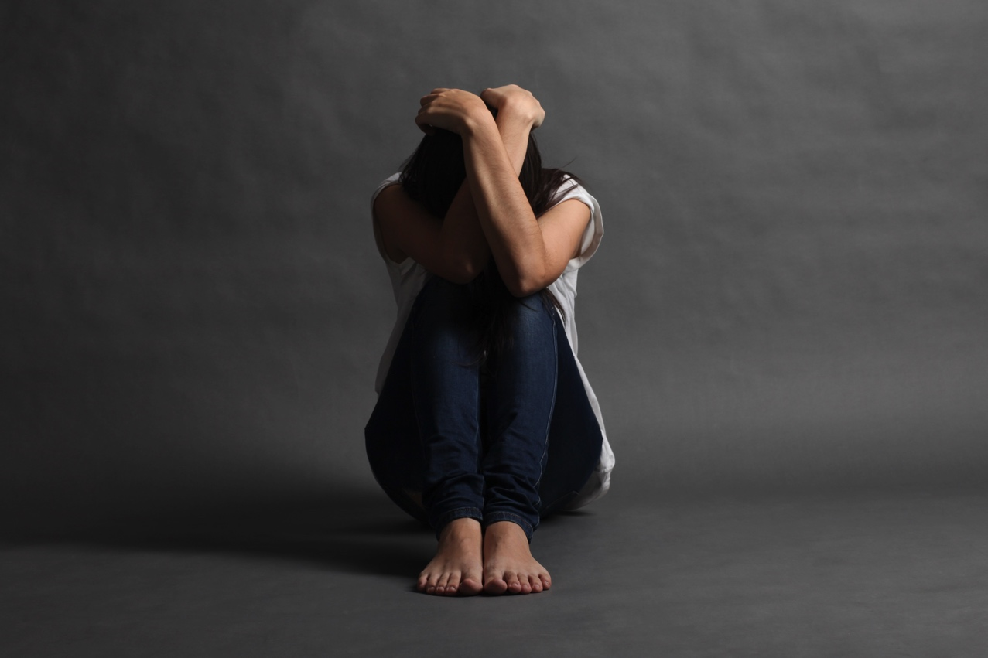
10 signs of an unhealthy relationship
The following advice was adapted from the Womens’s Aid 2in2u website.

Slide 3

10 signs of an unhealthy relationship
He or she complains about your friends or family or says you spend too much time with them.

Slide 4
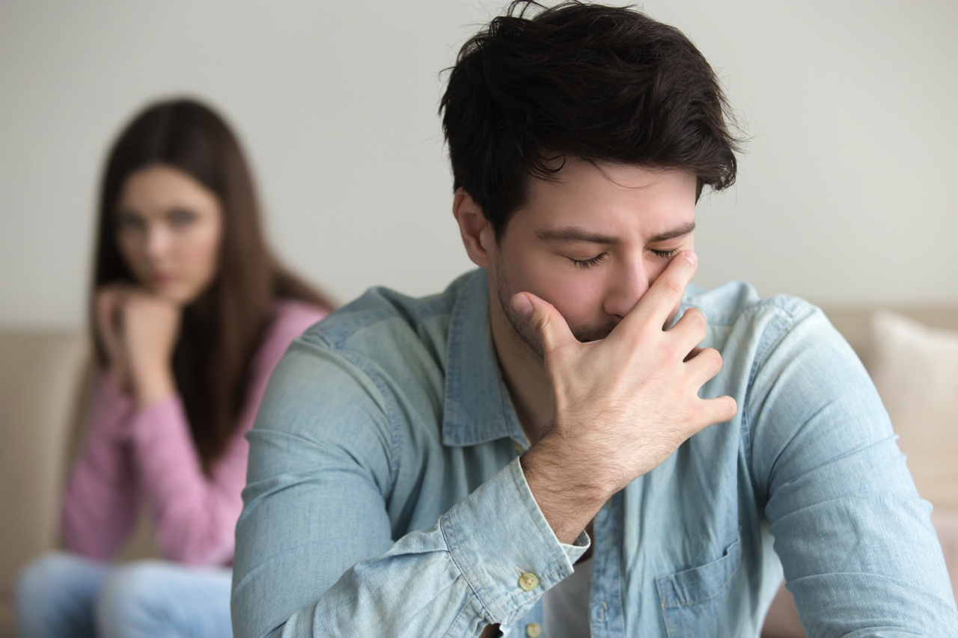
10 signs of an unhealthy relationship
He or she insists on choosing your clothes and makes negative comments about how you look or dress.

Slide 5
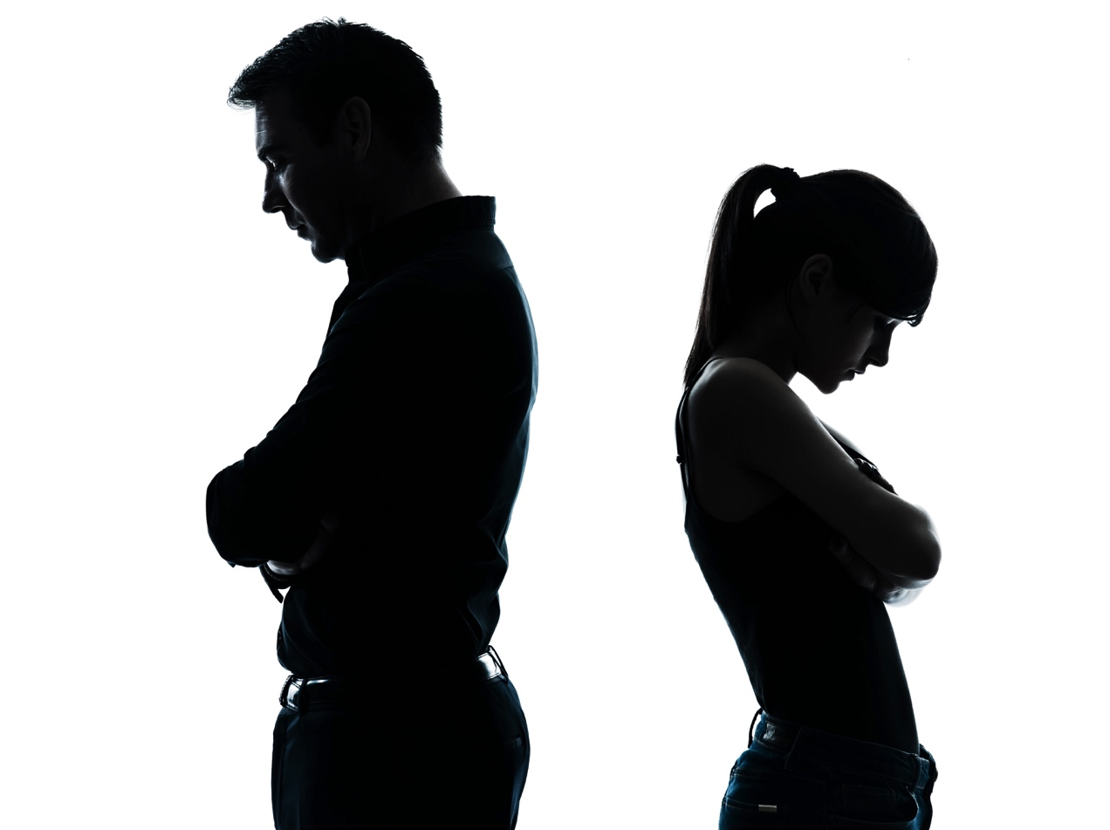
10 signs of an unhealthy relationship
He or she complains that you spend too much time apart from each other and insists that you spend all your time together.

Slide 6
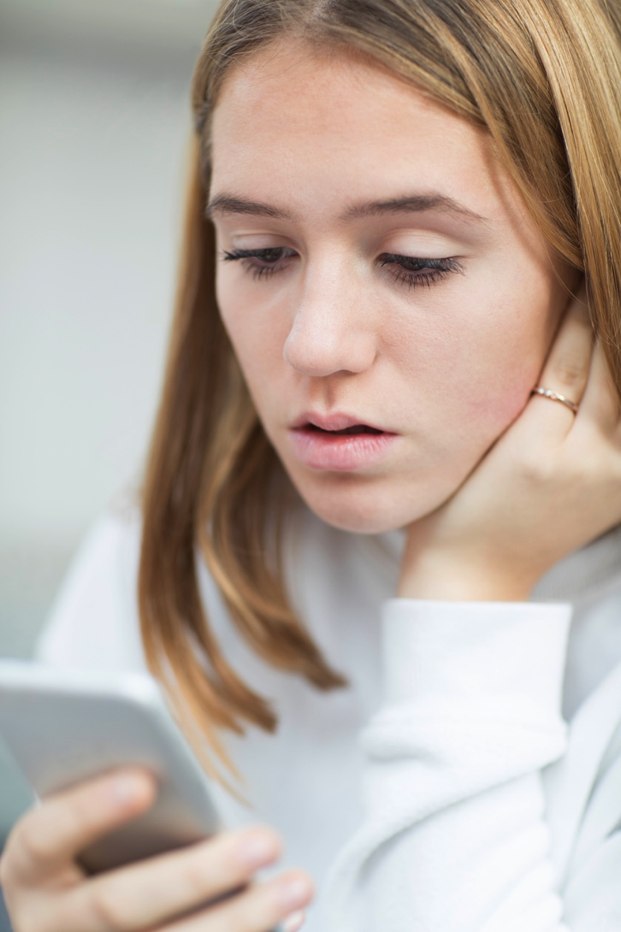
10 signs of an unhealthy relationship
He or she constantly rings you or sends you texts checking up on you when you are not together.

Slide 7
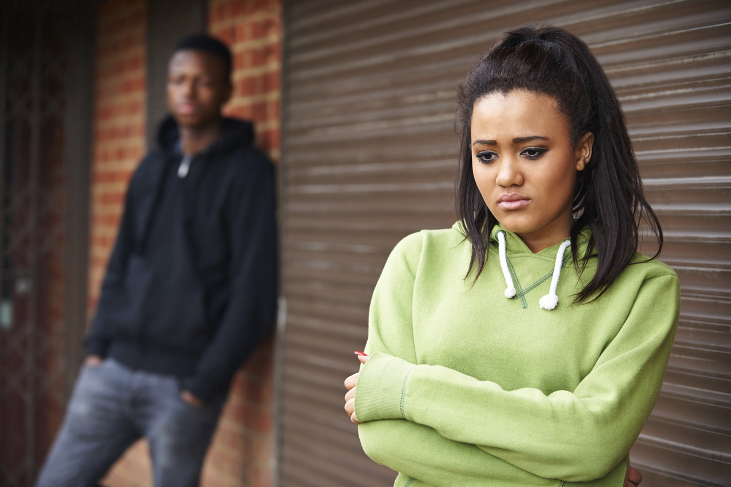
10 signs of an unhealthy relationship
He or she is jealous and suspicious and accuses you of cheating on them all the time.

Slide 8
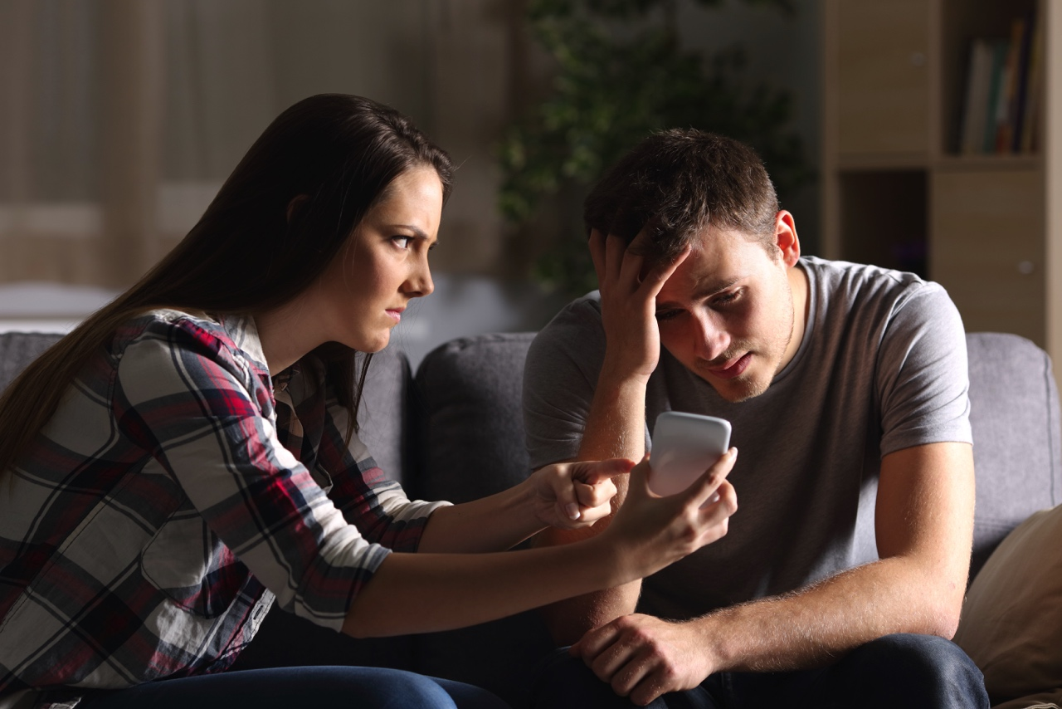
10 signs of an unhealthy relationship
He or she demands to know your passwords and checks your phone, emails and social networking accounts to see who you've been talking to.

Slide 9
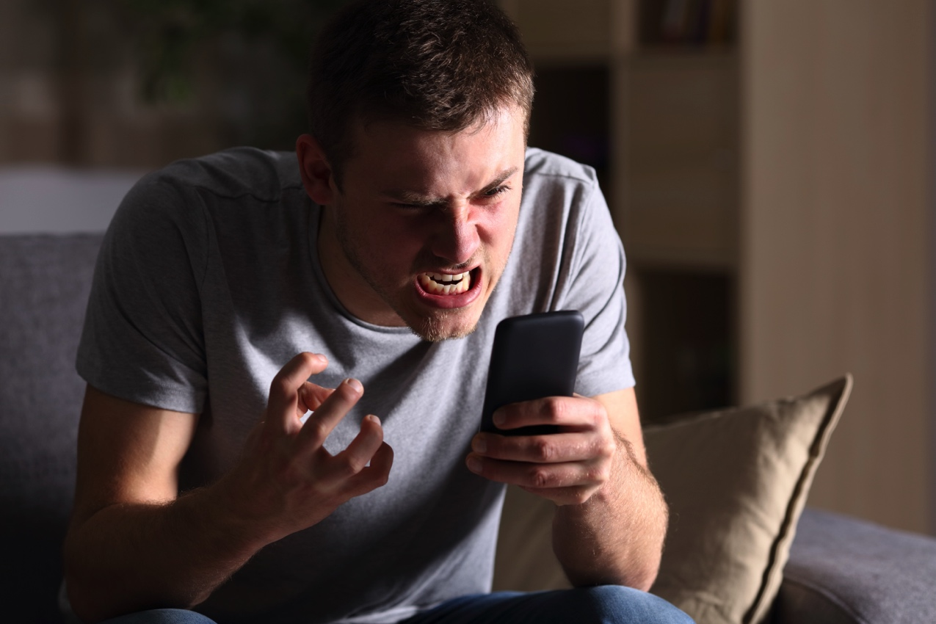
10 signs of an unhealthy relationship
He or she has a bad temper and you feel afraid to disagree with him or her or to stand up for yourself.

Slide 10
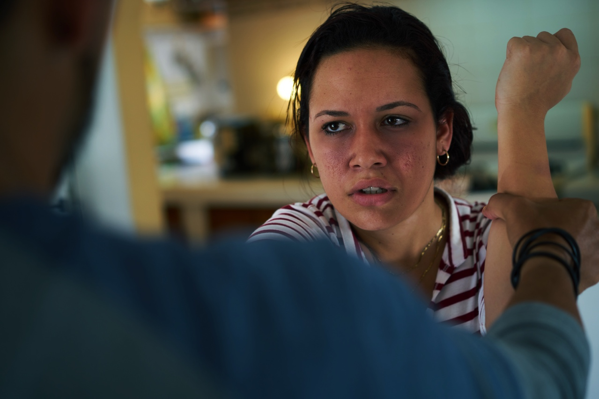
10 signs of an unhealthy relationship
He or she hits, kicks or pushes you or threatens to hurt you or humiliate you.

Slide 11

10 signs of an unhealthy relationship
He or she pressures you to do sexual things that make you feel uncomfortable or that you have said you don’t want to do.

Slide 12
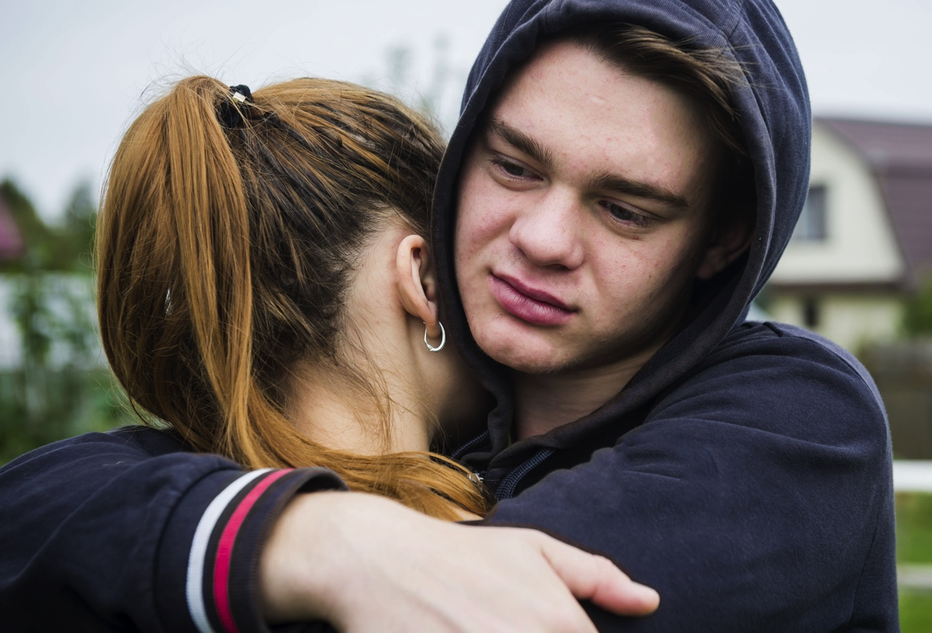
10 signs of an unhealthy relationship
You feel afraid to break up or tell anyone because he or she has told you that he or she will hurt you or themselves if you do or that they can’t live without you.

Slide 13
10 signs of an unhealthy relationship
Take the quiz on the 2in2u website to find out if you are in an unhealthy relationship, to get advice on how to protect yourself in relationships and to read stories from others who have been in an unhealthy relationship.
The slogan from Women’s Aid is ‘if it feels wrong, it probably is’.

