Slide 1
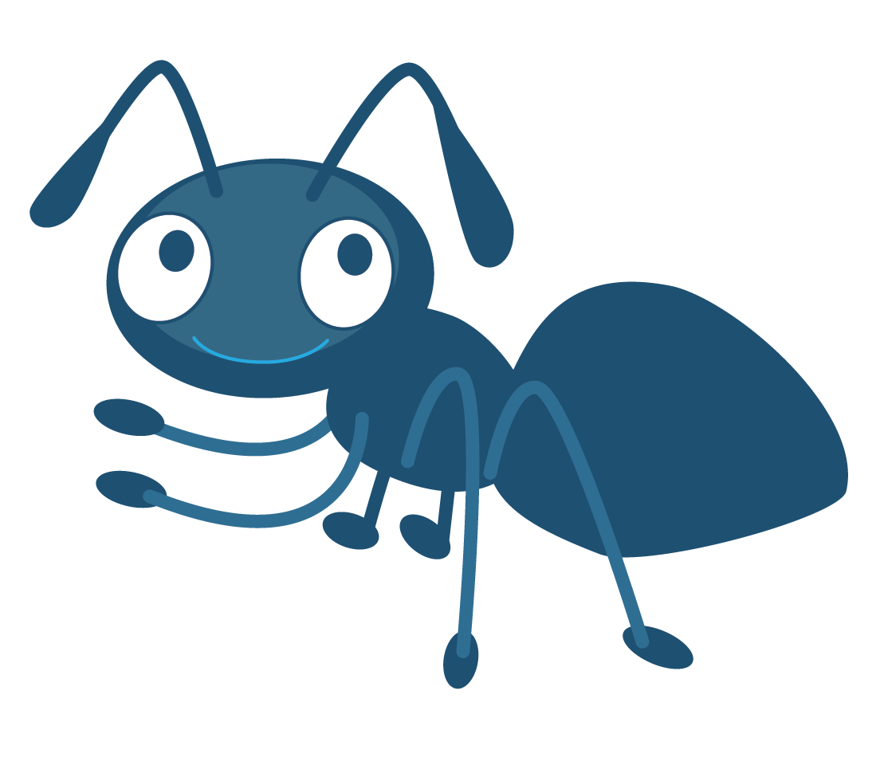
Learning Module 5:
Challenging ANTs

Slide 2
Emily didn’t say hi this morning. I bet she doesn’t want to be my friend anymore.
I did well on that test because I studied so hard. I’m proud of myself!
Everybody is going to notice my stupid new haircut. They’re all going to laugh at me.
I feel bad for arguing with Adam. I’ll apologise later and try to make it up to him.
I’m disappointed that I didn’t come first in the race, but I know I did my very best.
I just know today is going to be a really bad day.
I’m so bad at spelling. There’s no point in even trying to improve.

Slide 3
Everybody thinks I’m rubbish at football…

Slide 4
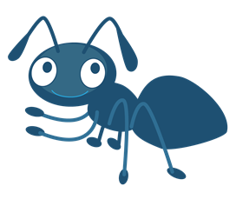
Hi!
Automatic
Negative
Thought

Slide 5
Remember!
Thoughts are not facts.
Am I absolutely sure this is true?
Is this a helpful thought?
Can I replace it with a kinder, more helpful thought?

Slide 6
Emily didn’t say hi this morning. I bet she doesn’t want to be my friend anymore.
Am I absolutely sure this is true?
Is this a helpful thought?
Can I replace it with a kinder, more helpful thought?

Slide 7
Everybody is going to notice my stupid new haircut. They’re all going to laugh at me.
I just know today is going to be a really bad day.
I’m so rubbish at spelling. There’s no point in even trying to improve.
Emily didn’t say hi this morning. I bet she doesn’t want to be my friend any more.

Slide 8
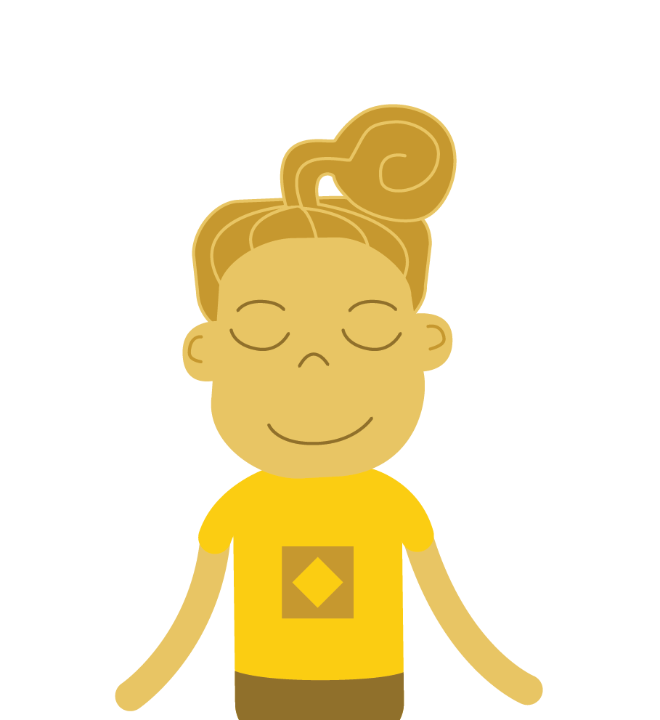
I will never be popular

Slide 9
How can YOU challenge your ANTs?

