Slide 1

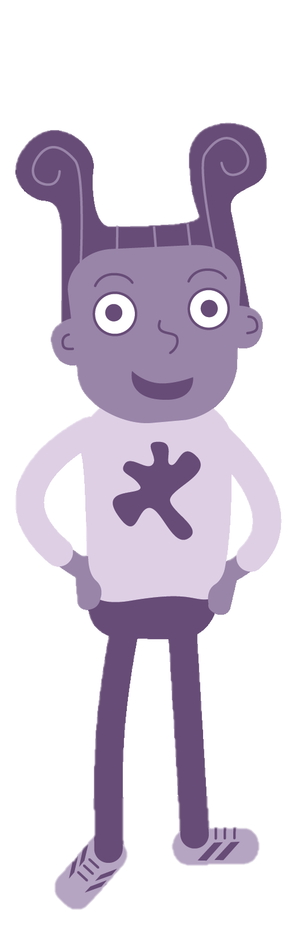
Learning Module 1:
Uniquely me

Slide 2

You are not a pretzel. Don’t twist yourself into who you think people want you to be.
- Karen Salmansohn
Today you are you!
That is truer than true!
There is no one alive
Who is you-er than you!
- Dr. Seuss
Be yourself.
Everyone else
is already taken.
- Oscar Wilde
Embrace your uniqueness.
Time is much too short to be living someone else’s life.
- Kobi Yamada
Being the best is great, you’re the number one. Being unique is greater, you’re the only one.
- Anonymous

Slide 3
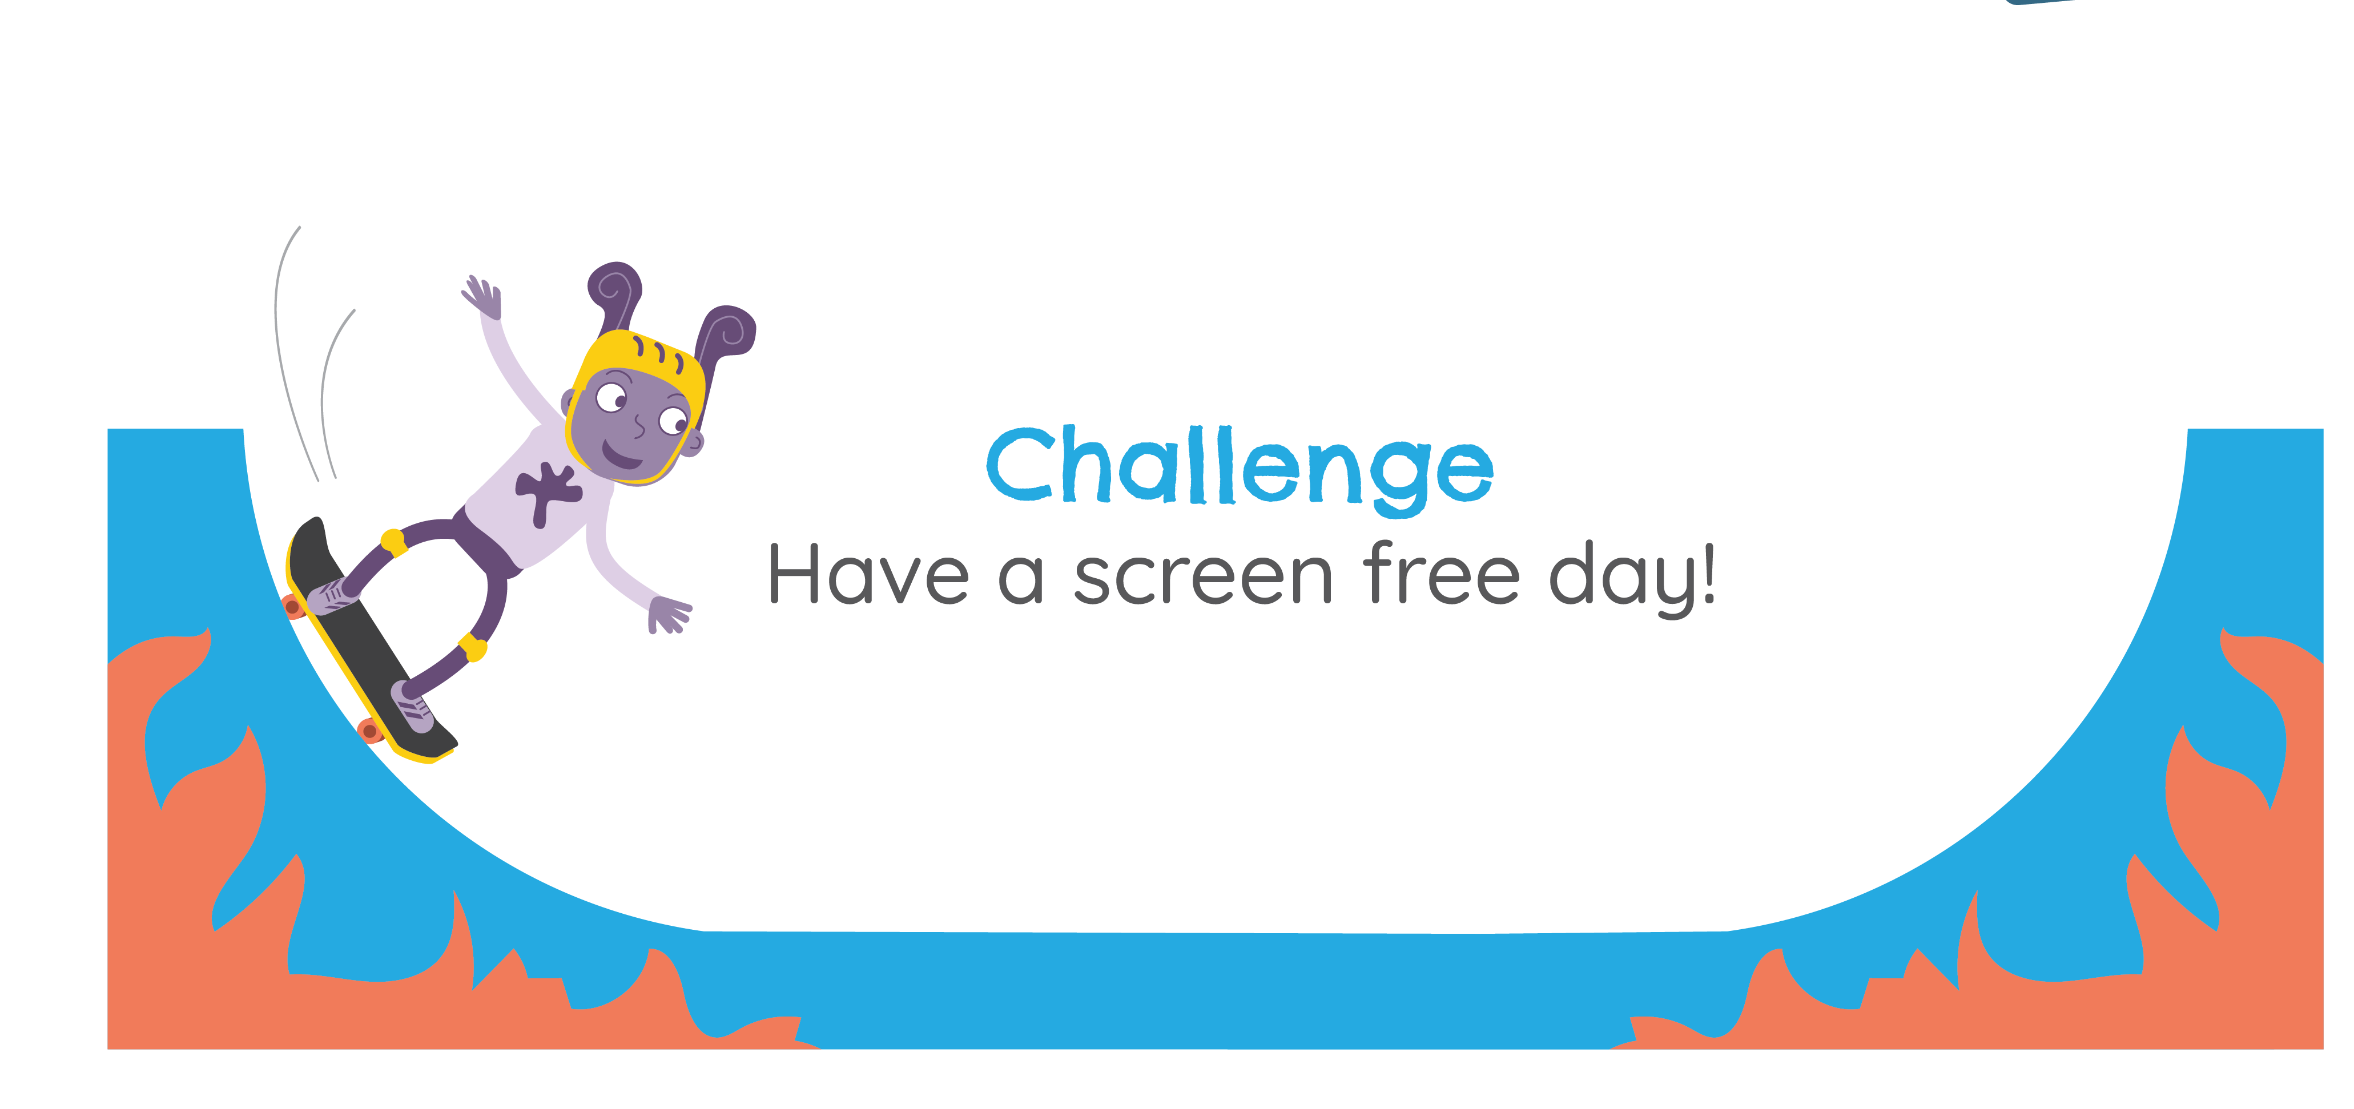




Strawberries
Pizza
Brave
Reading
LOYAL

Slide 4


Slide 5

Girls are better at cleaning and cooking than boys
Boys’ sports are more important than girls’ sports
Boys don’t make very good nurses
Girls show their feelings more than boys
Boys are better leaders than girls

Slide 6
I just want to be like everybody else…
Will I ever fit in?
I wish I was the same as her.
I hope they think I’m normal…

Slide 7

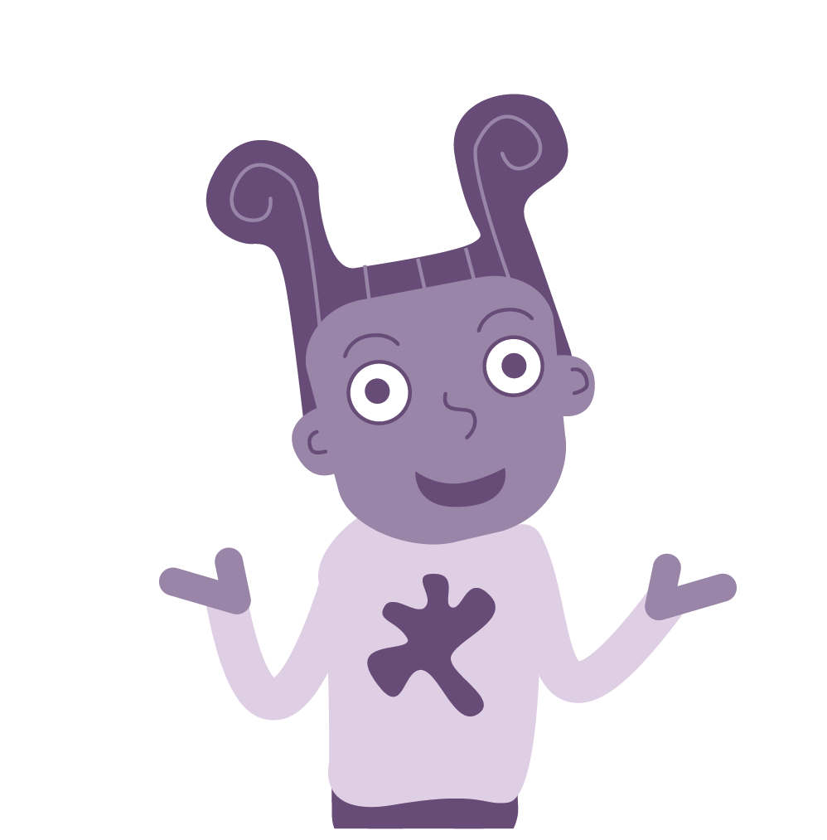
What makes
YOU unique?

