Slide 1
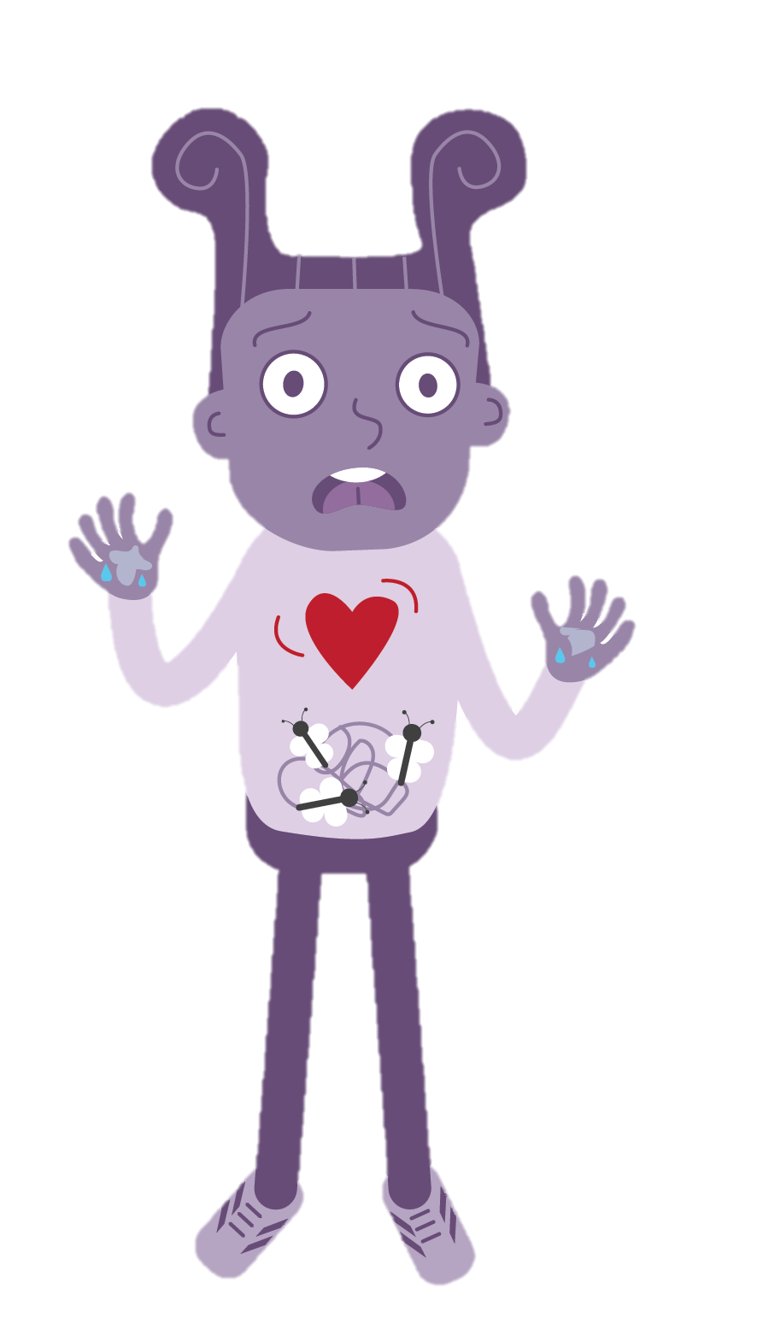
Learning Module 5:
Flipping Our Lids

Slide 2
What does it mean to ‘flip your lid’?
Have you ever flipped your lid?
Why did it happen?
How did it make you feel?
How did you react?
What were the consequences?

Slide 3
Prefrontal Cortex (The thinking brain)
Solves problems and makes decisions
In charge of processing thoughts and emotions
Helps you to predict and think through the consequences of actions

Slide 4
Amygdala (The ancient brain)
Reacts to danger
Can’t tell the difference between minor stresses and life-threatening events
Stops the prefrontal cortex and hippocampus from working properly

Slide 5
Hippocampus
Stores and recalls memories
Helps you to form emotional reactions

Slide 6
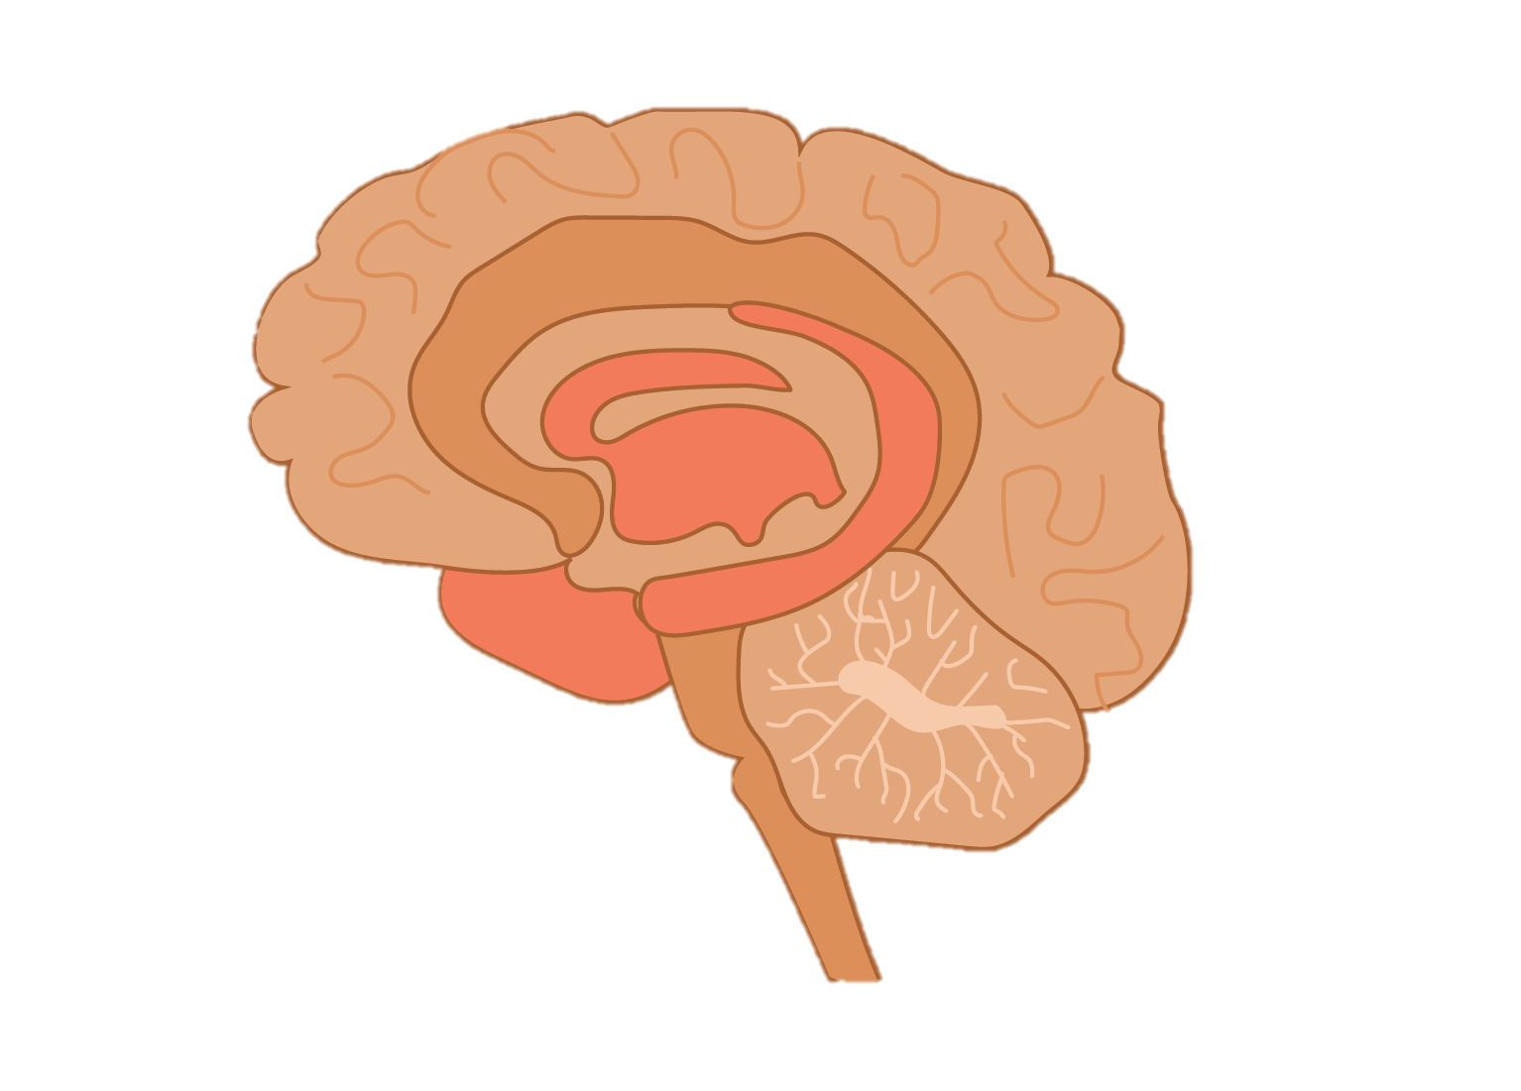
Our brain has an alarm system that activates when we are in very stressful situations.
This alarm system triggers a fight-or-flight response.

Slide 7
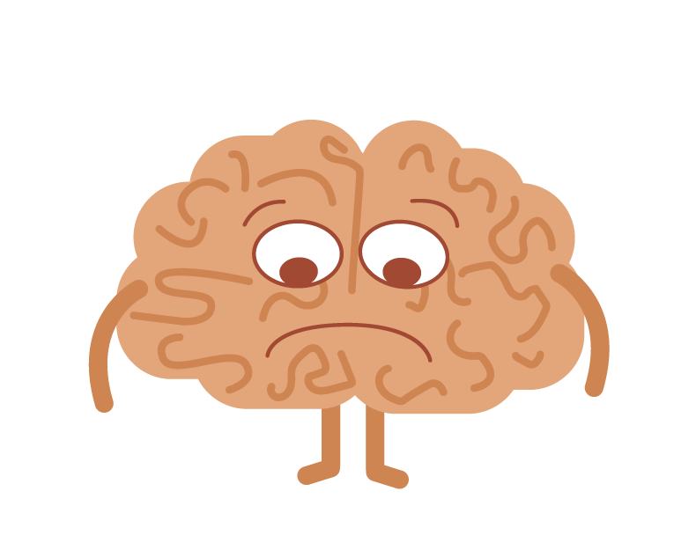
Mind racing
Difficulty concentrating
Thought stuck in head
Sweaty palms
Heart racing
Dry mouth
Butterflies

Slide 8
How to keep your lid on!
Name the emotion
Accept the emotion
Breathe
Focus on your body

Slide 9
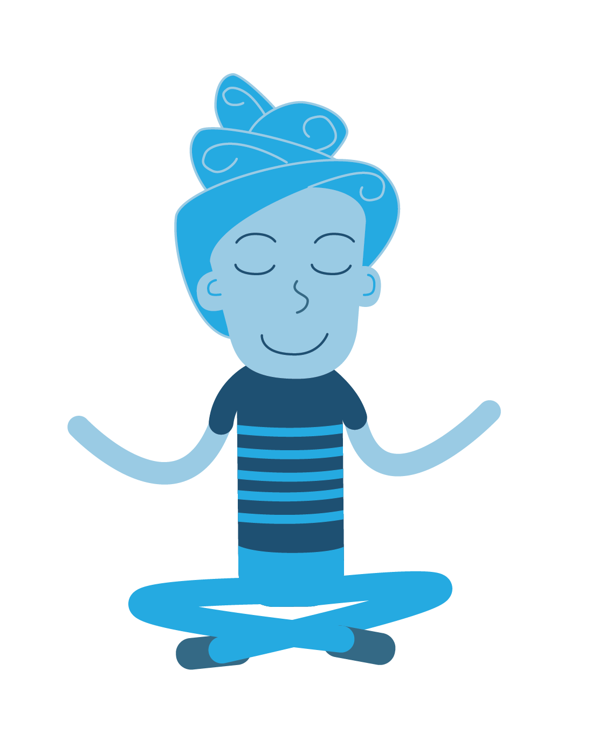
Using our senses to notice things around us
Counting backwards from 10
Talking to someone
Exercising

Slide 10
What different ways of calming down will YOU try this week?

