Slide 1
Farming
Chapter
15
Learning outcome 2.3

Slide 2
At the end of this chapter, you will be able to:
15.1 Describe the different types of economic activities.
15.2 Identify different types of farming.
15.3 Explain what is a system.
15.4 Describe and explain farming as system.
15.5 Explain how the physical landscape influences farming.
15.6 Give examples of farming in other regions of the world.
15.7 Describe challenges to farming sustainability.

Slide 3
Keyword connections

Slide 4
15.1 Describe the different types of economic activities.
‘Economic activities’ is a way of describing how people make a living.
Economic activity | Example | Examples of workers
Primary | Fishing and aquaculture | Trawler workers Fish farmers
 | Farming and horticulture | Farmers
 | Forestry | Foresters
 | Mining | Miners

Slide 5
15.1 Describe the different types of economic activities.
Economic activity | Example | Examples of workers
Secondary | Industry (making finished products) | Workers in a flour mill Bakers Manufacturers of circuit boards for computers Manufacturers of computers

Slide 6
15.1 Describe the different types of economic activities.
Economic activity | Example | Examples of workers
Tertiary | Professional services | Doctors Dentists Accountants Teachers
 | Information technology | Computer programmers App developers
 | Selling (retailing) | Shop assistants Sales consultants
 | Personal services | Hairdressers Beauticians
 | Tourism | Hotel staff Chefs Tour guides
 | Transport | Truck, train, van drivers Ship captains

Slide 7
15.2 Identify different types of farming.
Economic activity | Example
Pastoral | Rearing animals such as sheep or dairy and beef cattle. Farms that keep milking cows only are called dairy farms.
Tillage/arable | Growing crops such as cereals (wheat, barley, rice, oats), potatoes, carrots, sugar beet.
Mixed | A mixture of pastoral and tillage farming on the same farm. Most farms in Ireland are mixed farms.
Horticulture/market gardening | Intensive growing of fruit, flowers and vegetables, often in greenhouses close to cities.
Subsistence | Farming that supplies food for the farmer’s own consumption. Small surpluses might be sold or bartered.
Commercial | Producing food for sale on the market.
Intensive farming | Using artificial fertilisers, pesticides and machinery to get the most out of the land. This usually takes place on fertile, well-drained land in regions with a temperate climate. In Ireland, the south and east of the country have intensive farming.
Extensive farming | Occurs where the soil is not very fertile, the land is poorly drained, and it is difficult to grow crops. In Ireland, land in the west and north-west have extensive farming.

Slide 8
15.1 & 15.2
1. What is meant by ‘economic activities’?
2. Give one example of each of the three types of economic activity.
3. What is a system?
4. What is the difference between pastoral and tillage farming?
5. What is the difference between subsistence and commercial farming?

Slide 9
15.1 & 15.2
Going further… 1
1. There are primary, secondary and tertiary activities. Could there be quaternary economic activities?
2. What is the most common type of farming practised in Ireland?
3. Why are greenhouses used to grow crops?

Slide 10
15.1 & 15.2
Go to Sections 15.1 and 15.2 on page 83 of your Skills Book.

Slide 11
15.3 Explain what is a system.
A system is a way of describing and/or doing something. Almost everything can be described as a system. A system is made up of three parts – inputs, processes and outputs.
1. Inputs
Inputs are the ‘ingredients’ of a system. They are needed to produce something.
2. Processes
Processes are the activities or work done to the inputs to make something new or different.
3. Outputs
Outputs are the results of the processing, usually a new product.
Waste
By-product

Slide 12
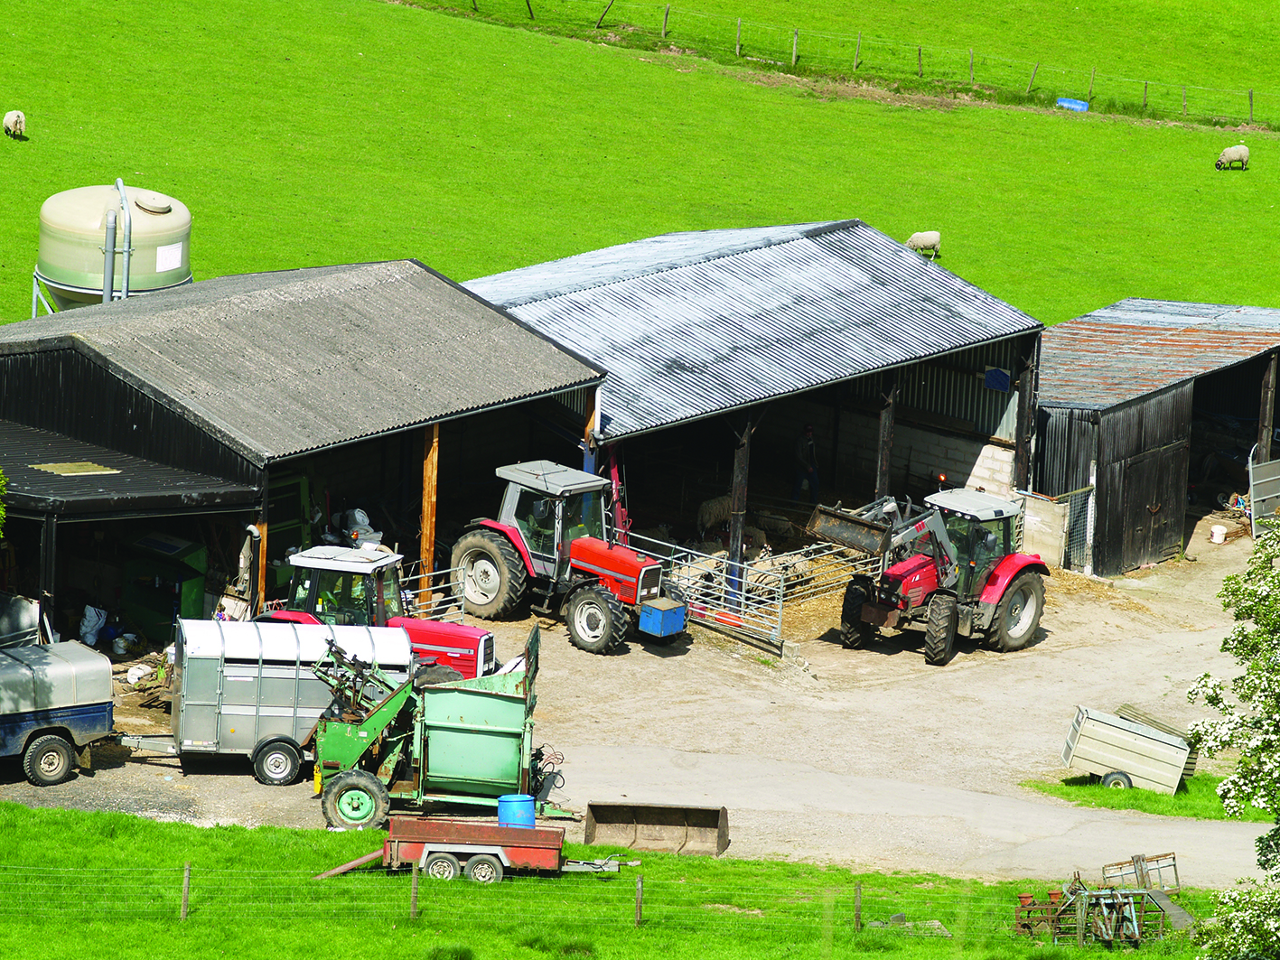
15.4 Describe and explain farming as system.
Inputs
Labour
Stock
Farm buildings
Machinery
Capital

Slide 13
15.4 Describe and explain farming as system.
Processes
Season | Crops | Livestock
Spring | The ground is ploughed and seeds are planted. This includes lea grass. | Cattle are milked twice a day. Calving and lambing take place. Cows and sheep graze the permanent pasture.
Summer | Grass is cut for silage. It is stored in large bales of black plastic on the farm for use in the winter. | The calves and lambs are reared through summer and sold to market later in the year.
Autumn | Crops are harvested and stored. Extra produce is sold to market. | Animals continue to graze throughout autumn, depending on the weather.
Winter | The store of crops is used up in winter to feed the livestock. The forestry is inspected. | Cattle are barn-fed using silage and feeding barley. The sheep are also barnfed during winter.

Slide 14
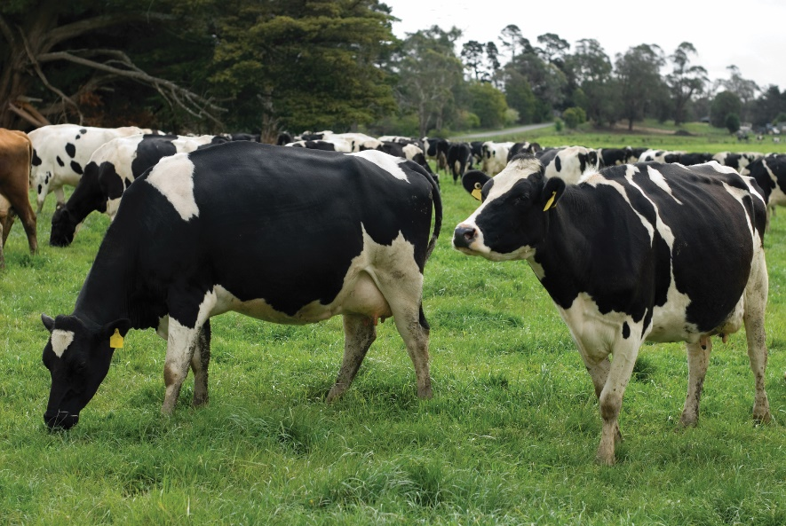
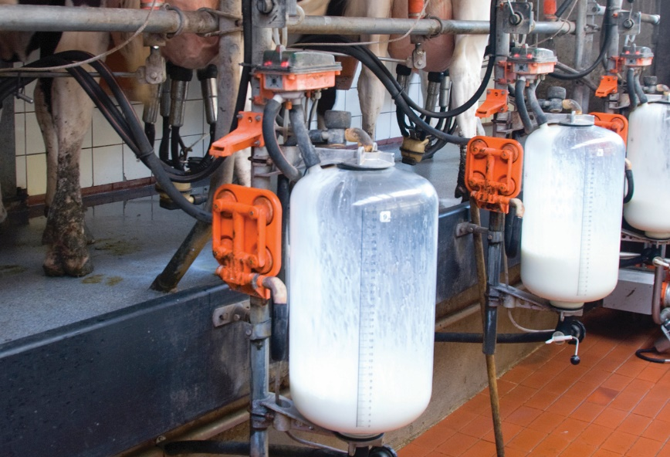
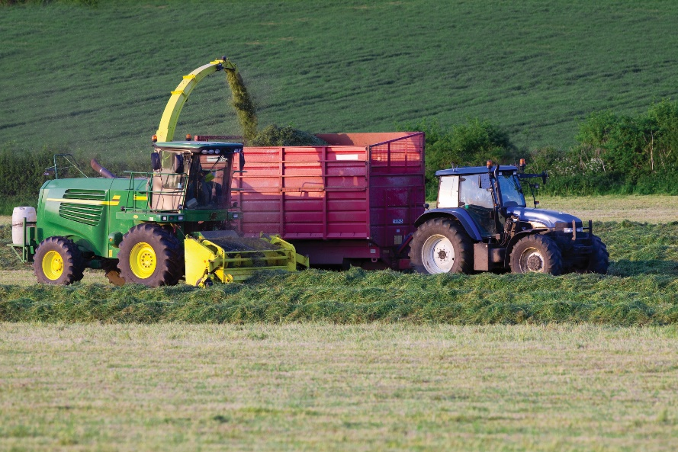
15.4 Describe and explain farming as system.
Processes
1
2
3
Identify the processes shown in the photographs above.

Slide 15
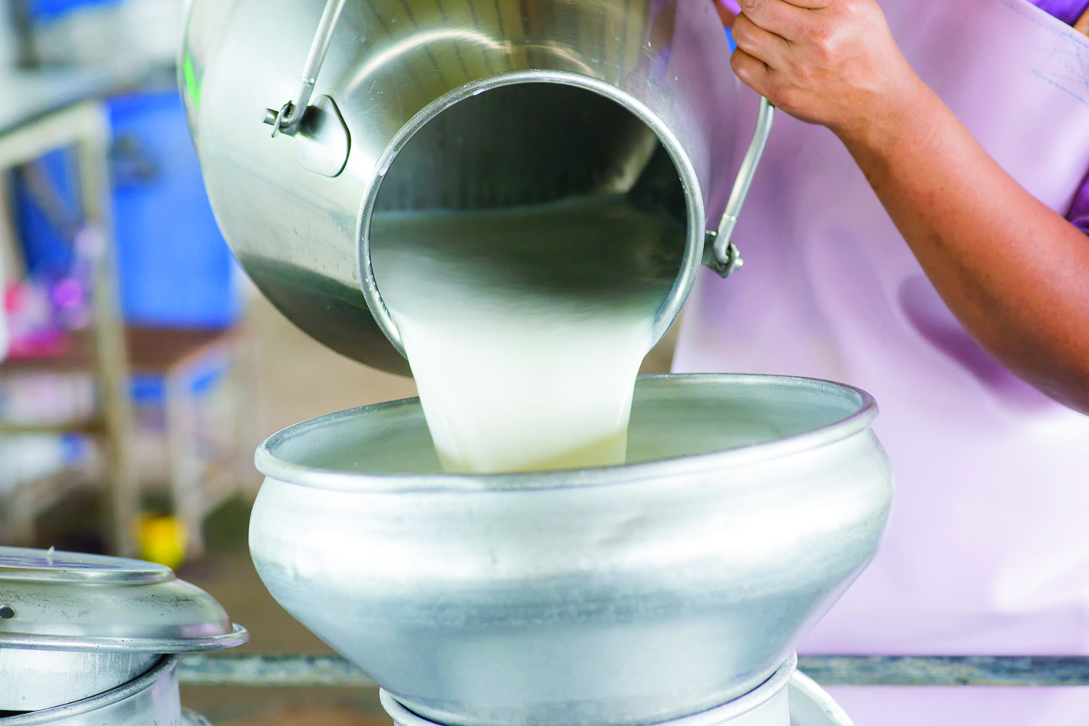
15.4 Describe and explain farming as system.
The outputs of the Fitzpatrick farm:
Milk
Silage
Feeding barley
Maize
Slurry
Calves and lambs

Slide 16
15.3 & 15.4
Summary
Inputs | Processes | Outputs
Labour Stock Farm buildings Machinery Capital | Ploughing Planting Cutting/harvesting Storing Feeding Milking Calving/lambing Maintenance Paperwork Accounting | Raw milk Silage Feeding barley Maize Slurry Calves and lambs

Slide 17
15.3 & 15.4
1. List three farm inputs.
2. List two farm processes linked to those inputs.
3. List one farm output.
4. What is the main farming activity on the Fitzpatrick farm?
5. What is silage?

Slide 18
15.3 & 15.4
Going further… 2
1. Inputs, processes, outputs, waste and by-products are all parts of a system. Could there be other parts?
2. What are the advantages and disadvantages of farming as an occupation?
3. Farming produce leaves a farm and goes directly to a supermarket, or it may pass through a factory to be processed. Farm, factory and supermarket: Who makes the most money from farm produce?

Slide 19
15.3 & 15.4
Go to Sections 15.3 and 15.4 on page 84 of your Skills Book.

Slide 20
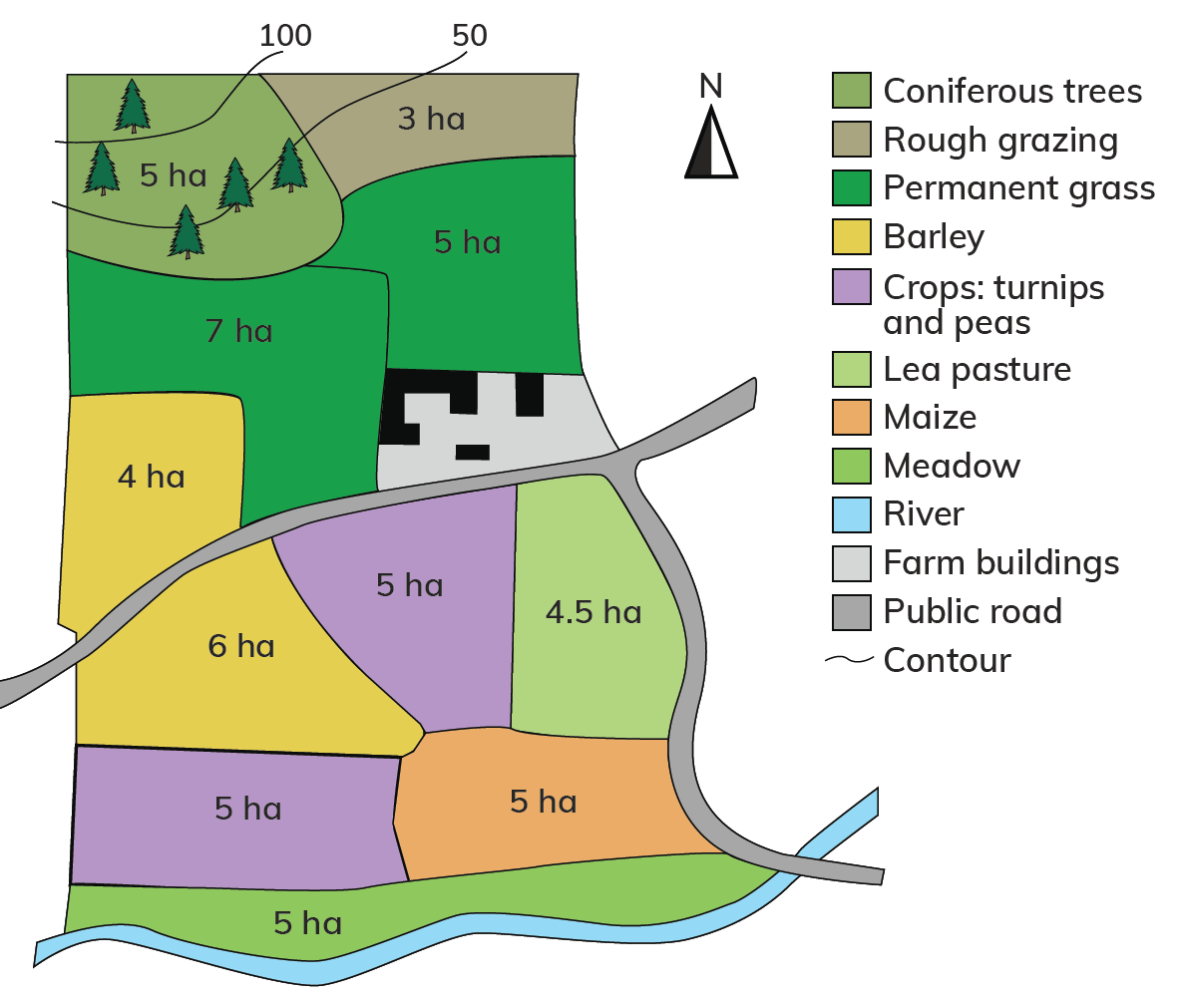
15.5 Explain how the physical landscape influences farming.
Climate
Relief
Aspect
Soils
Gleys
Peaty
Brown
Drainage
Floodplain

Slide 21
15.5 Explain how the physical landscape influences farming.
1. What is the total size of the Fitzpatrick farm?
2. How much land is given over to permanent grass?
3. What is the total area of grassland on the farm?
4. How much of the farm is not suitable for growing crops?
5. List the soil types on the farm.
6. What is the aspect of the farm?
7. Why are trees planted in the north-west of the farm?
8. Why is the meadow only used in summer?
9. What is crop rotation?
10. What is meant by ‘drainage’? Describe the drainage on the farm.

Slide 22
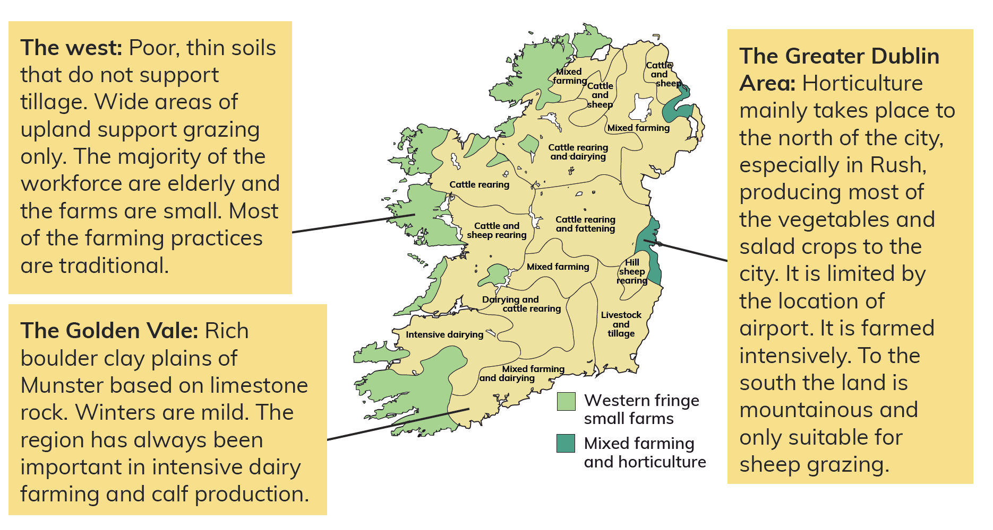
15.5 Explain how the physical landscape influences farming.
Irish
farming
regions

Slide 23
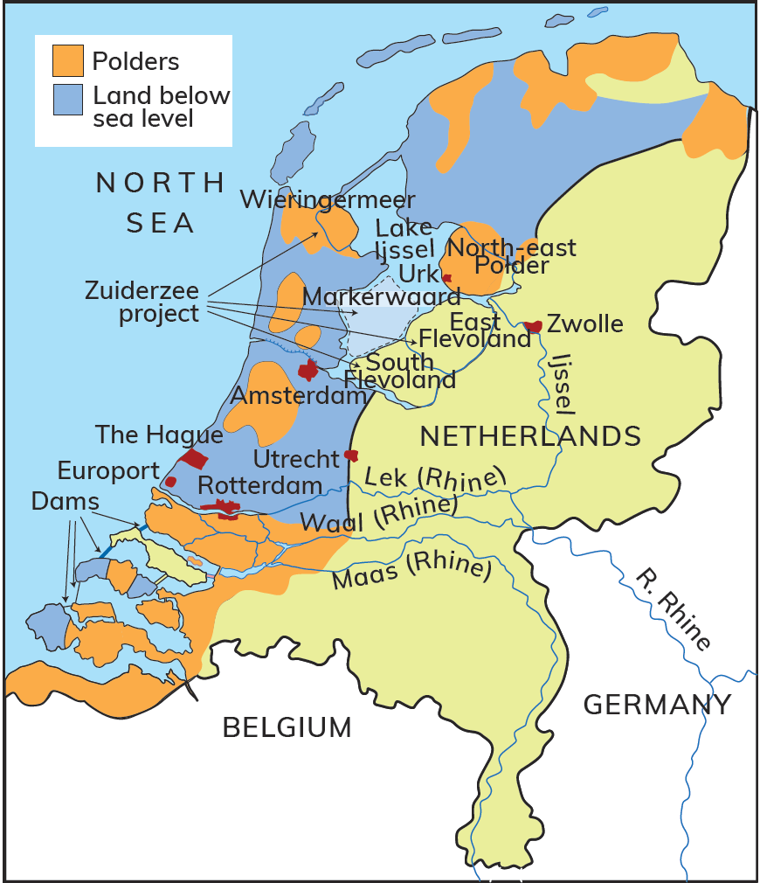
15.6 Give examples of farming in other regions of the world.
The Netherlands
One-third the size of Ireland
Three times the Irish population
Large areas lie below sea level

Slide 24
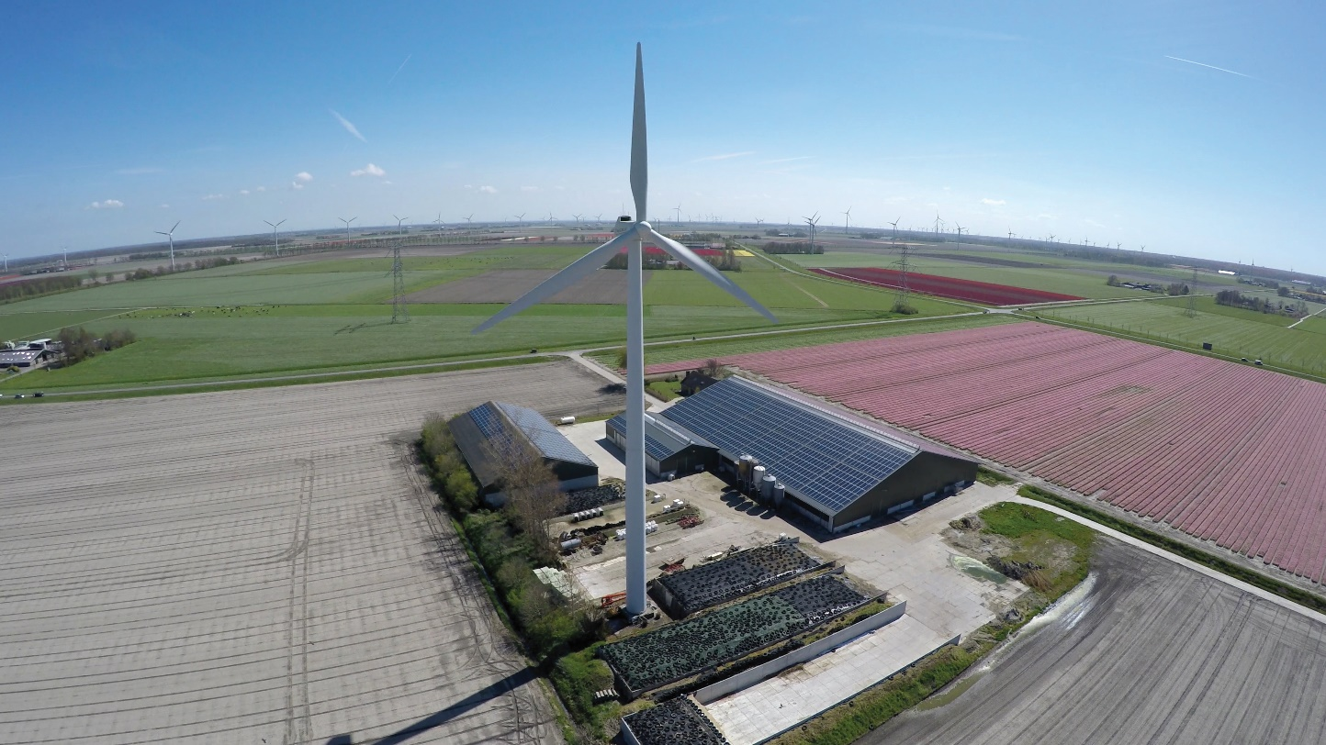
15.6 Give examples of farming in other regions of the world.
The Netherlands
The Dutch government built polders – areas of land reclaimed from the sea:
To stop the land from flooding
To house and feed people
Farmers were interviewed.
They had to agree to practise modern, intensive agriculture.
Flowers, salad crops, potatoes and other vegetables are grown intensively.

Slide 25
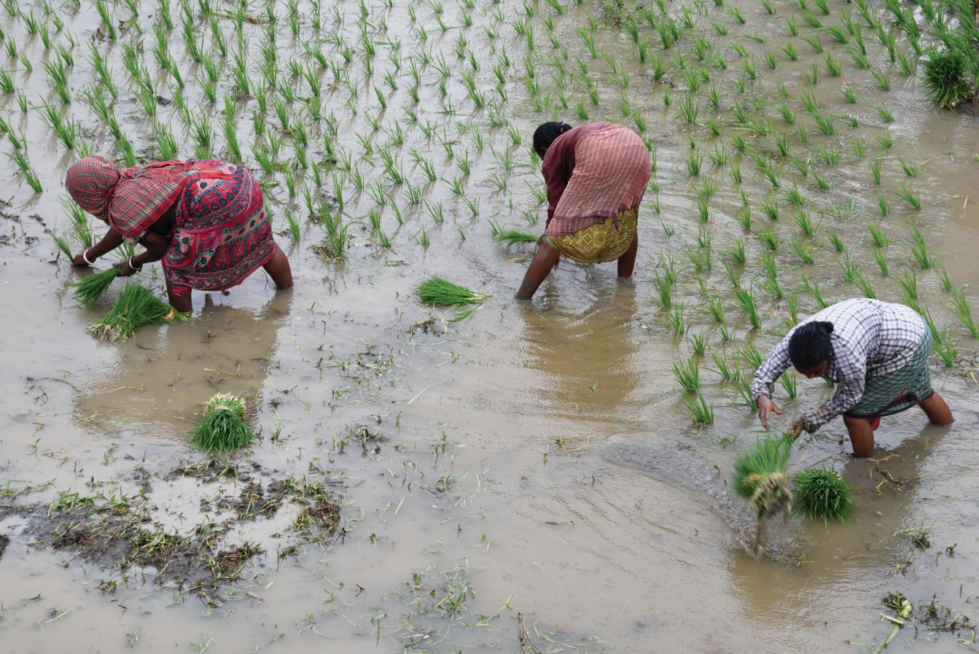
15.6 Give examples of farming in other regions of the world.
Rice paddies in Asia
Over half of the world’s population lives in Asia. Family sizes are large.
The climate varies between too hot and dry or too hot and wet for European-style agriculture.
Rice is the staple food of Asia.
The rice is planted in a water-logged field called a rice paddy.
It is planted and harvested by hand.
Rice needs high temperatures to grow.

Slide 26
15.7 Describe challenges to farming sustainability.
Increase in the world’s population
Demand for more food
More use of artificial fertilisers
and
More use of pesticides
Increase in food production
but
Negative impact on the environment

Slide 27
15.7 Describe challenges to farming sustainability.
Sustainable farming in Europe
The Common Agricultural Policy (CAP) was set up in 1963.
The CAP provided money:
To support farmers
To encourage food production
However, this had a negative impact on the environment:
Farmers cut down hedgerows.
This affected bird, bee and small animal habitats.
Farmers also used artificial fertilisers and pesticides.
This affected soil and water quality.

Slide 28
15.7 Describe challenges to farming sustainability.
New CAP scheme in 2023
The new CAP scheme will put greater emphasis on climate change.
This aims to:
Cut greenhouse gas emissions from farms by 10 per cent
Promote organic farming
Fund wetlands restoration, which will help absorb carbon dioxide

Slide 29
15.5, 15.6 & 15.7
1. What is a polder?
2. Give two reasons why the Dutch government built polders.
3. What is a rice paddy?
4. Give two reasons why rice is grown in south-east Asia.
5. What is meant by ‘sustainable agriculture’?

Slide 30
15.5, 15.6 & 15.7
Going further… 3
1. Look at Figure 15.3 on page 188. Now flip through your textbook and find other maps of Ireland (Hint: Settlement and Climate). What patterns can you find when you compare these maps?
2. Have you ever eaten rice? How did it get from where it is grown to where you live? Try to think of as many of the steps involved as you can.
3. How might climate change affect farming? Use the examples you studied in this topic to consider the effect in Ireland, in the Netherlands and in Asia.

Slide 31
15.5, 15.6 & 15.7
Go to Sections 15.5–15.7 on pages 85–86 of your Skills Book.

Slide 32
Assess your progress
Go to page 87 of your Skills Book and assess your progress.
15.1 Describe the different types of economic activities.
15.2 Identify different types of farming.
15.3 Explain what is a system.
15.4 Describe and explain farming as system.
15.5 Explain how the physical landscape influences farming.
15.6 Give examples of farming in other regions of the world.
15.7 Describe challenges to farming sustainability.
Identify any gaps in your learning. Use the Rapid Revision on page 194 of your textbook to jog your memory.

