Slide 1

Strand 1
Chapter 3
Personal Financial Life Cycle

Slide 2
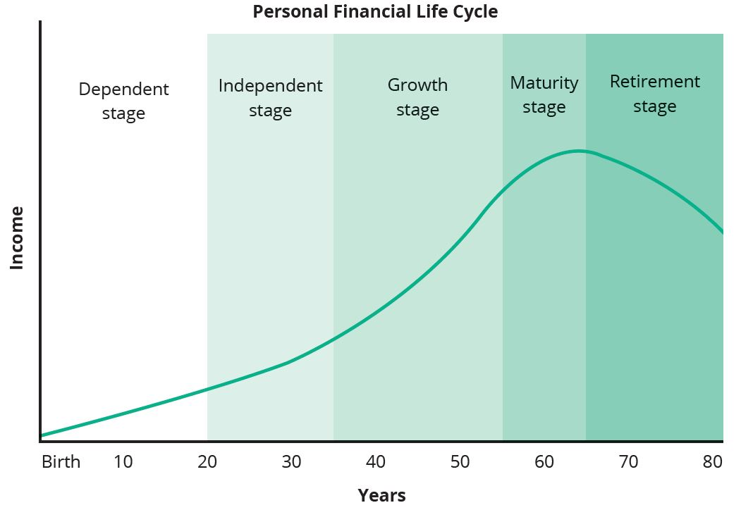
Personal Financial Life Cycle
What Is It?
The Personal Financial Life Cycle describes the financial resources we require to meet our needs and wants at the different stages in our life.

Slide 3
Personal Financial Life Cycle
Dependent Stage
This is the time in our life when we rely on other people to provide for our essential needs and wants.
This stage will usually last from our birth to the time we finish our formal education at secondary school or third level.
Some older children may have some income of their own during this period, for example from part-time work, but often this will not be enough to meet all their needs, so they continue to rely on other people
The term dependents is often used to describe children and young people at this stage, as they depend on other people for their needs and wants.

Slide 4
Personal Financial Life Cycle
Dependent Stage
Needs and Wants
Food, clothing, shelter (our home), education costs, membership of sports clubs (as well as the gear and equipment needed to participate), toys, books, bus and train fares, bicycle, smartphone and credit, laptop or tablet
Can you think of any more examples?
Sources of Finance
The money to provide for our needs and wants at the dependent stage will usually come from our parents or guardians.
As we get older, we may get a part-time job or a summer job to provide us with additional income. This will allow us to achieve more of our wants.

Slide 5

Personal Financial Life Cycle
Independent Stage
This is the time in our life when we no longer rely on other people to provide the money we need to achieve the majority of our needs and wants. We may still rely on our parents or guardians to provide some of our needs and wants, for example if we still live at home.
At this stage we will have started working and earning or we may be looking for work and collecting Jobseeker’s Benefit/Allowance.
The age of people at this stage could range from 18 (those who enter the workforce immediately after leaving school) to mid-thirties.

Slide 6

Personal Financial Life Cycle
Independent Stage
Needs and Wants
Food, clothing, shelter (our home), household bills, laptop/tablet, smartphone, car/motorbike, entertainment, holidays and various types of insurance
Sources of Finance
The money to provide for our needs and wants at the independent stage will usually come from our wages/salary, from bank or credit union loans, or from the Department of Social Protection if we are looking for a job (Jobseeker’s Benefit/Allowance).

Slide 7

Personal Financial Life Cycle
Growth Stage
This is the period in our life when we become more settled in our working and family life.
We may have a family of our own and in our working life we may be looking for new challenges in the form of a promotion or a new job.
The age of people at this stage ranges from mid-thirties to mid-fifties.
We continue to provide for ourselves as well as for our partner and children.

Slide 8

Personal Financial Life Cycle
Growth Stage
Needs and Wants
Food, clothing, shelter (our home), childcare, entertainment, car, various types of insurance, household expenses, furniture, IT and electronic equipment, holidays, school and college fees for children, payments into pension fund
Sources of Finance
The money to provide for our needs and wants at the growth stage will continue to come from our wages/salary plus bonuses, Child Benefit, bank or credit union loans or from Jobseeker’s Benefit if we are looking for a job.

Slide 9

Personal Financial Life Cycle
Maturity Stage
This is the time in our life when we have reached the top of our career and no longer expect to be promoted or be given increased responsibility.
We begin to think about and plan for our retirement.
The age of people at this stage ranges from mid-fifties to mid-sixties.
During this period we continue to provide for ourselves and our family. We may also be caring for our elderly parents or relations.

Slide 10
Personal Financial Life Cycle
Maturity Stage
Needs and Wants
Food, clothing, shelter (our home), entertainment, holidays, college fees for children, household expenses, various types of insurance, house redecoration and refurbishment expenses, IT and electronic equipment, payments into pension fund
Sources of Finance
The money to provide for our needs and wants at the maturity stage will continue to come from our wages/salary plus bonuses or from Jobseeker’s Benefit if we are looking for a job.

Slide 11

Personal Financial Life Cycle
Retirement Stage
This is the time of our life when we have stopped working and instead spend a lot of our time on other pursuits and interests.
The age of people at this stage typically ranges from mid-sixties onwards.
During this period we continue to provide for ourselves and our partner, but increasingly less for other members of our family.
The age of retirement varies depending on the type of job we have and, more important, the type of pension we are entitled to.

Slide 12
Personal Financial Life Cycle
Retirement Stage
Needs and Wants
Food, clothing, shelter (our home), car expenses, entertainment, holidays, household expenses, various types of insurance, house redecoration, refurbishment expenses
Sources of Finance
The money to provide for our needs and wants at the retirement stage will mainly come from the state pension and/or our private pension if we have paid into a pension scheme while we were working. We will also use our savings during this stage. Large household expenses like our mortgage will usually have been paid off by the time we reach the retirement stage, so the amount of finance we need is reduced.

Slide 13
Personal Financial Life Cycle
Planning for the Future
Dependent Stage
Financial planning such as paying for our debs ball, going out socialising or saving for our first holiday with our friends
Independent Stage
Financial planning for buying our first car, and for the growth stage, such as saving the deposit for our first home
Growth Stage
Financial planning for the maturity stage, such as university fees for our children, as well as the cost of refurbishing our home
Financial planning for the retirement stage by paying into a pension plan
Maturity Stage
Financial planning for our retirement by continuing to pay into our pension plan
Retirement Stage
Planning ahead to ensure we have enough money to cover the cost of nursing home care if we need it and, indeed, funeral expenses.

