Slide 1
Strand 2
Chapter 24
Business Cash Flow and Finance

Slide 2
Cash Flow Statement
Cash Flow Statement
Cash flow statement: A plan showing all the expected cash receipts and cash payments in a firm over a period of time.
A cash flow statement shows:
The expected income over a period of time
The expected total payments divided into fixed costs and variable costs for the same period
The expected net cash (expected receipts minus expected payments) each month
The opening cash and closing cash each month

Slide 3
Cash Flow Statement
Fixed Costs and Variable Costs
Fixed Costs
These are business costs that remain the same each time they are paid – they are unrelated to the amount of business (sales) the firm does.
Examples include rent, mortgage and loan repayments.

Slide 4
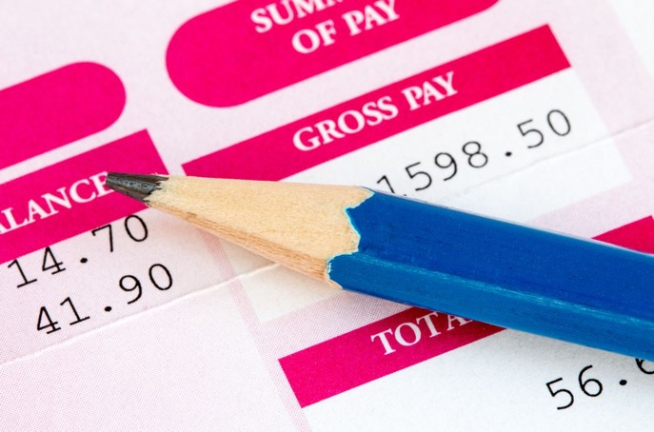
Cash Flow Statement
Fixed Costs and Variable Costs
Variable Costs
These are business costs where the amount changes each time they are paid depending on the amount of business the firm does. Examples include:
Wages: The more business you do, the more employees you will need.
Materials: The more products you make, the more materials you have to use.
Electricity and telephone: The bigger the business, the higher these bills will be.
The total costs of the business for any period are the total of fixed costs plus variable costs.

Slide 5
Cash Flow Statement
Reasons for Preparing a Cash Flow Statement
A cash flow statement is important because:
It shows the organisation if they will have enough cash (income) to be able to pay all their bills in a particular month.
It shows the organisation which months they may find themselves short of cash (deficit).
It shows the organisation which months they may have some extra cash available (surplus).
If the organisation is looking to borrow money, the cash flow statement will show the lender if the organisation is likely to be able to make the loan repayment each month.

Slide 6
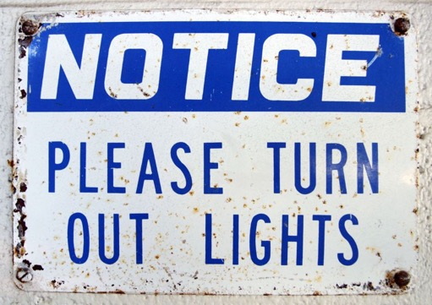
Cash Flow Statement
Solving Cash Flow Problems
Increase income from sales
Look at entering new markets
Introduce some special offers to encourage sales, such as free competitions
Increase the selling price
Reduce costs, especially variable costs
Find cheaper suppliers
Cut down on waste – for example, by installing sensors on lights
Reduce the number of employees – and therefore the wage bill – by outsourcing some of the work to outside firms who can do it at a cheaper price
Delay any plans for discretionary spending
Collect money that is owed to the business as quickly as possible to reduce the amount of bad debts.

Slide 7
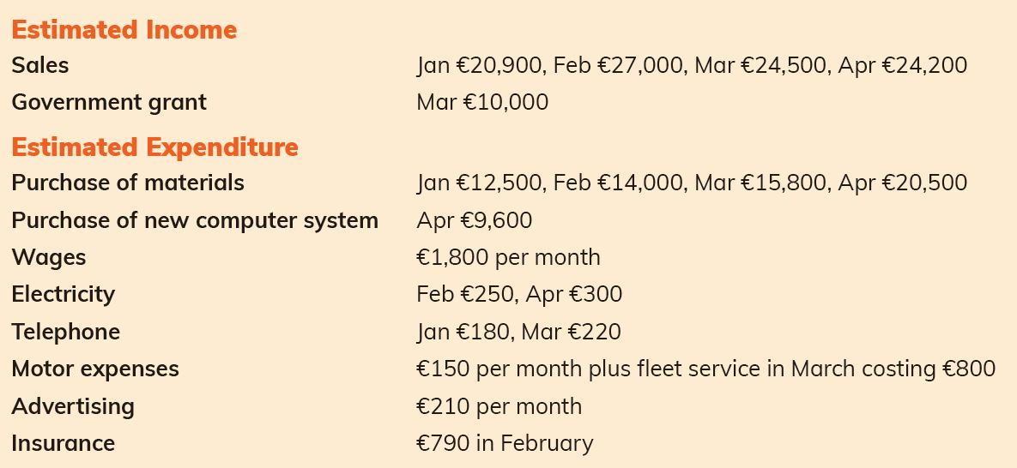
Preparing a Cash Flow Statement
Pages 296–7: The following information relates to Traders Ltd for the four-month period January to April. There was an opening cash amount of €4,500 on 1 January.

Slide 8
Preparing a Cash Flow Statement
Cash flow statement for Traders Ltd for January to April
Details | Jan | Feb | Mar | Apr | Total
RECEIPTS
Sales | 20,900 | 27,000 | 24,500 | 24,200 | 96,600
Government grant |  |  | 10,000 |  | 10,000
TOTAL RECEIPTS | 20,900 | 27,000 | 34,500 | 24,200 | 106,600
PAYMENTS
Materials | 12,500 | 14,000 | 15,800 | 20,500 | 62,800
Computer system |  |  |  | 9,600 | 9,600
Wages | 1,800 | 1,800 | 1,800 | 1,800 | 7,200
Electricity |  | 250 |  | 300 | 550
Telephone | 180 |  | 220 |  | 400
Motor expenses | 150 | 150 | 950 | 150 | 1,400
Advertising | 210 | 210 | 210 | 210 | 840
Insurance |  | 790 |  |  | 790
TOTAL PAYMENTS | 14,840 | 17,200 | 18,980 | 32,560 | 83,580
NET CASH | 6,060 | 9,800 | 15,520 | –8,360 | 23,020
OPENING CASH | 4,500 | 10,560 | 20,360 | 35,880 | 4,500
CLOSING CASH | 10,560 | 20,360 | 35,880 | 27,520 | 27,520

Slide 9
Solution step-through
To see how the account is completed, open the PowerPoint file:
Ch 24_Step-through_Cash flow statement

Slide 10
Business Finance
 | Short Term | Medium Term | Long Term
Time period | (0–1 Year) | (1–5 Years) | (Over 5 Years)
Source | Trade creditors Bank overdraft Accrued expenses | Term loan Leasing Hire purchase | Equity finance (ordinary shares) Retained earnings Sale and leaseback Long-term loans Government and EU grants
Main uses | Raw materials Business overheads ICT support | Equipment Motor vehicles Furniture and fittings ICT equipment | Premises Industrial machinery

Slide 11
Business Finance
Trade Creditors
Operation
Here a firm delays payment to their creditors and instead puts the money on deposit with a financial institution to earn interest.
Cost
There is no cost to using trade credit in this way except if the firm loses out on cash discounts they would have received for early payment.
Risk
The firm could risk having their credit terms reduced if they are consistently late in paying their suppliers.
The firm may get a bad reputation among suppliers, who may refuse to do business with them in the future unless they pay in cash.

Slide 12
Business Finance
Bank Overdraft
Operation
Here the business has permission from their bank to overdraw their current account. This means that they can continue to make electronic payments, write cheques or withdraw money up to a certain amount, even though they have no money in their account.
Cost
Interest is only charged by the bank on the amount of the overdraft being used.
The interest rate charged on overdrafts is higher than on other types of loans.
Risk
The bank may withdraw the overdraft facility if they find that the business is constantly overspending.

Slide 13
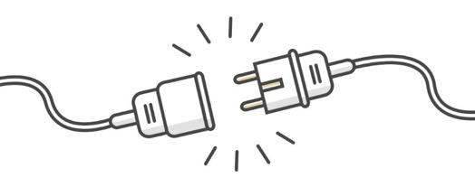
Business Finance
Accrued Expenses
Operation
Here the business delays payment of their business expenses for as long as possible and instead places the money in their bank to earn interest.
Cost
There is no cost to using accrued expenses as a source of finance. However, the Revenue Commissioners will charge interest for late payment of taxation.
Risk
The firm runs the risk of having the utility – for example electricity – cut off which would be very damaging for the business and costly to get reconnected once payment has been made.

Slide 14
Business Finance
Term Loan
Operation
This is a loan from a bank or other financial institution that is repaid over a period of between one and five years. Term loans can be used for different purposes, such as the purchase of a new delivery van. The loan and the interest are repaid in equal amounts every month until the entire loan has been repaid. Advantages of a term loan as a source of finance include:
The business knows exactly how much must be paid each month, which helps their planning.
The loan can be repaid over whatever time period suits the business.
Cost
Interest must be paid on the amount of the loan.
The total amount paid over the life of the loan will be a lot more than the value of the item that was purchased.
Risk
The interest rate can increase, making repayments more expensive.

Slide 15
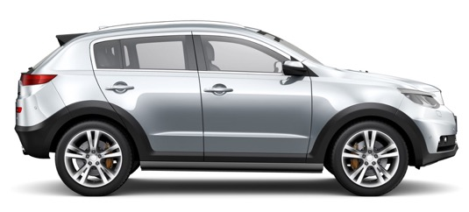
Business Finance
Leasing
Operation
Leasing is used by firms to get assets such as new equipment or motor vehicles. The firm enters into an agreement with a finance company to pay them an agreed amount of money each month in return for the use of the asset. The leasing company owns the asset at all times but the firm has full use of it.
Cost
The firm will end up paying more for the asset than it is worth, which makes leasing expensive.
The firm has the use of an asset without having to pay out a large amount of money.
Risk
No risk unless the firm fails to pay the leasing charge and, as a result, the asset is repossessed (taken back).

Slide 16
Business Finance
Hire Purchase
Operation
Used by firms to purchase assets such as equipment and vehicles.
Involves three parties: the buyer, the seller and a finance company.
The finance company pays the seller in full for the asset, then collects the money in instalments from the buyer over an agreed period of time.
Cost
Use of an important asset without having to pay full price up front.
Interest is fixed in advance, so you know exact monthly repayments.
Interest rate very high compared to other sources of finance.
Risk
No risk unless the firm fails to make the hire purchase payment and, as a result, the asset is repossessed (taken back).

Slide 17
Business Finance
Equity Finance (Issue of Ordinary Shares)
Operation
The business owners bring their own personal money into the business (equity finance) to start a new business or expand an existing one.
Alternatively, they may ask other people to invest in the new business by providing equity finance in return for a share of the business.
Cost
No interest has to be paid on equity finance or to new shareholders unless the business decides to pay the shareholders a dividend out of the profits.
The firm does not have to pay back the money raised from selling shares.
Risk
Each new share carries a vote and therefore each new shareholder will have a say in the future running of the company. This usually happens at the annual general meeting (AGM) of shareholders.

Slide 18
Business Finance
Retained Earnings
Operation
In a private limited company, the profits can either be paid to the owners of the business (the shareholders) or kept in the business to pay for new equipment or to expand the business. Profits that are kept in the business are known as retained earnings.
Cost
No cost to using retained earnings as a source of finance.
Risk
The shareholders may become unhappy if they do not receive any dividend and may sell their shares. This could cause people to lose confidence in the business, which could impact on sales and profits
Retained earnings: The part of the profits of a business that are kept in the business rather than paid out to shareholders in the form of dividends

Slide 19
Business Finance
Sale and Leaseback
Operation
Firms with valuable fixed assets, such as land and buildings, may find themselves short of cash. Instead of selling these assets, they could decide on a sale and leaseback. They sell the asset to an investment company for its market value, and then lease it back over a period of time (usually 21 years) at an annual rent. Advantages include:
The firm secures cash to run the business without having to borrow.
The firm can continue to use the asset as they always did.
Cost
The firm must pay a yearly lease charge to the new owners.
Risk
The firm no longer owns the asset, so will not benefit if the value increases.
At the end of the lease period, the finance company may increase the annual rent.

Slide 20
Business Finance
Long-Term Loan
Operation
A long-term loan can be for any period up to 35 years.
Loan + interest must be paid back in equal instalments over the length of the loan.
Usually used to purchase business premises or land (mortgage loan)
Cost
Interest must be paid on the loan, but rates are lower than on most other loans.
Spreading the repayments over a long period of time means the firm will end up paying considerably more for the asset over time than its value.
Risk
The interest rate may increase over the course of the loan period.
If the long-term loan is used to purchase property (mortgage), the firm risks losing the property if the loan is not repaid.

Slide 21
Business Finance
Government Grants
Operation
Grants are non-repayable sources of finance available from the government and the EU to help people who want to start a new business or expand an existing business. Grants are available from Government agencies such as: Enterprise Ireland, Local Enterprise Office, Údarás na Gaeltachta, EU grants, such as Horizon 2020
Cost
There is no cost to the firm, as grants do not have to be repaid provided they are used by the business for the purposes intended.
There is no interest paid on grants.
Risk
The agency giving the grant may look for it to be repaid if the business does not meet any targets agreed when they were given the grant.

