Slide 1
Strand 3
Chapter 29
Demand and Supply

Slide 2
Demand and Supply
Assumptions about Consumer Behaviour
All consumers have a limited income no matter how much they earn or how much wealth they have.
Consumers have many needs and wants, so they must make choices when deciding what needs and wants to satisfy and what opportunities to forego.
Most consumers make rational decisions about what to spend their income on – they purchase goods and services that offer the best value for money.
There is a limit to how much of a product or service a consumer will purchase, since the more of an item we purchase, the less satisfaction we get from it. This is known as the law of diminishing marginal utility.

Slide 3
Demand and Supply
Impact of Price
Price is the biggest factor that affects which goods and services consumers choose.
This is because consumers and households have limited income (scarce resources).
When a consumer buys goods or services at a cheaper price, this means they can satisfy more of their needs and wants with the same level of income.

Slide 4
Demand and Supply
Demand
Demand: The number of units (quantity) of a particular product or service that consumers are willing to purchase at a particular price.
There are two types of demand:
Individual demand: The quantity of a product or service that one consumer is prepared to purchase at a particular price.
Market demand: The total quantity of a product or service that all consumers in a particular place (market) are prepared to purchase at a particular price.

Slide 5
Demand and Supply
Demand and Price
If the price of a product or service rises, demand will usually fall because:
Some consumers can no longer afford the product or service
Some consumers switch to an alternative brand (known in economics as a substitute’)
Some consumers no longer think it is worth the money
If the price of a product or service falls, demand will usually rise because:
Consumers who previously could not afford to purchase the product or service can now do so
Some consumers switch from an alternative brand that is now more expensive
Some consumers who previously regarded it as too expensive now believe it is worth the money

Slide 6
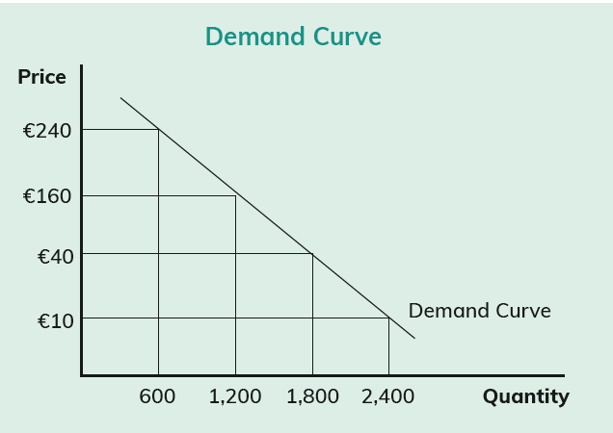
Demand and Supply
Displaying Demand Graphically –The Demand Curve
Let’s look at a product that is in plentiful supply – for example, airline seats to London with Aer Lingus – and where price increases will cause demand to fall and vice versa.
Product: Aer Lingus seats from Dublin to London return
Period: February
Demand curve: A graph that shows the relationship between the price of goods and services and the quantity of those goods and services that consumers will purchase at that price.
Price | Quantity Sold
€10 | 2,400
€40 | 1,800
€160 | 1,200
€240 | 600

Slide 7
Demand and Supply
Other Factors Affecting Demand
1. A change in the price or features of a substitute good or service
There are many different producers and suppliers of goods and services. For example:
If a consumer wanted to purchase a new mobile phone they could choose Apple, Samsung, Sony, Huawei, Nokia, Motorola or Alcatel, among others. For their network provider, they could choose Three, Vodafone or Eir.
The products and services of all these producers and suppliers are said to be substitutes for each other because each can provide the same service to the consumer as the other.
If one of these manufacturers changes the price, quality or features available, it can affect the demand for the products or services of the others.
An increase in the price of a substitute good or service can lead to an increase in demand for the products or services of another producer and vice versa.

Slide 8
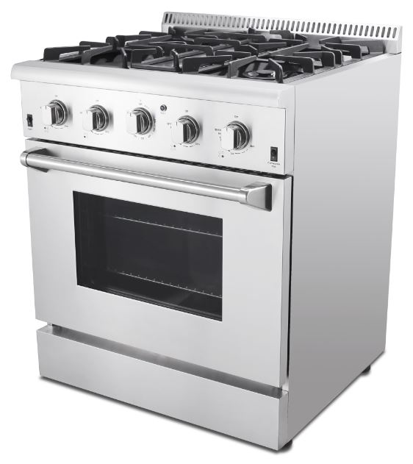
Demand and Supply
Other Factors Affecting Demand
2. A change in the price or features of a complementary good or service
When certain goods or services must be used together, they are said to be ‘complementary’ to each other. For example, if you want to purchase a gas cooker, you must have a gas supply to your home.
Because you cannot have one without the other, they are said to complement each other.
As a result, if the price of one goes up or down (for example, the cost of gas goes up), it could affect the demand for gas cookers as people decide to switch to electric cookers to save money.

Slide 9
Demand and Supply
Other Factors Affecting Demand
3. Advertising and promotion
If a particular manufacturer or supplier runs a big advertising campaign, it will increase the demand for that product or service.
Studies have shown that people continue to purchase more of a higher-priced good that is well advertised than lower-priced alternatives that are not well advertised.
4. Tastes and fashions
Consumers will always be inclined to purchase goods and services that are currently in fashion, either because they are the latest must-have toy or the latest fashion accessory.
The demand for goods and services will always change in response to changes in fashions and trends.

Slide 10
Demand and Supply
Other Factors Affecting Demand
5. Government action
The actions of the government can impact on the demand for certain goods and services.
For example, a rise in the rate of excise duty on petrol, diesel, cigarettes or alcohol in the annual budget may cause a reduction in the demand for these goods.
6. Unexpected factors
Unexpected factors can affect the demand for certain goods and services.
For example, if workers go on strike in one supplier, customers may switch to another while the strike is on.
Weather can also affect demand. For example, if the winter is unusually mild, the demand for logs and peat briquettes will be lower than normal, while if the summer is unusually cold, the demand for these products will increase.

Slide 11
Demand and Supply
Other Factors Affecting Demand
7. Changes in income
A change in a person’s income can also affect the demand for goods and services. For example:
If income increases the demand for some goods will increase, but the demand for some other goods (cheaper alternatives) may decrease. For example, households may purchase more branded goods and fewer own- brand goods because they can afford to.
If income decreases the demand for some goods will decrease, but the demand for other goods (cheaper alternatives) may increase. For example, households may purchase fewer branded goods and more own-brand goods because they are cheaper.
8. Seasonal factors
Some products are seasonal: there is demand from consumers for these products only at certain times of the year. Examples include Christmas trees and decorations, sunglasses and sunscreens in summer, and pumpkins at Halloween.

Slide 12
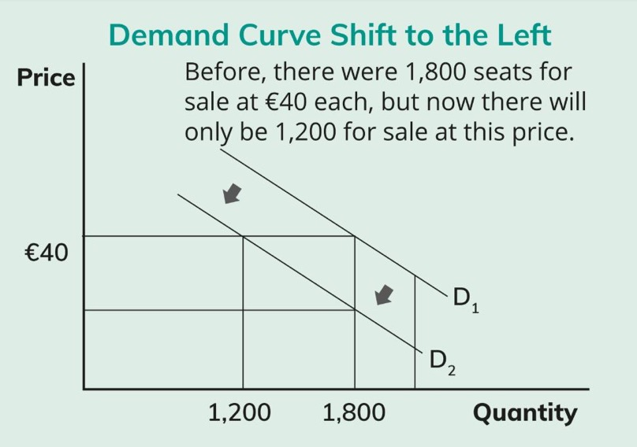
Demand and Supply
Effects of Other Factors on the Demand Curve
1. Change in the price of a substitute product
Let’s assume that Ryanair announces a sale on seats to London. Demand for Aer Lingus seats will fall even though there has been no change in the price of Aer Lingus seats. This will cause the Aer Lingus demand curve to shift to the left, as demand has now fallen at each price level.

Slide 13
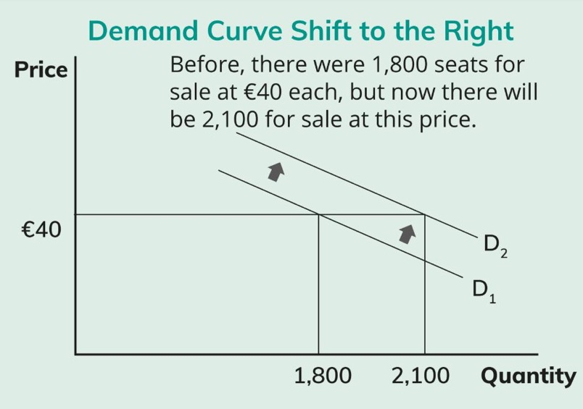
Demand and Supply
Effects of Other Factors on the Demand Curve
2. Unexpected factors
Let’s look at the example of a strike by Ryanair pilots resulting in the cancellation of a number of Ryanair flights to London and the possibility of further strikes throughout the next month. Aer Lingus will see an increase in demand even though they have not reduced their price. This will cause the Aer Lingus demand curve to shift to the right, as demand has now risen at each price level.

Slide 14
Demand and Supply
Effects of Other Factors on the Demand Curve
3. Shortage of goods
There are some situations where demand for a product or service will remain the same and even increase as the price goes up.
These situations are usually the result of a shortage of a particular good or service.
If something is scarce, demand will be greater than supply, so sellers can increase the price knowing that there will be enough demand among consumers with enough money to pay the higher prices. For example:
House prices go up because there is a shortage of houses. Enough people are still prepared to pay the higher prices because if they do not get one of the houses for sale, they will not have a home of their own.
A Kodaline concert is being organised in Semple Stadium. The demand for tickets will be far greater than the number of tickets available. The promoter can charge a high price because the demand is there and consumers have no other alternative if they want to see Kodaline in concert.

Slide 15
Demand and Supply
Supply
Supply: The quantity of goods or services that producers or suppliers are willing to make available for sale at a particular price.
If the price of a product or service rises, supply will usually rise because:
Existing producers and suppliers will supply more to increase their profits
New producers and suppliers will enter the market, as they see an opportunity to make profit
If the price of a product or service falls, supply will usually fall because:
Some producers and suppliers will leave the market, as there is not enough profit to be made
Supply and Price

Slide 16
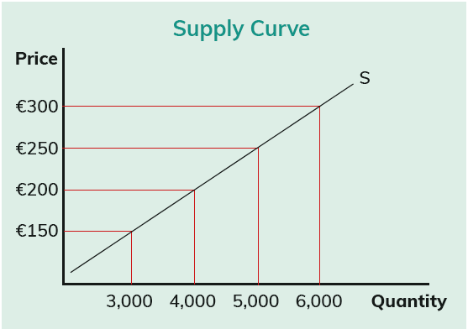
Demand and Supply
Displaying Supply Graphically – The Supply Curve
Let’s look at another example involving air fares. Imagine that Ireland has reached the World Cup finals for the first time since 2002, with the finals taking place in Germany. Airlines expect that record numbers of Irish fans will want to go to the finals and are already planning their flight schedule.
Product: Airline seats from Dublin to Germany return
Period: June/July
Price | Quantity supplied
€150 | 3,000
€200 | 4,000
€250 | 5,000
€300 | 6,000
Supply curve: A graph that shows the relationship between the price of goods and services and the quantity of those goods and services that are made available for sale by producers and suppliers.

Slide 17
Demand and Supply
Other Factors Affecting Supply
1. Changes to the price of other goods
A change in the price of one good can affect the supply of another. Let’s look at the following examples to better understand this.
Substitute goods
AB Ltd and CD Ltd produce dash-cams and sell them at the same price.
AB Ltd decides to increase their selling price, as their rent has increased.
CD Ltd increases supply of their dash-cam, as they expect there will be an increase in demand for their product, which is a substitute good.

Slide 18
Demand and Supply
Other Factors Affecting Supply
Complementary goods
EF Ltd offers a delivery service to Irish and international firms.
A reduction in the amount of excise duty charged on online purchases has resulted in an increase in sales and a corresponding increase in the need for a delivery service.
EF Ltd hires new drivers to increase supply, as theirs is a complementary service.

Slide 19
Demand and Supply
Other Factors Affecting Supply
2. The cost of production
If the cost of producing goods or supplying services increases (for example, wage levels go up or the cost of oil or raw materials increases), then some firms may stop supplying the market, as it is no longer profitable for them to do so. This causes a reduction in supply.
Similarly, if the cost of production falls, supply will be increased, as firms find it is now more profitable to sell goods and supply services than it was previously.
3. Government action
An increase in taxes – either direct (corporation tax) or indirect (VAT) – will increase the cost of production and reduce a firm’s profits. This may force some firms out of the market, so supply is reduced. A decrease in taxes will have the opposite effect.
Government may interfere in trade by imposing a quota (a limit on the quantity of goods that can be produced or imported) or an embargo (total ban on the production or importation of a certain good). Both of these actions will have the effect of reducing supply.

Slide 20
Demand and Supply
Other Factors Affecting Supply
4. Technology
Technology can have a positive impact on business costs and can lead to reduced production costs.
Reduced productions costs increase the profitability of producing and supplying goods and services.
This encourages businesses to increase supply and also encourages new firms to enter the market, thereby further increasing supply.
5. Competition
As an economy grows and prospers, people have more money to spend, so new producers and suppliers will enter the market.
This will lead to an increase in supply and can result in a decrease in prices as the new businesses compete for market share.

Slide 21
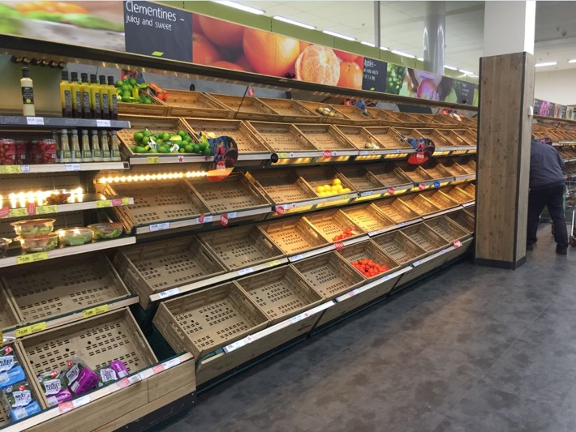
Demand and Supply
Other Factors Affecting Supply
6. Unforeseen events
Any number of unforeseen and unexpected events could occur that could have an effect on the supply of goods and services. These include:
Extreme weather – either extremely hot and dry or extremely wet and cold – can affect the supply of crops and ingredients, which in turn can affect the supply of finished goods.
Prolonged strikes and other industrial action can affect supply.
In 2018, Storm Emma affected the supply of fresh produce and other goods to supermarkets in Ireland.

Slide 22
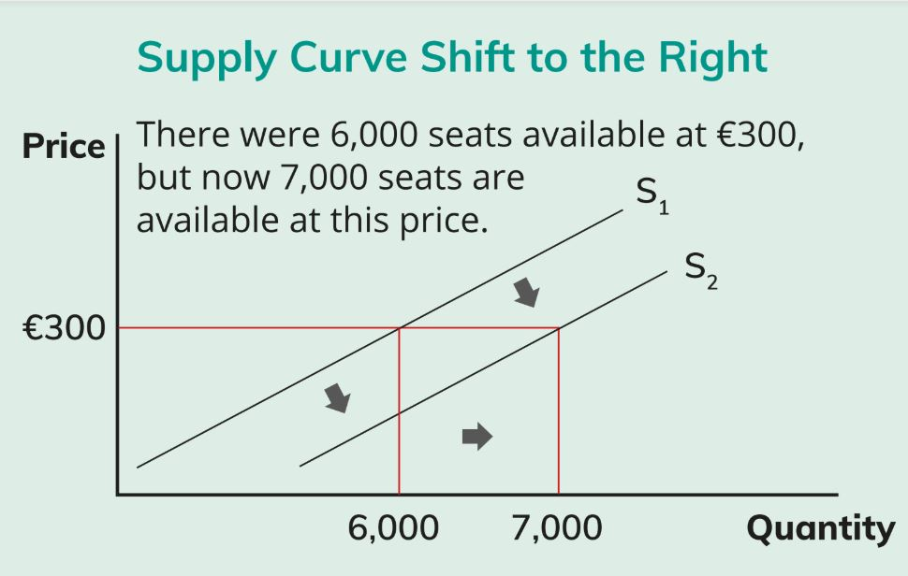
Demand and Supply
Effects of Other Factors on the Supply Curve
1. Change in the cost of production
Let’s assume that there is a major reduction in the price of airline fuel. It now costs the airlines less to fly the planes to Germany than they had thought. They release more seats but do not increase the price, as they are making more profit due to the cost reduction. This will cause the supply curve to shift to the right, as supply has risen at each of the price levels.

Slide 23
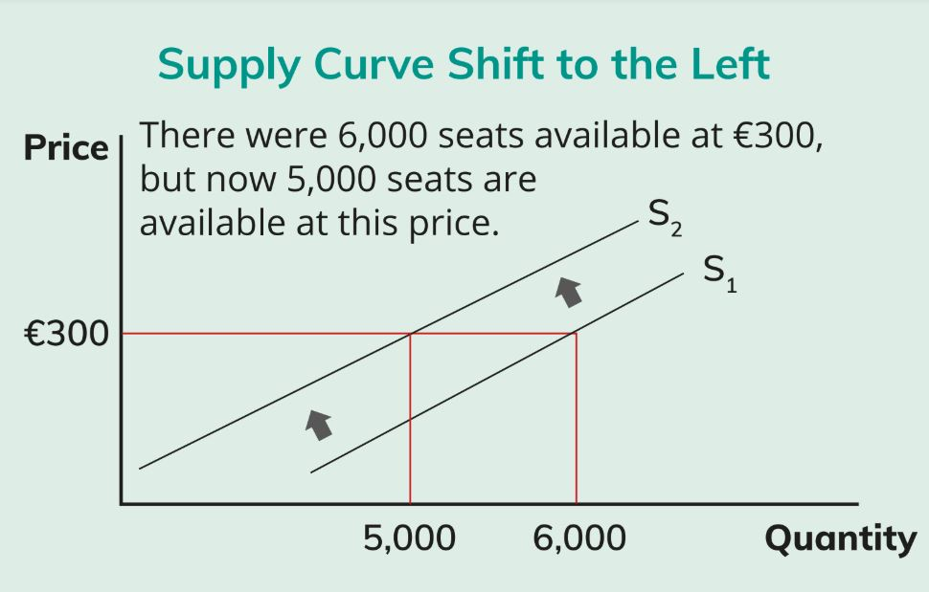
Demand and Supply
Effects of Other Factors on the Supply Curve
2. Unexpected factors
Let’s assume one of the airlines (a small independent airline based in Russia that had been planning to operate some of the flights) goes out of business. Supply immediately falls without any reduction in price. This will cause the supply curve to shift to the left, as supply has fallen at each of the price levels

Slide 24
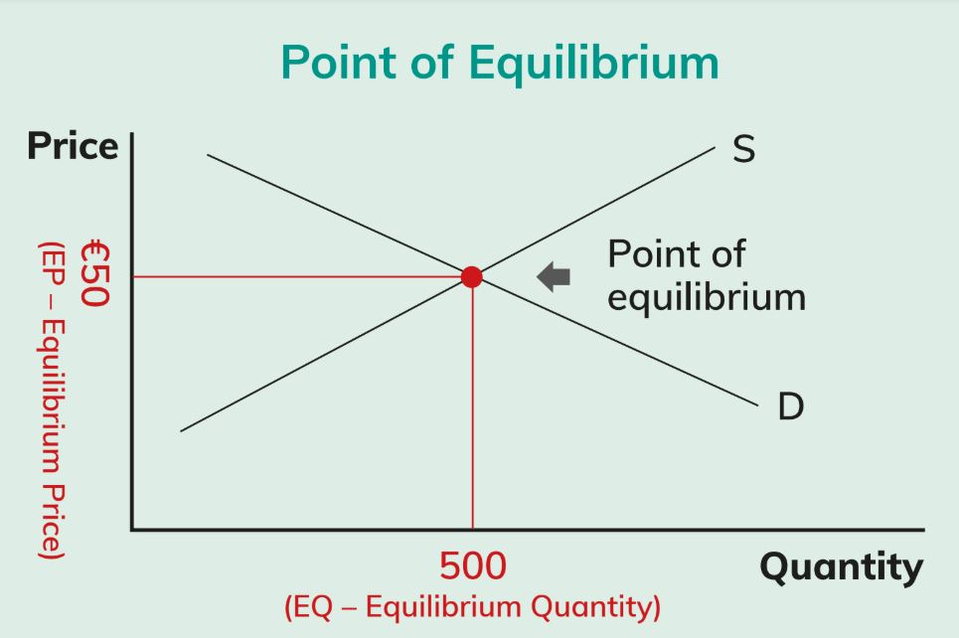
Demand and Supply
Equilibrium
Equilibrium is the term used in economics to describe the situation where demand for a product or service and the supply of that product or service is the same.
The point of equilibrium can be shown by placing the demand and supply curves on the same graph.
The point where they cross (intersect) is the point of equilibrium and is the price at which demand equals supply.

