Slide 1
Chapter 1: My Personal Resources Learning Outcomes: 1.1, 1.2, 1.3, 3.1

Slide 2
Learning Outcomes
1.1 Identify the resources available to achieve your needs and wants
1.2 Appreciate the importance of making wise decisions when you use your resources to satisfy your needs and wants
1.3 Investigate how satisfying your needs and wants can have a negative impact on others
P. 1

Slide 3
Keywords
P. 1

Slide 4
Activate Your Knowledge
P. 1

Slide 5
1.1 Individual and Household Resources
Resources are anything that helps you achieve your goals, needs and wants. There are four types:
Personal: Skills learned (in school), skills that come naturally
Financial: Money you have earned or saved
Physical: Things you own
Human: People who can help you
P. 2

Slide 6
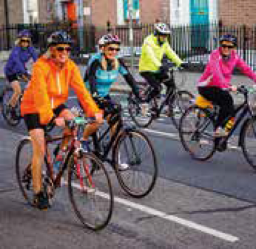
1.1 Individual and Household Resources
Resources are anything that helps you achieve your goals, needs and wants.
P. 2

Slide 7
1.1 Individual and Household Resources
Four types of resources:
1. Personal Resources | 2. Financial Resources
Skills you have learned Example: A language at school. Skills that come naturally Example: Being a good organiser | The money you have earned or saved. Example: Wages
3. Physical Resources | 4. Human Resources
Things you own Example: A phone Things you use Example: WiFi | People in life who can help you Example: Family and friends
P. 2

Slide 8
1.1 Individual and Household Resources
Class discussion: Can you think of two more examples of:
Personal resources
Financial resources
Physical resources
Human resources

Slide 9
1.1 Individual and Household Resources
Scarce resources
Our resources are scarce. We only have a limited amount.
This is due to a number of factors:
Education or training
The type of job/earnings
Your age
Employment situation
Network of family and friends
P. 3

Slide 10
1.1 Individual and Household Resources
Time
Time is another important resource.
Your time is limited.
So make the best use of the time you have.
P. 3

Slide 11
1.1 Individual and Household Resources
P. 3

Slide 12
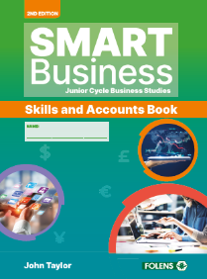
1.1 Individual and Household Resources
Go to Section 1.1 of the Skills and Accounts Book (p. 1).

Slide 13
1.2 Making Choices: Our Needs and Wants
Resources are scarce.
We cannot have everything we would like.
We have to make choices.
So it’s important to know your needs and wants.
P. 4

Slide 14
1.2 Making Choices: Our Needs and Wants
Needs | Wants
The essential things that must come first. Example: Food | The things you can only have after all your needs have been met. Example: A holiday
P. 4

Slide 15
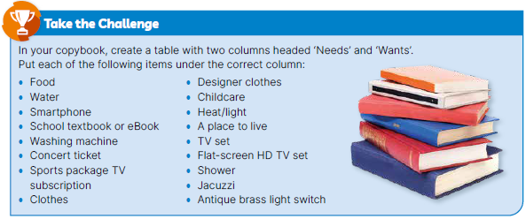
1.2 Making Choices: Our Needs and Wants
P. 4

Slide 16
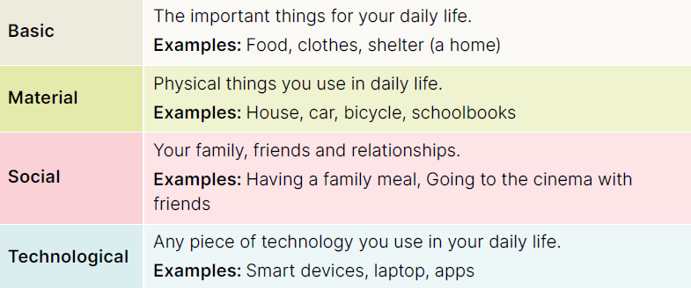
1.2 Making Choices: Our Needs and Wants
The four types of needs and wants:
P. 4

Slide 17
1.2 Making Choices: Our Needs and Wants
What influences your needs and wants?
Health and wellbeing
Hobbies and interests
Your age
Concern for the environment
Current trends and fashions
Your peers/friends
Class discussion: Can you think of an example for each of these?
Your financial resources
P. 5

Slide 18
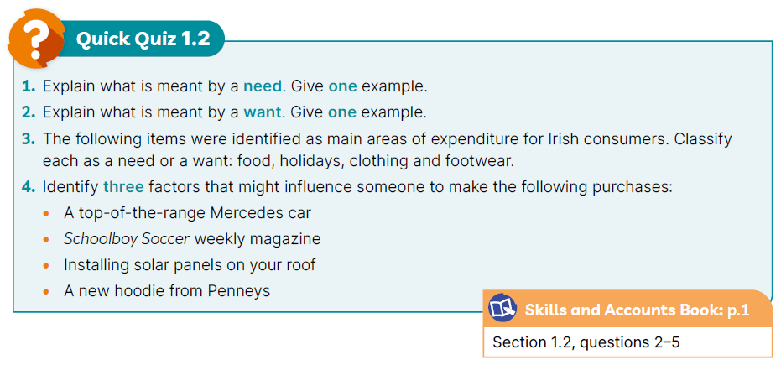
1.2 Making Choices: Our Needs and Wants
P. 5

Slide 19
1.2 Making Choices: Our Needs and Wants
Go to Section 1.2 of the Skills and Accounts Book (p. 1)

Slide 20
1.3 The Impact Our Choices Have on Others
Before using our resources, we should consider how our choices affect other people.
In other words, we should consider their impact.
P. 6

Slide 21
1.3 The Impact Our Choices Have on Others
Impact 1: Basic Needs and Wants | Impact 2: Material Needs and Wants
Food is an essential need. But … eating too many unhealthy foods can impact our health and wellbeing. | We might want to wear designer brands. But … buying cheap versions may impact people employed to make them (e.g. poor pay or working conditions).
Impact 3: Social Needs and Wants | Impact 4: Technological Needs and Wants
We spend time on hobbies and interests. But ... this might result in less time with friends and family, which might impact on our wellbeing. | Technology benefits in many ways. But … using technology may have a negative impact on society (e.g. pollution) and on our wellbeing (e.g. cyberbullying).
P. 6

Slide 22
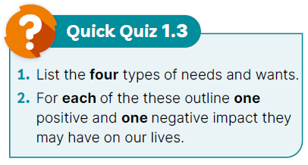
1.3 The Impact Our Choices Have on Others
P. 7

Slide 23
1.3 The Impact Our Choices Have on Others
Go to Section 1.3 of the Skills and Accounts Book (p. 3)

Slide 24
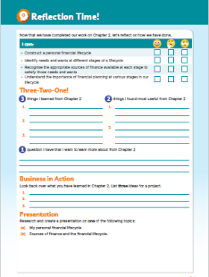
Reflection Time!
Go to page 4 of the Skills and Accounts Book and assess your progress.
Complete the ‘I can’ reflection table.
Complete the Three-Two-One! activity
Business in Action: Note any ideas for your CBA 1 (Project)
Presentation: Note any ideas for your CBA 2 (Presentation)

