Slide 1
Chapter 28: Introduction to Bookkeeping Learning Outcomes: 2.12, 1.2; 1.13; 2.10 – 2.13; 3.2

Slide 2
Learning Outcomes
28.1 Prepare ledger accounts for various business transactions
28.2 Balance ledger accounts and extract a trial balance
28.3 Prepare and analysed cash account for a business, post these transactions to the relevant ledger accounts and extract a trial balance
P. 279

Slide 3
Keywords
P. 279

Slide 4
Activate Your Knowledge
P. 279

Slide 5
28.1 Bookkeeping
Transactions are activities in a business that result in money going out of the business or money coming in.
Businesses have to keep a record of all these transactions.
This is called bookkeeping.
P. 280

Slide 6
28.1 Bookkeeping
A ledger is where a firm records all its business transactions.
It is divided into accounts.
An account is a ‘story’ about some aspect of the business.
Like any story, an account has:
A beginning: Opening balance
A middle: Transactions that took place
An end: Closing balance
P. 280

Slide 7
28.1 Bookkeeping
A business should keep an account of five key things:
Assets | The things we own
Liabilities | The things we owe
Expenses | Bills we pay
Losses | Losses we make
Revenue | Income we receive
P. 280

Slide 8
28.1 Bookkeeping
All business transactions have two parts:
Both parts must be recorded in the ledger.
This system is called double-entry bookkeeping.
The next two slides give two examples.
A giving part | A receiving part
P. 280

Slide 9
28.1 Bookkeeping
P. 280

Slide 10
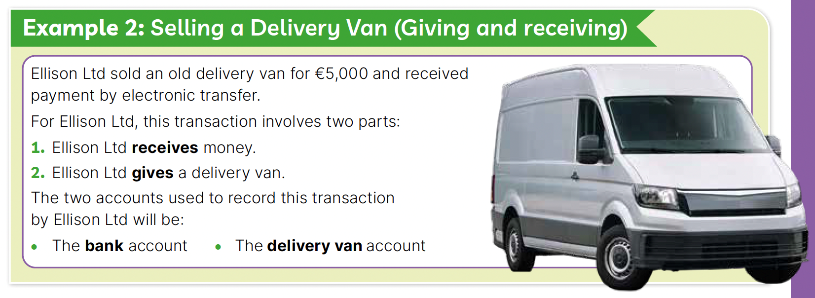
28.1 Bookkeeping
P. 281

Slide 11
28.1 Bookkeeping
Let’s discuss: For the following two examples, identify:
(a) the two parts of the transaction
(b) the two accounts that might be used
Example 1: Food4U Ltd purchased a new van for €10,000 from The Van Company by electronic funds transfer.
Example 2: Food4U sold a printer for €1,000 and received payment by electronic funds transfer.
P. 281

Slide 12
28.1 Bookkeeping
Chapter 6 looked at recording household income and expenditure.
The same rules apply for preparing business accounts.
An account has two sides:
Let’s look at the Ellison Ltd examples again to see what is given and what is received.
Debit (Dr) side | Credit (Cr) side
The receiving side | The giving side
P. 281

Slide 13
28.1 Bookkeeping
P. 281

Slide 14
28.1 Bookkeeping
P. 281

Slide 15
28.1 Bookkeeping
Expenses and Gains
It is sometimes difficult to figure out what was given or received in a transaction if it is not a simple purchase or sale.
One example of this is expenses (e.g. a bill) and gains (e.g. rent).
The rule for expenses and gains is:
Use the Debit (Dr) side of the account to show expenses
Use the Credit (Cr) side of the account to show gains
P. 282

Slide 16
28.1 Bookkeeping
P. 282

Slide 17
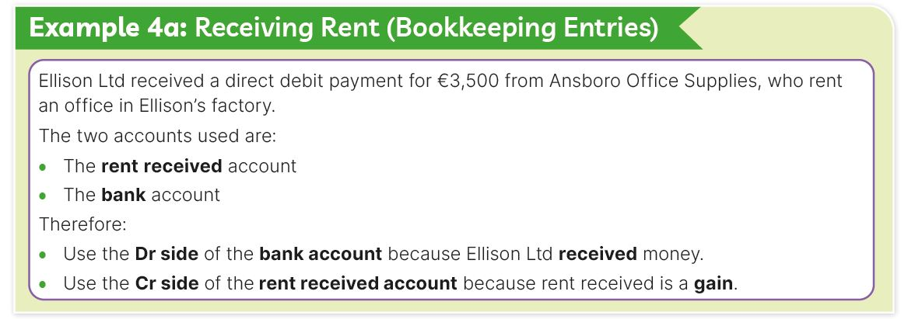
28.1 Bookkeeping
P. 282

Slide 18
28.1 Bookkeeping
Assets and Liabilities
Assets are things the firm owns (e.g. machinery).
Liabilities are things the firm owes (e.g. a loan).
The rule for expenses and gains is:
Use the Debit (Dr) side of the account to show assets.
Use the Credit (Cr) side of the account to show liabilities.
P. 282

Slide 19
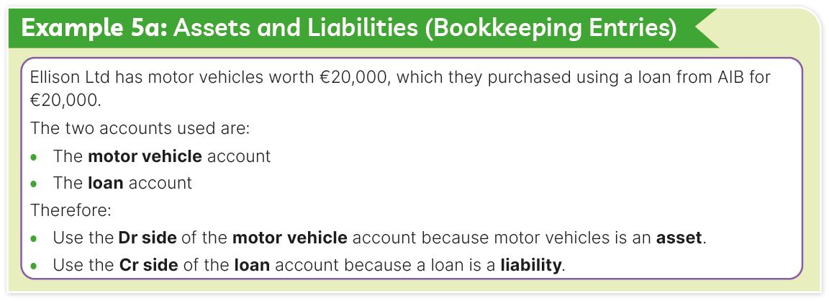
28.1 Bookkeeping
P. 283

Slide 20
28.1 Bookkeeping
Let’s discuss: Can you identify examples of two other assets and two other liabilities that a business might have?

Slide 21
28.1 Bookkeeping
The Layout of an Account (the ‘T’ account)
Debit (Dr) side
(Receiving side)
P. 283

Slide 22
28.1 Bookkeeping
The Layout of an Account (the ‘T’ account)
Credit (Cr) side
(Giving side)
P. 283

Slide 23
28.1 Bookkeeping
The examples that follow show how Ellison Ltd uses the double-entry bookkeeping system to post transactions for:
A computer purchase
A van sale
Paying wages
Receiving rent
Assets and liabilities

Slide 24
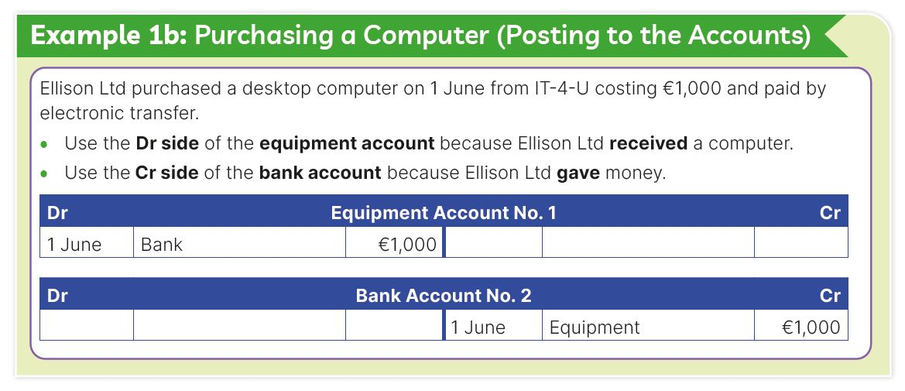
28.1 Bookkeeping
P. 283

Slide 25
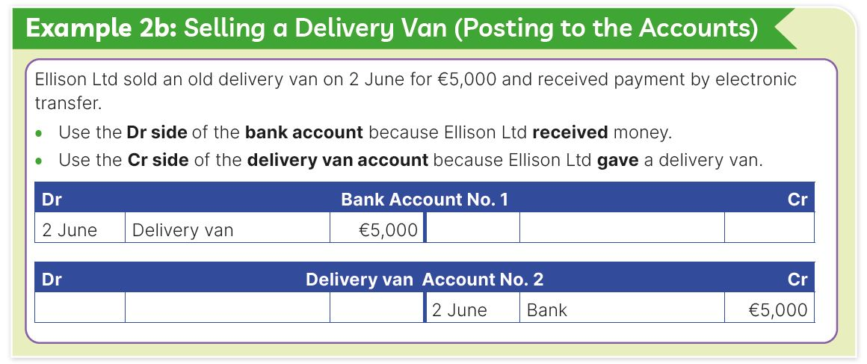
28.1 Bookkeeping
P. 284

Slide 26
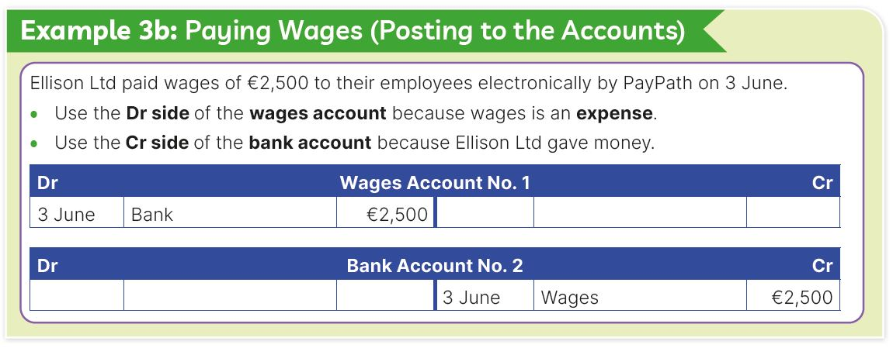
28.1 Bookkeeping
P. 284

Slide 27
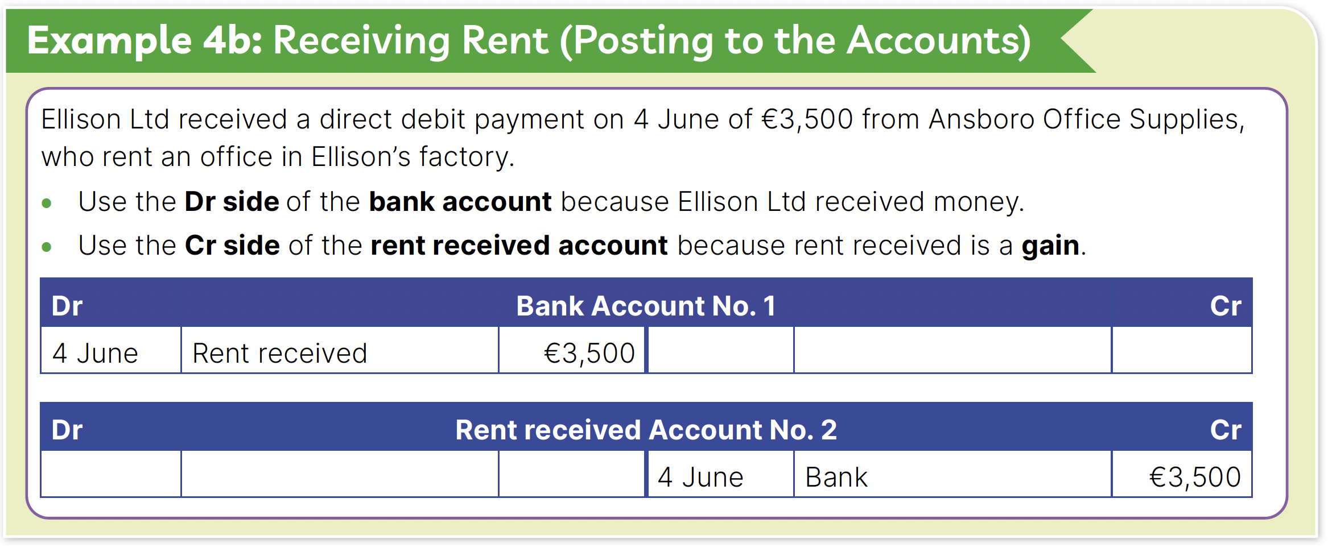
28.1 Bookkeeping
P. 284

Slide 28
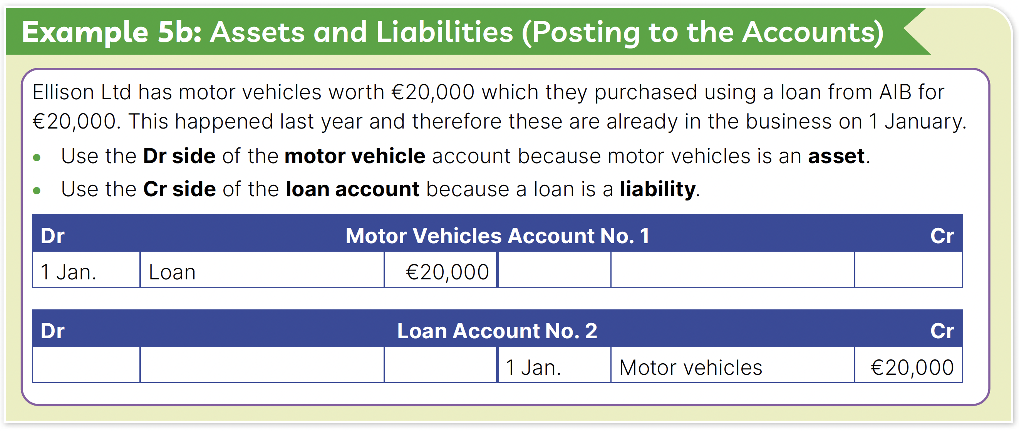
28.1 Bookkeeping
P. 285

Slide 29
28.1 Bookkeeping
P. 285

Slide 30
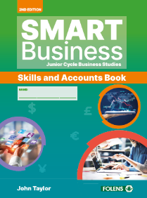
28.1 Bookkeeping
Go to Section 28.1 of the Skills and Accounts Book (p. 214).

Slide 31
28.2 Balancing Accounts and Preparing a Trial Balance
In a real business situation transactions are posted to the same account.
P. 285

Slide 32
28.2 Balancing Accounts and Preparing a Trial Balance
Like a household, a business needs to balance its account to see how much money it has.
An account for a business is balanced in the same way that you balance an analysed cash book (covered in Chapter 6).
P. 285

Slide 33
28.2 Balancing Accounts and Preparing a Trial Balance
Step 1: Add total columns on both sides.
Total on Dr side:
€8,500
Total on Cr side:
€3,500
P. 285

Slide 34
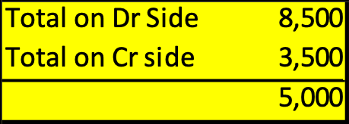
28.2 Balancing Accounts and Preparing a Trial Balance
Step 2: Subtract the smaller total from the larger one.
Total on Dr side:
€8,500
Total on Cr side:
€3,500
P. 285

Slide 35
28.2 Balancing Accounts and Preparing a Trial Balance
Step 3: On the side with the smaller total, carry the balance down below the last entry (‘Balance c/d’).
P. 286

Slide 36
28.2 Balancing Accounts and Preparing a Trial Balance
Step 4: Total both sides of the account on the same line.
P. 286

Slide 37
28.2 Balancing Accounts and Preparing a Trial Balance
Step 5: Bring the balance down to the other side of the account. Use the next day’s date.
P. 286

Slide 38
28.2 Balancing Accounts and Preparing a Trial Balance
Trial Balance
When all the accounts have been prepared and balanced a trial balance should be prepared.
This is a list of all the balances in the ledger accounts.
You take the balance brought down figures from each account and put them on the same side of the trial balance.
Both sides of the trial balance should add up to the same total.
P. 286

Slide 39
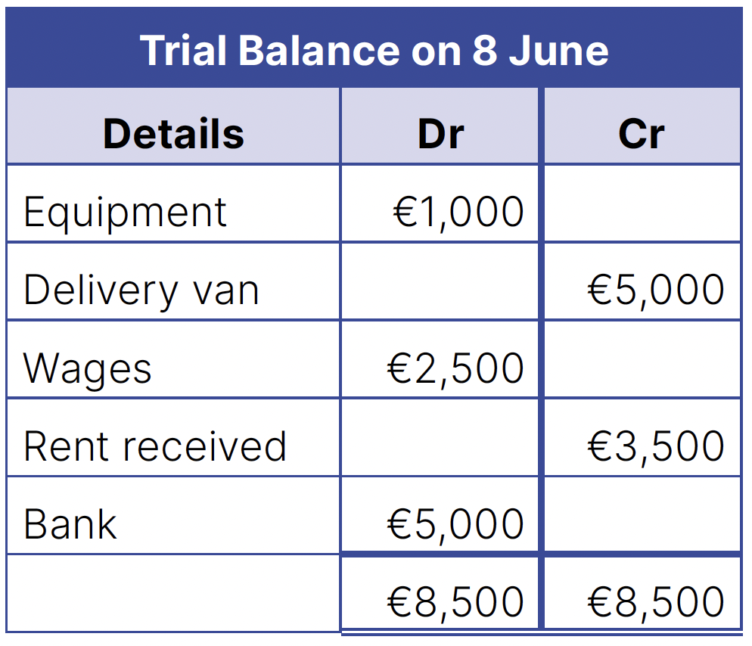
28.2 Balancing Accounts and Preparing a Trial Balance
Trial Balance
This is the trial balance for the Ellison Ltd example.
P. 286

Slide 40
28.2 Balancing Accounts and Preparing a Trial Balance
A helpful rule for tricky transactions:
Rule | Example
Use the Purchase or Sales account when a transaction involves the purchase of sale of goods that the firm deals in. | Julliette Nolan is a butcher. She purchased meat costing €500 and paid by cheque. Debit Purchases account Credit Bank account
Use the Asset account when the transaction involves the purchase or sale of an asset for the firm’s own use. | Julliette purchased a new refrigerator costing €3,000 and paid by electric funds transfer. Debit Equipment account Credit Bank account
P. 287

Slide 41
28.2 Balancing Accounts and Preparing a Trial Balance
P. 287

Slide 42
28.3 The Analysed Cash Account
Purchases, Sales and VAT
Value-Added Tax (VAT) is explained in Chapter 9.
VAT is included in the prices of most goods.
So it is important for a firm to record VAT in its accounts every time it buys or sells goods or services.
P. 288

Slide 43
28.3 The Analysed Cash Account
Purchases, Sales and VAT
In this example, you record the following:
Bank account: €2,460 (Cr)
Purchases account: €2,000 (Dr)
VAT account: €460 (Dr)
Cash purchases from Maloney & Sons | €2,460 (€2,000 + VAT €460)
P. 288

Slide 44
28.3 The Analysed Cash Account
Purchases, Sales and VAT
In this example, you record the following:
Bank account: €4,305 (Dr)
Sales account: €3,500 (Cr)
VAT account: €460 (Cr)
Cash sales Maloney & Sons | €4,305 (€3,500 + VAT €805)
P. 288

Slide 45
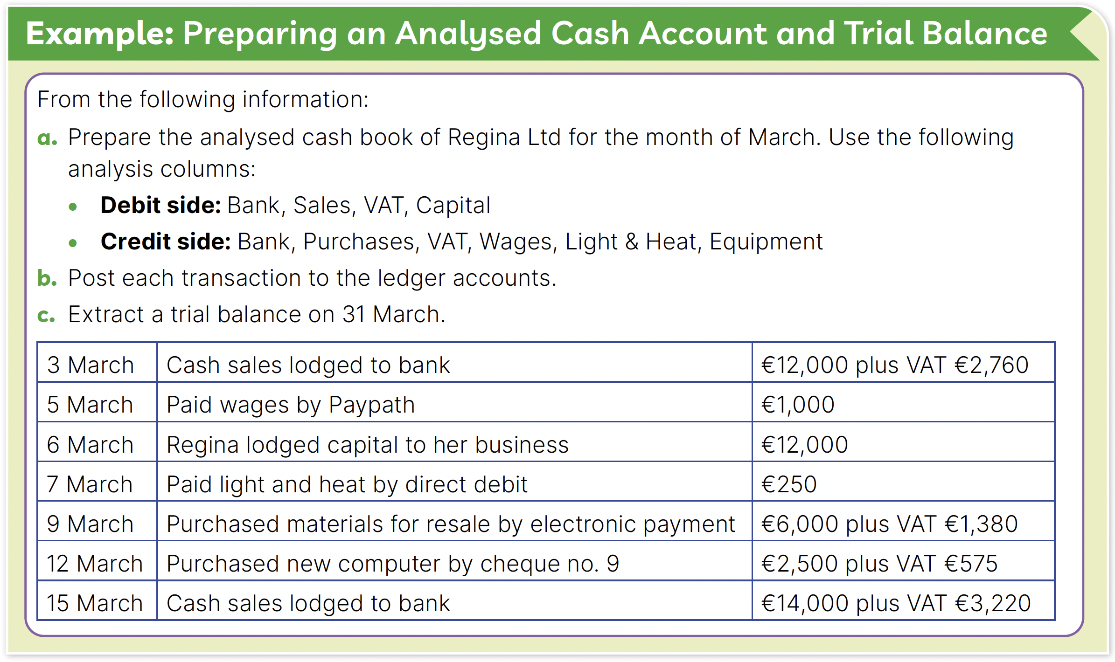
28.3 The Analysed Cash Account
P. 288

Slide 46
P. 289

Slide 47
P. 289

Slide 48
P. 289

Slide 49
P. 289

Slide 50
P. 289

Slide 51
P. 289

Slide 52
P. 289

Slide 53
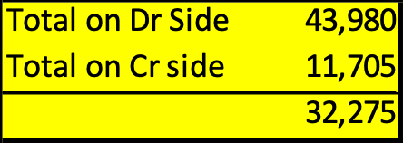
Total on Cr side:
€11,705
Total on Dr side:
€43,980
P. 289

Slide 54
Balance carried down:
€32,275
P. 289

Slide 55
Totals
P. 289

Slide 56
Balance brought down
P. 289

Slide 57
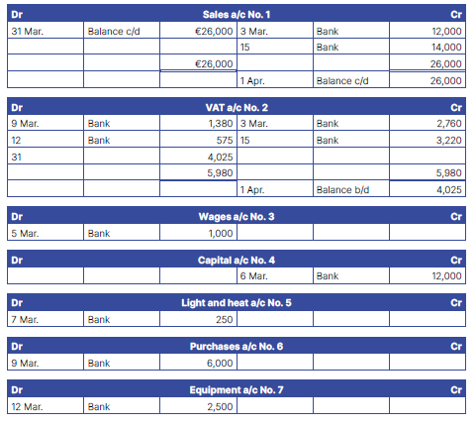
P. 289

Slide 58
P. 289

Slide 59
P. 289

Slide 60
P. 289

Slide 61
P. 289

Slide 62
P. 289

Slide 63
P. 289

Slide 64
P. 289

Slide 65
P. 289

Slide 66
P. 289

Slide 67
P. 289

Slide 68
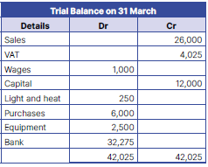
28.3 The Analysed Cash Account
P. 290

Slide 69
28.3 The Analysed Cash Account
P. 290

Slide 70
28.3 The Analysed Cash Account
P. 290

Slide 71
28.3 The Analysed Cash Account
P. 290

Slide 72
28.3 The Analysed Cash Account
P. 290

Slide 73
28.3 The Analysed Cash Account
P. 290

Slide 74
28.3 The Analysed Cash Account
P. 290

Slide 75
28.3 The Analysed Cash Account
P. 290

Slide 76
28.3 The Analysed Cash Account
P. 290
Balance brought down in Analysed Cash Book (see slide 58)

Slide 77
28.3 The Analysed Cash Account
Go to Section 28.3 of the Skills and Accounts Book (p. 225).

Slide 78
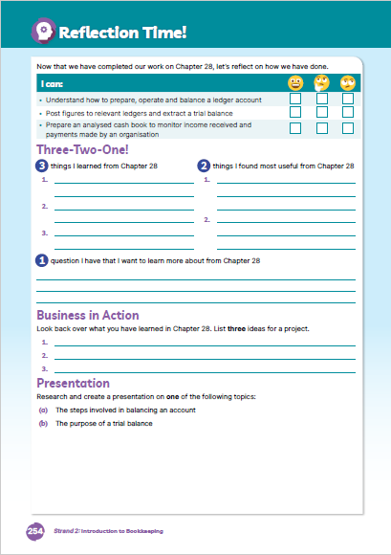
Reflection Time!
Go to page 235 of the Skills and Accounts Book and assess your progress.
Complete the ‘I can’ reflection table.
Complete the Three-Two-One! activity
Business in Action: Note any ideas for your CBA 1 (Project)
Presentation: Note any ideas for your CBA 2 (Presentation)

