Slide 1
Chapter 35: Economic Growth and Sustainability Learning Outcomes: 3.6, 1.9, 2.2, 2.5. 3.3, 3.7, 3.9 , 3.10, 3.11

Slide 2
Learning Outcomes
35.1 Explain what is meant by economic growth and how it is calculated
35.2 Assess the impacts of economic growth on society and the environment
35.3 Appreciate the need to promote sustainable development as a central part of economic growth
P. 359

Slide 3
Keywords
P. 359

Slide 4
Activate Your Knowledge
P. 359

Slide 5
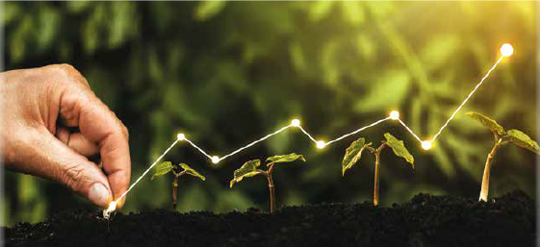
35.1 Economic Growth
Economic growth is the change in the total value of goods and services produced from one year to the next.
Because the value of production can go up OR down, economic growth can be positive or negative.
P. 360

Slide 6
35.1 Economic Growth
Economic growth is usually calculated by measuring percentage changes in two values:
Measure | Definition
Gross Domestic Product (GDP) | The total value of all goods and services produced in a country in any one year. For Ireland, GDP includes both Irish and foreign-owned companies located in Ireland
Gross National Product (GNP) | The total value of all goods and services produced by Irish companies or individuals both in Ireland and abroad. This does not include activities of foreign-owned companies based in Ireland.
P. 360

Slide 7
35.1 Economic Growth
Economic growth formula:
P. 360

Slide 8
35.1 Economic Growth
P. 360

Slide 9
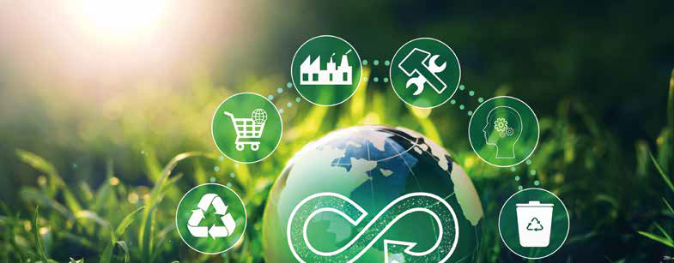
35.1 Economic Growth
Benefits of economic growth:
New jobs (unemployment decreases)
Higher standard of living (people have more to spend)
Government has more to spend on education, health and social welfare
P. 361

Slide 10
35.1 Economic Growth
Conditions for economic growth:
Low inflation
Low interest rates
Wage increases and other costs kept low
Good budgeting by the government
P. 361

Slide 11
35.1 Economic Growth
Economic cycles are how economies change over time. The main stages are:
Boom
Recession
Depression
Recovery
P. 361

Slide 12
35.1 Economic Growth
Economic Boom:
This is a period of substantial economic growth over a period of time:
Wage levels rise
Production increases (to meet increase in customer demand)
Prices increase (due to higher wages, leading to inflation)
P. 361

Slide 13
35.1 Economic Growth
P. 361

Slide 14
35.1 Economic Growth
Recession
This is a period where economic activity drops over a period of time:
There is a slow down in production
Employment levels fall
Government income falls
Some firms may close
Inflation falls
P. 362

Slide 15
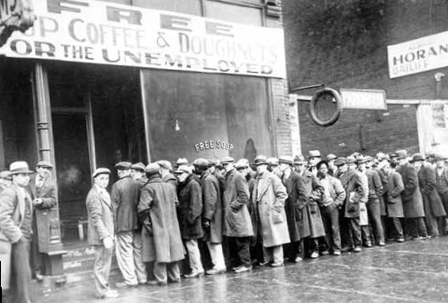
35.1 Economic Growth
Depression
This is a recession that lasts a long time. Depressions are rare. Signs of a depression are:
Increasing unemployment
Fall in demand for goods and services
Reduced customer spending
Long periods of low inflation
P. 362
P.

Slide 16
35.1 Economic Growth
Recovery
This is the period after a recession or depression. Signs of recovery include:
Increased customer spending
Increased production (to meet more customer demand)
Falling unemployment
Inflation and interest rates stop falling
P. 363

Slide 17
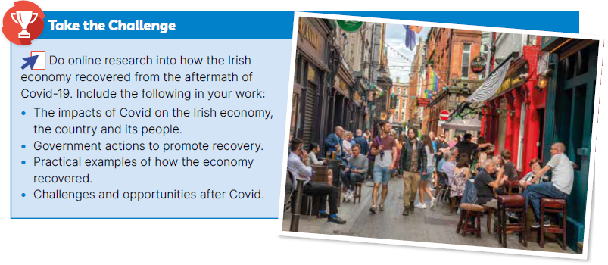
35.1 Economic Growth (CBA opportunity)
P. 363

Slide 18
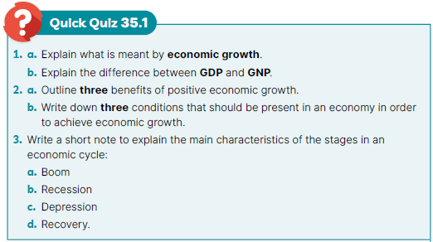
35.1 Economic Growth
P. 363

Slide 19
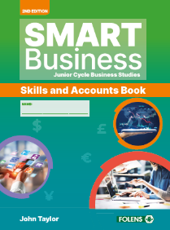
35.1 Economic Growth
Go to Section 35.1 of the Skills and Accounts Book (p. 281).

Slide 20
35.2 The Impact of Economic Growth
Positive economic growth has positive and negative effects on society and the environment.
Let’s Discuss: Before looking at the next slide, can you think of some positive and negative effects that economic growth has on society or the environment?
Keyword clues: Employment, Technology, Production, Climate, Demand, Supply
P. 364

Slide 21
35.2 The Impact of Economic Growth
Economic Growth: Impacts on Society
Positive | Negative
Increase in employment | Advances in technology = loss of unskilled jobs
Government has more money to spend | Employment in agriculture has fallen
Increase in new Irish businesses | More work pressures affects people’s wellbeing
Standard of living improves
P. 364

Slide 22
35.2 The Impact of Economic Growth
Economic Growth: Impacts on the Environment
Positive | Negative
More money for government to promote sustainability and fight climate change | Increase in the use of fossil fuels
More money for business to invest in ‘clean’ technologies | Pollution and traffic congestion
More household income and grants for improving energy efficiency | Overall negative impact on climate change
 | More roads and housing threatens wildlife
P. 364

Slide 23
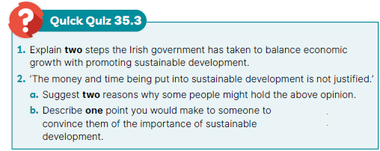
35.2 The Impact of Economic Growth
P. 365

Slide 24
35.1 The Impact of Economic Growth
Go to Section 35.2 of the Skills and Accounts Book (p. 282).

Slide 25
35.3 Economic Growth and Sustainable Development
Government has a responsibility to minimise the negative impacts of economic growth. Recent laws have been passed to help with this:
The Environmental Protection Agency Act 1992
The Waste Management Act 1996
The Protection of the Environment Act 2003
The Environmental Acts 2011/2015
The Climate Action and Low Carbon Development Act 2015
P. 365

Slide 26
35.3 Economic Growth and Sustainable Development
The government has also signed up to the United Nations Framework for Climate Change:
Kyoto Protocol on climate change (2005)
Paris Agreement on greenhouse gas emissions and climate change (2016)
P. 365

Slide 27
35.3 Economic Growth and Sustainable Development
Let’s Discuss: Go to page 365 of your textbook and read the section ‘Justifying Sustainable Development’.
Do you think it is justified for governments to spend large amounts of money on climate action?
What is the opportunity cost of spending government money on climate action?

Slide 28
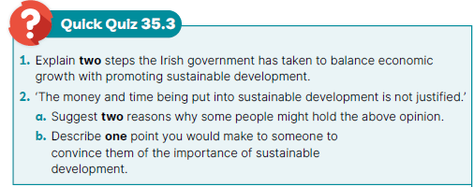
35.3 Economic Growth and Sustainable Development
P. 365

Slide 29
35.3 Economic Growth and Sustainable Development
Go to Section 35.3 of the Skills and Accounts Book (p. 283)

Slide 30
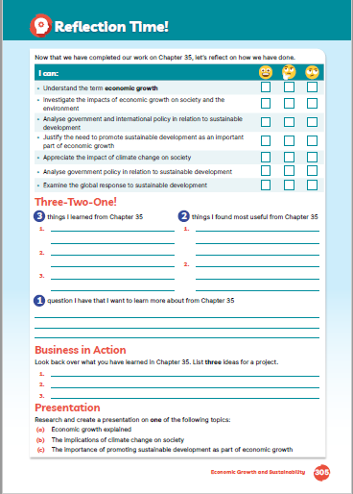
Reflection Time!
Go to page 284 of the Skills and Accounts Book and assess your progress.
Complete the ‘I can’ reflection table.
Complete the Three-Two-One! activity
Business in Action: Note any ideas for your CBA 1 (Project)
Presentation: Note any ideas for your CBA 2 (Presentation)

