Slide 1

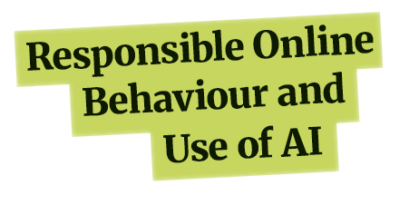

MODULE
Lesson 1
Your Digital Footprint

Slide 2
Learning Intentions
Understand the factors that contribute to your digital footprint
Recognise the impact of your digital footprint
Know how to make thoughtful choices that support a safe and responsible online presence

Slide 3
Key Words
Digital footprint: The trail of information you leave behind when you use the internet.

Slide 4

What Is Your Digital Footprint?
Your digital footprint is the trail of information you leave behind when you use the internet.
It includes:
Information you choose to share
Information that is collected automatically

Slide 5

What your posts say about you | eSafety Commissioner

Slide 6
What do you think your digital footprint might look like?

Slide 7





Why Does Your Digital Footprint Matter?
Remember to think before you post – your digital footprint can last a long time!
Future opportunities
The internet remembers
Safety and wellbeing
Real-world consequences
Positive connections

Slide 8
Debate: People should have the right to delete their digital footprint

Slide 9
Managing Your Digital Footprint
Think carefully before you post or comment.
Remember that you lose control of photos once you post them.
Avoid sharing sensitive personal information.
Regularly review and update your privacy settings.
Delete or deactivate old accounts.

Slide 10

Find Out More…
https://www.youtube.com/watch?v=3jKqgcM_ja4

Slide 11
Reflection: Identify one action you could take to improve your digital footprint.

