Slide 1

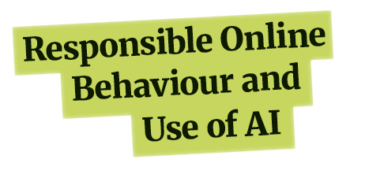

MODULE
Lesson 2
Algorithms

Slide 2
Learning Intentions
Explain how social media platforms use algorithms to keep users engaged
Understand the impact these algorithms can have on the experience each user has

Slide 3
Key Words
Algorithm: A set of instructions that tells a computer what to do.
Echo chambers: Online spaces where people mostly see ideas and opinions similar to their own.
Targeted advertising: Advertising shown to specific users based on their online behaviour and interests.

Slide 4
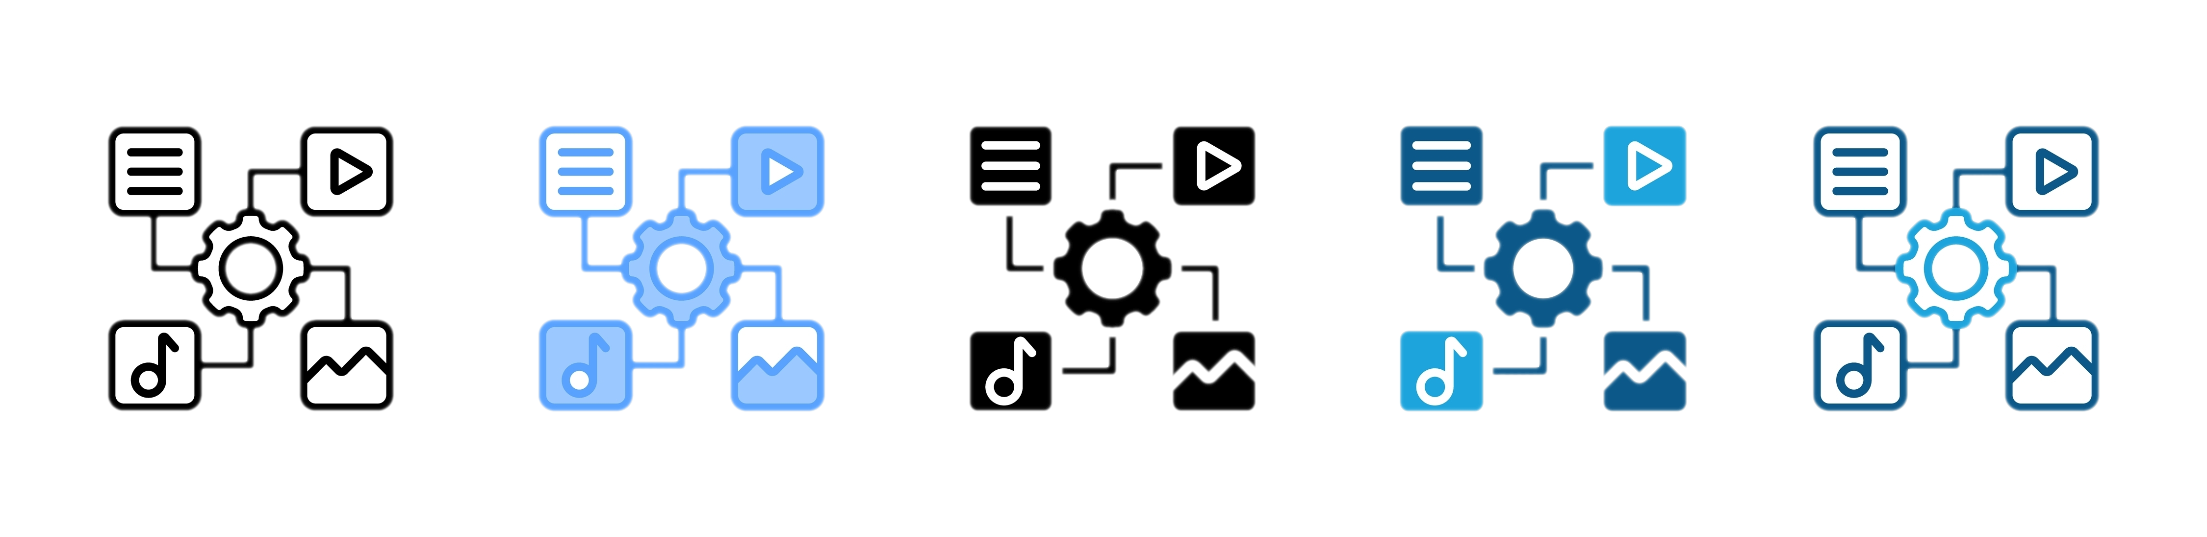
What Is an Algorithm?
A set of instructions that tells a computer what to do.
On social media, algorithms look at:
Viewing behaviour
Likes and shares
Time spend on posts
They use this to decide what to show next.

Slide 5

How Algorithms Decide What You See
Age, gender and location
What you watch, click or like
What similar users engage with

Slide 6
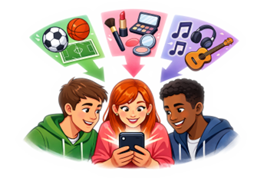
What This Means
Your feed is not the same as everyone else’s.
Teachers, students, and people in other countries may see very different content.
Feeds become personalised over time
(‘For You’ pages).

Slide 7
The Dangers of Algorithms: Exposure to Harmful Content
To keep users engaged, algorithms may promote content that:
Is extreme or shocking
Provokes strong emotional reactions
Creates conflict or controversy
As a result, users may be exposed to harmful content. Repeated exposure can affect what feels normal online.

Slide 8
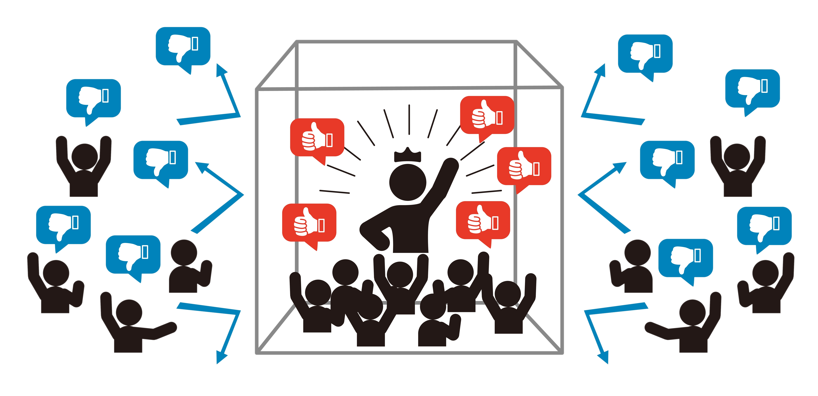
The Dangers of Algorithms: Echo Chambers
Algorithms can also create echo chambers that:
Reinforce one-sided views
Make it harder to understand other perspectives
Increase division and intolerance

Slide 9
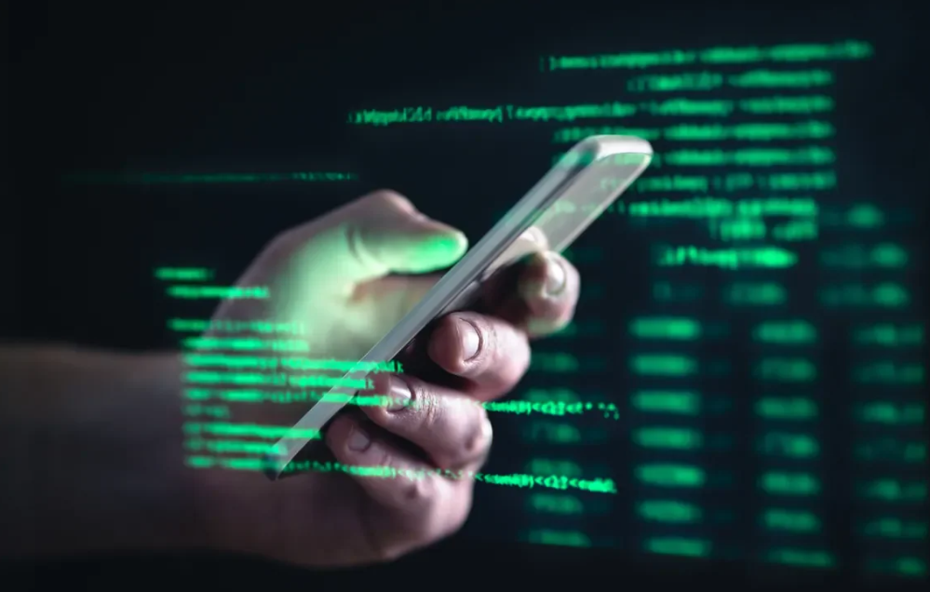
Further Reading …
New research shows how TikTok and YouTube Shorts are bombarding users with misogynist content.
New research shows how TikTok and YouTube Shorts are bombarding users with misogynist content | Dublin City University

Slide 10

The Dangers of Algorithms: Targeted Advertising
Algorithms are also used for targeted advertising.
This can be more persuasive and harder to recognise, increasing the
risk of manipulation.

Slide 11
What food and drinks do you see being targeted at people your age, and where do you usually see these ads?
Would you say these foods and drinks are generally nutritious or not?
How do you think this targeted advertising might be different for your parents/guardians?

Slide 12
Intepreting Research
Why is it significant that harmful content appeared even when users did not search for it?
How might repeated exposure to this type of content affect users over time?
What responsibility do social media platforms have for the content they promote?
New research shows how TikTok and YouTube Shorts are bombarding users with misogynist content | Dublin City University

Slide 13

Understanding Your Algorithm
Algorithms shape what we see online.
Understanding how they work helps us use digital spaces responsibly.

Slide 14
Be an Informed Digital Citizen
Question what you see.
Recognise when content is designed to influence you.
Take control of your online behaviour.

Slide 15
Reflection
One thing I learned today about how algorithms affect behaviour is …
One way this might affect my
own use of apps or technology is …

