Slide 1
Comprehension Strategy: Making Connections

Slide 2
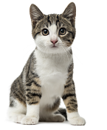
Imagine reading a story about a boy called Cian. When he loses his dog, you feel terrible.
You remember how awful you felt when your cat got lost once.

Slide 3
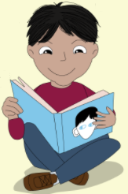
Guess what? You’ve just connected with the reading.

Slide 4
This reminds me
of the time when I thought our new soccer coach looked really strict and cross and it turned
out he was kind and
great fun.
Good readers use what they already know to help them make connections to what they are reading.

Slide 5
There are three different types of connections you can make:
1. Text to Self
2. Text to Text
3. Text to World

Slide 6
1. Text to Self
Connections with my own life – people I know, places I’m familiar with, things I like to do, feelings I’ve experienced
This story reminds me of when I went on holidays by the sea last year.

Slide 7
1. Text to Text
Connections with other books, magzines or newspapers I’ve read, movies or TV shows I’ve seen
I watched a video about someone who was bitten by a spider last month and now I’m reading a book about the most venomous spiders.

Slide 8
1. Text to World
Connections with real world events - things I’ve seen on the news, or read about on the Internet
I saw on the news that global temperatures are rising and now I’m reading about how fossil fuel cars are a major cause of global warming.

Slide 9
Unit 1a: Our Adventure Weekend

Slide 10
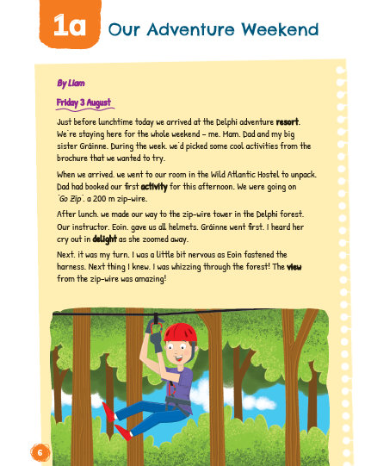
Have you ever been to an adventure centre or gone zip-lining? Did you enjoy it? Why or why not?
Have you ever felt nervous doing an adventurous activity or sport? How did you feel before, during and after it?

Slide 11
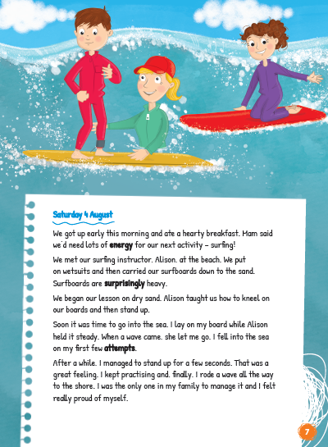
Have you ever been surfing or watched it on TV or online? Do you think it’s a challenging activity?
Have you ever found an activity difficult but practiced it and got better? How did you feel afterwards?

Slide 12
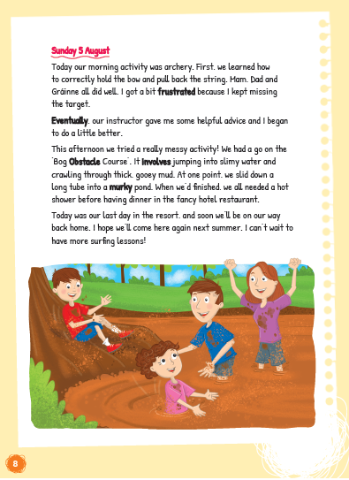
Have you ever been in a bog or taken part in a Bog Obstacle Course?
Have you walked through cold muddy water? What did it feel like?

Slide 13
Unit 1b: My Coasteering Adventure

Slide 14
Have you ever been to Kenmare or to Kerry? Have you read something or seen something on TV about this part of the country?
Have you ever swam in the sea in a wetsuit? What did it feel like? Were you cold or did you warm up quickly?

Slide 15
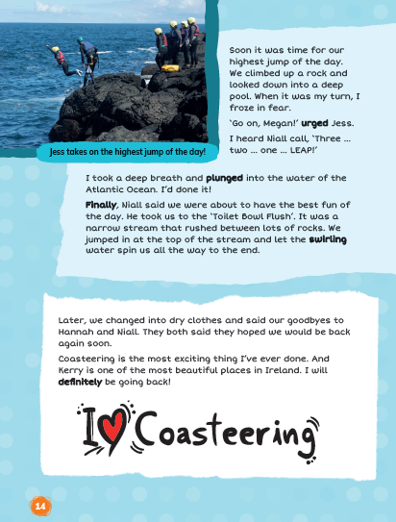
Have you ever jumped into the sea from a height or even just from rocks? What did it feel like? Were you scared? What it exciting?
The author refers to a narrow stream between rocks called the ‘Toilet Bowl Flush’. Connect what you now about how a toilet flushes to help you visualize this scene.

