Slide 1
Comprehension Strategy: Determining Importance

Slide 2
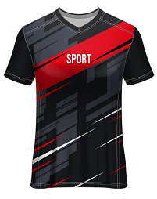
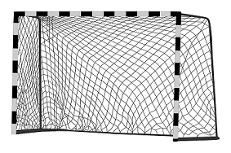
Imagine you are going to play a game of soccer with your friends. What are the three most important items you need?

Slide 3
You can’t play soccer without a ball and goals. It’s also difficult to run around without a pair of soccer boots or runners.

Slide 4
Good readers need to be able to tell the difference between:
Important ideas
Interesting details
This is what’s called ‘determining importance’.

Slide 5
It’s a bit like straining the water from spaghetti. You keep the important things (spaghetti) and lose the bits you don’t need (water).
Important
information
Interesting
details

Slide 6
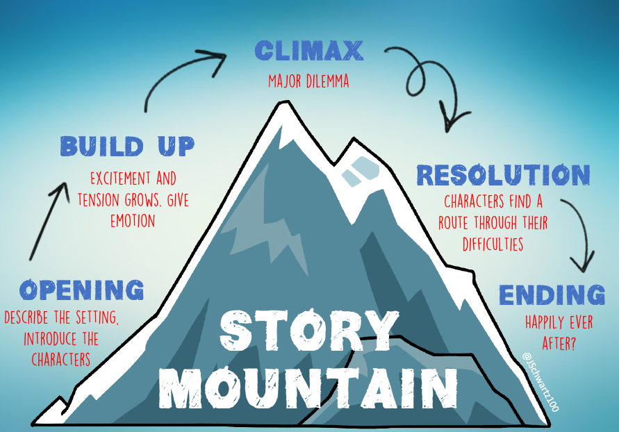
Fiction
The important information in a fiction text, usually sits somewhere in the story mountain

Slide 7
See if you can identify the important information in this extract from The Boy Who Cried Wolf.

Slide 8
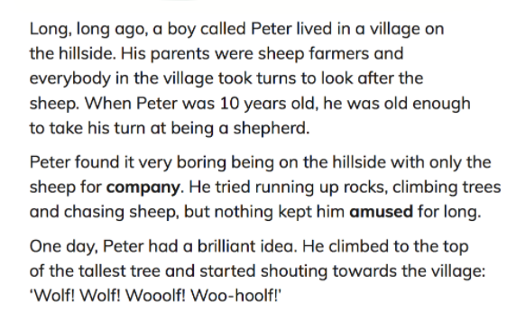

Slide 9
Interesting details
Important information

Slide 10
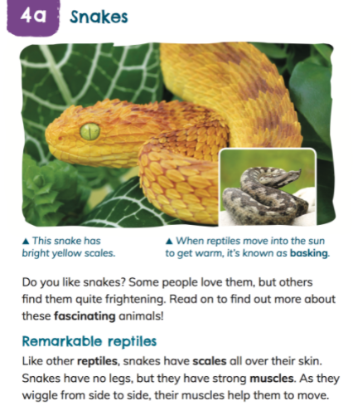
Nonfiction
When determining importance in nonfiction texts, keep an eye out for main topics, facts and ideas.

Slide 11
See if you can identify the important information in this nonfiction paragraph about crocodiles.

Slide 12
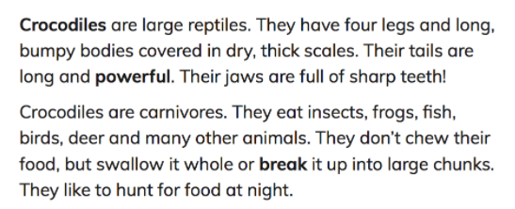

Slide 13
Important information
Interesting details

Slide 14
Unit 1a: The Race to Space

Slide 15
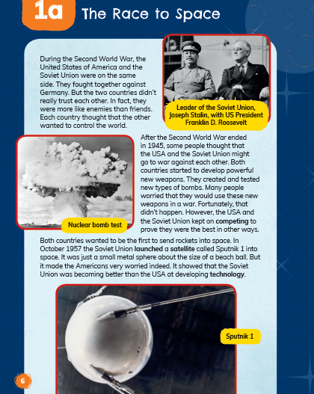
Read the first page of The Race to Space. Which of the following is important information and which is an interesting detail?
The leader of the Soviet Union was Joseph Stalin.
After the Second World War, the USA and the Soviet Union became rivals in sending a rocket to space.
Sputnik 1 was a small metal sphere about the size of a beach ball.
People worried that the Soviet Union and the USA would use new weapons, like bombs, in a war.

Slide 16
Read the last paragraph on
page 7. What do you think is the main idea or most important information?

Slide 17
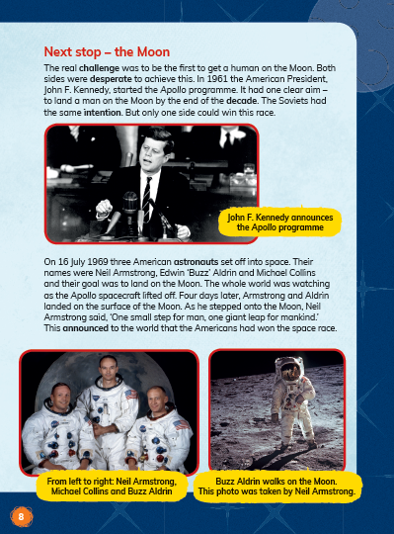
Having read The Race to Space, can you….
summarise the text using only important information?
identify any important information in the text features (e.g. headings, images, labels)?
identify key vocabulary related to the important information (e.g. satellite)?
justify why the information you have identified is important?

Slide 18
Unit 1b: Valentina Tereshkova: First Woman in Space

Slide 19
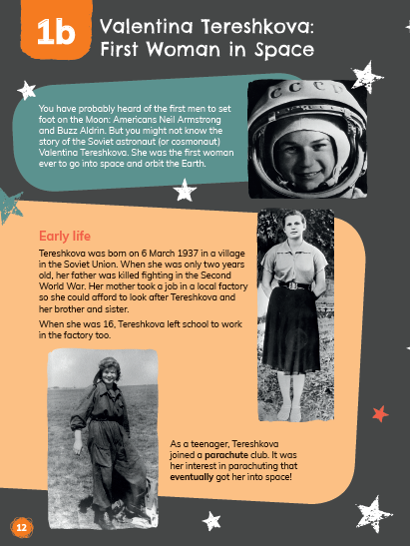
A student identified the below as the important information in page 12. Do you agree? Justify your answer.
The Soviet astronaut Valentina Tereshkova was the first woman ever to go into space.
Tereshkova’s interest in parachuting was what got her into space.

Slide 20
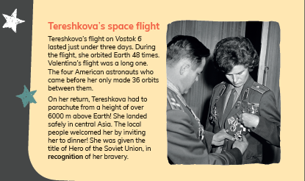
Which piece of information in this paragraph on page 14 do you think is the most important? Why?

