Slide 1


Comprehension Strategy: Inferring

Slide 2
An inference is something you conclude based partly on clues in the text and partly on your own experience or knowledge.

Slide 3


+
What I already know
=
Clues in the text
Inference

Slide 4

What would you infer if you read the following:
“Ella stood with her arms folded tightly
across her chest, and glared out the
window.”

Slide 5
Clues in the text
What I already know
=
+
Inference
Ella’s arms are folded tightly across her chest and she’s glaring.
People who fold their arms tightly and glare are often angry or upset.
Ella must be angry or upset about something.

Slide 6
What would you infer from each of the below sentences?
“My family and I have everything we need: tickets, popcorn and drinks!”
“Claire rolled her eyes and stuck out her tongue when she saw the pile of broccoli on her plate.”
“Dad glanced out the window before we left the house and grabbed an umbrella.

Slide 7
Unit 1a: The Beast from the East

Slide 8
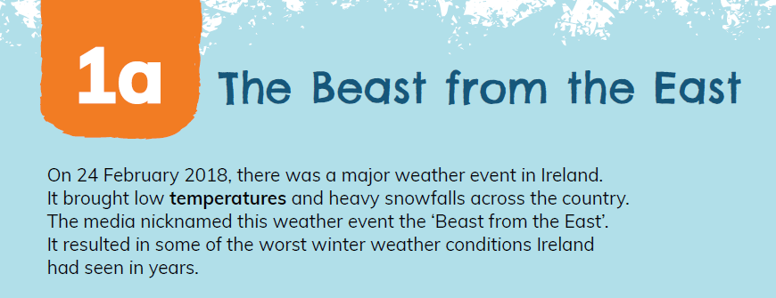
What might you infer from the fact that the weather event was called ‘The Beast from the East’?

Slide 9
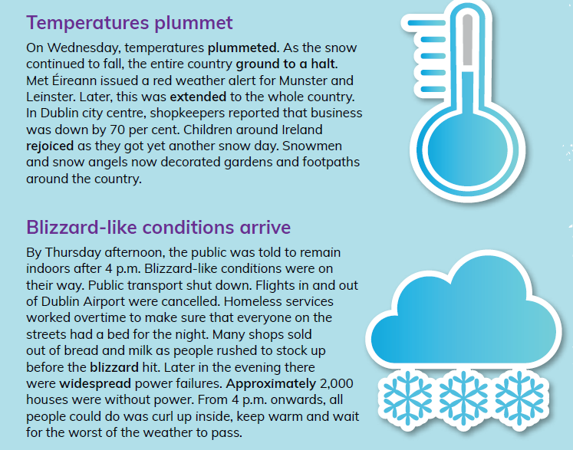

What can you infer from these statements in the 2nd paragraph on page 7?

Slide 10
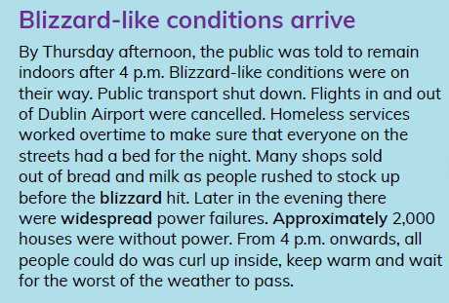
In the 3rd paragraph on page 7:
1. Why do you think people rushed to stock up on bread and milk before the blizzard hit?
2. Why do you think there were widespread power failures?

Slide 11
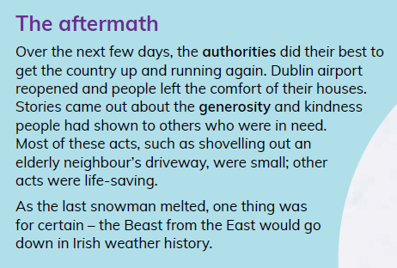
In the final line the author says that the ‘Beast from the East would go down in Irish weather history.’
What does this statement mean? How can we tell from the text that this was a significant weather event?

Slide 12
Unit 1b: A Rescue with a Difference

Slide 13


What might you infer about Tommy based on this information from page 12 of the text?
What might you infer about Áine based on this information from page 12 of the text?

Slide 14
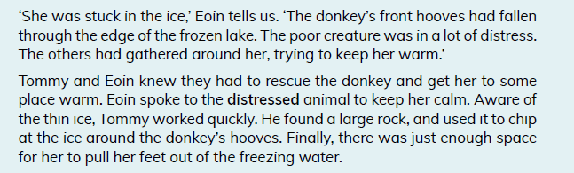
What can you infer from the below statement from page 14?
‘Aware of the thin ice, Tommy worked quickly.’

