Slide 1


Comprehension Strategy: Making Connections

Slide 2
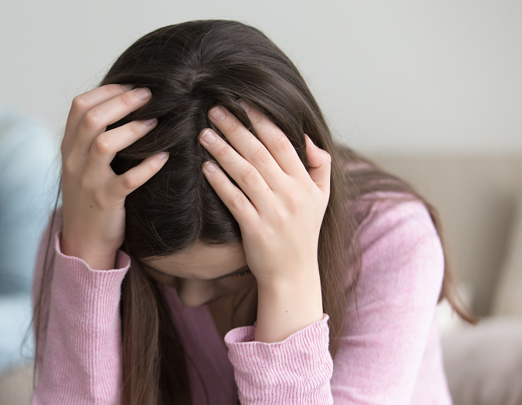
Imagine reading a story about a girl called Julia. When she has a terrible fight with her best friend you feel sorry for her.
You remember how upset you felt when you fought with one of your friends.

Slide 3
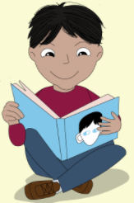
Guess what? You’ve just connected with the reading.

Slide 4
This reminds me
of the time when I thought our new soccer coach looked really strict and cross and it turned
out he was kind and
great fun.
Good readers use what they already know to help them make connections to what they are reading.

Slide 5



There are three different types of connections you can make:
1. Text to Self
2. Text to Text
3. Text to World

Slide 6
1. Text to Self
Connections with my own life – people I know, places I’m familiar with, things I like to do, feelings I’ve experienced
This story reminds me of when our team won the league last year.

Slide 7
1. Text to Text
Connections with other books, magzines or newspapers I’ve read, movies or TV shows I’ve seen
I watched a TV programme about the Great Famine and now I’m reading a story about a family trying to survive the same famine.

Slide 8
1. Text to World
Connections with real world events - things I’ve seen on the news, or read about on the Internet
We’ve just been reading about vaccines in SESE. This reminds me of Covid-19 and how people all over the world are being vaccinated against the virus.

Slide 9
Unit 1a: 15 September 1996: My First All-Ireland Final

Slide 10
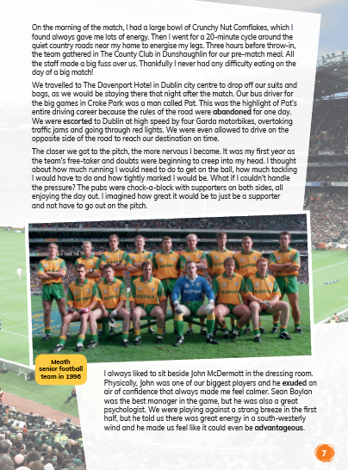
In paragraphs 3 and 4 on page 7, Trevor talks about his pre-match nerves.
Think about a time when you faced a challenge. What were your strategies for preparing and dealing with it? Compare these strategies with Trevor’s
How do you deal with nerves and pressure?

Slide 11
List some of the ‘What if’ questions people often ask themselves in challenging situation. Then come up with positive answers (Example: What if I fall over? I can just get up again and carry on.)
Trevor states that he liked to sit beside John McDermott in the dressing room because he gave him confidence. Who are the people who give you confidence in dealing with pressure?

Slide 12
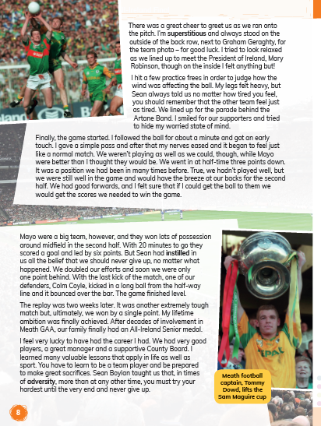
Imagine you know nothing about Gaelic football and then read the first three paragraphs on page 8. What might be confusing for someone who didn’t know anything about Gaelic football? What words/actions would they not understand?
How does your prior knowledge of the game (if you have any) help you to understand the details in the text?

Slide 13
Unit 1b: The Wee Wonders Golf European Championship

Slide 14
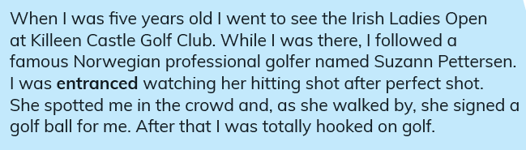
On page 12, Caoimhe describes how she was inspired by the actions of Suzanne Pettersen.
Think about when you have been inspired by watching someone or by having a conversation with someone.
What happened? Why was it inspiring?

Slide 15
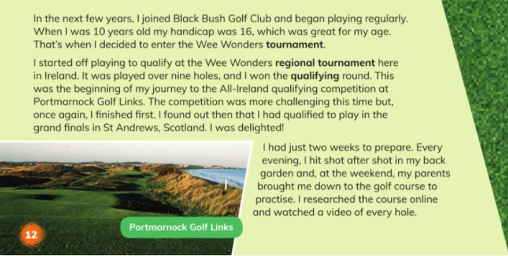
In the last paragraph on page 12, Caoimhe describes how she prepared for the tournament.
Have you ever practiced or prepared for something in the way that Caoimhe did?
What does this tell you about the kind of person she is?

