Slide 1
Feeling Grateful
WINNING WELLBEING

Slide 2
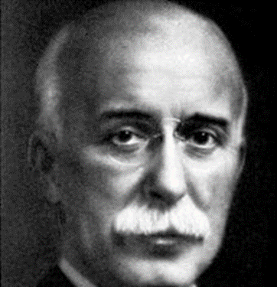
“Gratitude is a vaccine, an antitoxin, and an antiseptic.”
John Henry Jowett, 1863–1923

Slide 3
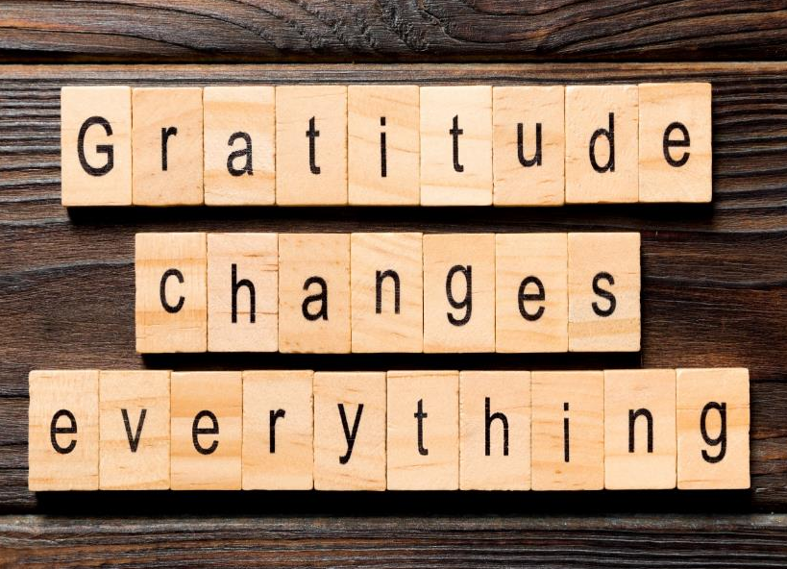
Study by Wong, Owen, Gabana & Gilman (2015):
College students receiving mental health counselling (for depression/anxiety) were given these additional therapies:
Group 1: Write one letter of gratitude to another person weekly for 3 weeks
Group 2: Write about their deepest thoughts and feelings about stressful experiences
Group 3: No writing activity
Results:
Group 1 reported significantly better mental health than the other groups one month after the writing exercise ended, then again three months after.

Slide 4
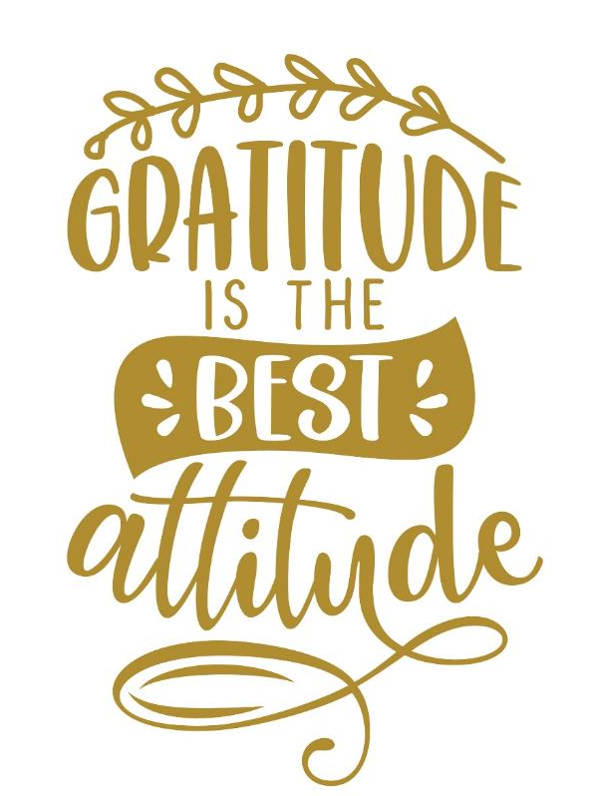
An ‘attitude of gratitude’ means making it a habit to say thank you in all areas of your life, daily, for both the big and the small things.

Slide 5
Gratitude increases happiness and life satisfaction.
People who are grateful are more resilient to stress.
People who are grateful get along better with others.
People who are grateful are less depressed.
People who are grateful achieve more.
People who are grateful are more helpful and generous.

Slide 6
You may not feel much the first few times you practise. That’s natural. Gratitude sort of needs to be awakened for us to fully experience it. The more you practise, the stronger the feelings tend to become.
By taking the time to notice the good things that happen to you and around you, it helps to make you happier.
Developing a habit of noticing these good things and being grateful for them, is what we mean by having ‘an attitude of gratitude’.

Slide 7
1. Look around the class and notice the many things you have to be grateful for.
2. Turn to your partner and ask them what things they noticed.
Did you have any similarities?

Slide 8
Everyone likes getting compliments!
When we are grateful for something somebody has done, we can show that we ‘appreciate’ them, by giving them a compliment.
Turn to the person beside you now and give them a genuine compliment.

Slide 9
Activity
As a class, why not try creating a gratitude collage, using pictures from magazines that show things that you are grateful for?
The collage can include items that you are into, including mobile phones. Then hang the collage in your room to remind yourselves to always be grateful for what you have.

