Slide 1
Inclusion for all
WINNING WELLBEING

Slide 2
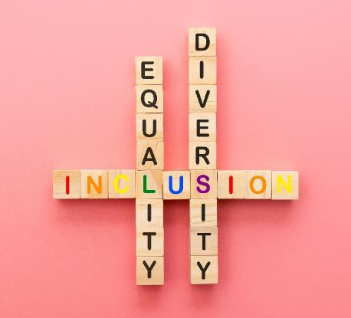
Diversity means understanding that everyone is unique and recognising and respecting our individual differences.
We must all show kindness, inclusion and equality, but we must also stand up for justice and fairness and not allow unkind jokes or comments to slide by without challenging them.

Slide 3
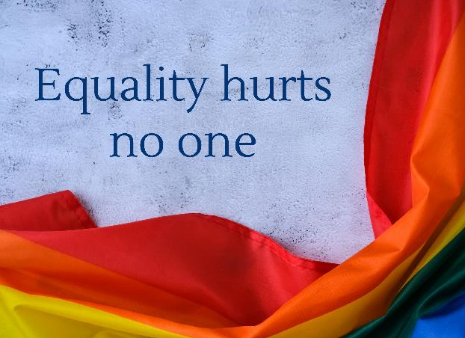
Regardless of differences, we are actually all the same.
Every person has something to contribute and has a basic right to be treated with dignity and respect, regardless of
who they love, their colour, background, gender, sexuality, religion, nationality, abilities or body type
– because the real truth is that it is diversity that makes us stronger.

Slide 4
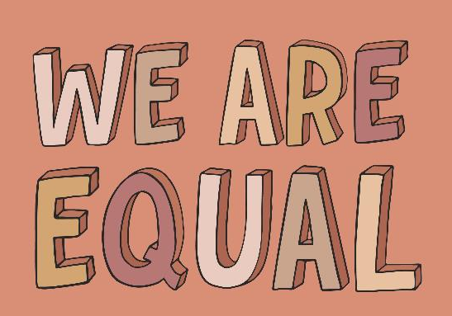
We all have to tear down any remaining barriers around discrimination and to ensure a real change in attitudes is firmly instilled so that fair play and respect for all is ingrained in our minds. When we truly believe this, we can move forward – celebrating our uniqueness – because strength lies not in similarities but in difference which affords everyone the opportunity to succeed and grow.

Slide 5
Words can be used to build up or destroy, so use them to empower people and lift them up.
We may all be different, but we all belong to the same race. There is only one race – the Human race.
We’re all people – we are all equal.
Everyone smiles in the very same language.
We are all able in different ways. In sport, a bad attitude is the only disability.
Whether you follow a certain religion or are non-believing, we are all equal. Similar yet different.
Love makes the world go round – who you love doesn’t matter. Equal human rights for all.
Beauty comes in all shapes and sizes. Our goal is health and fitness.
Diversity makes us stronger.

