Slide 1
FEAR OF FAILURE
WINNING WELLBEING

Slide 2
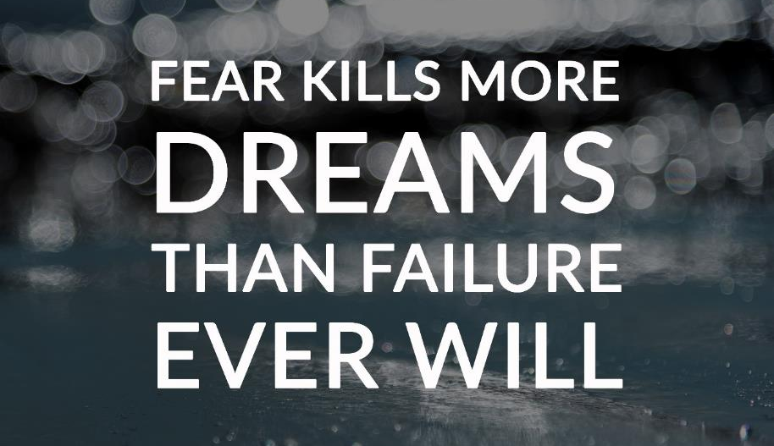
Failure
Take a moment to write down:
What does failure mean to you?
What do you think it looks like?
What do you think it feels like?
How does failure affect us?
Why do we fear failure?

Slide 3
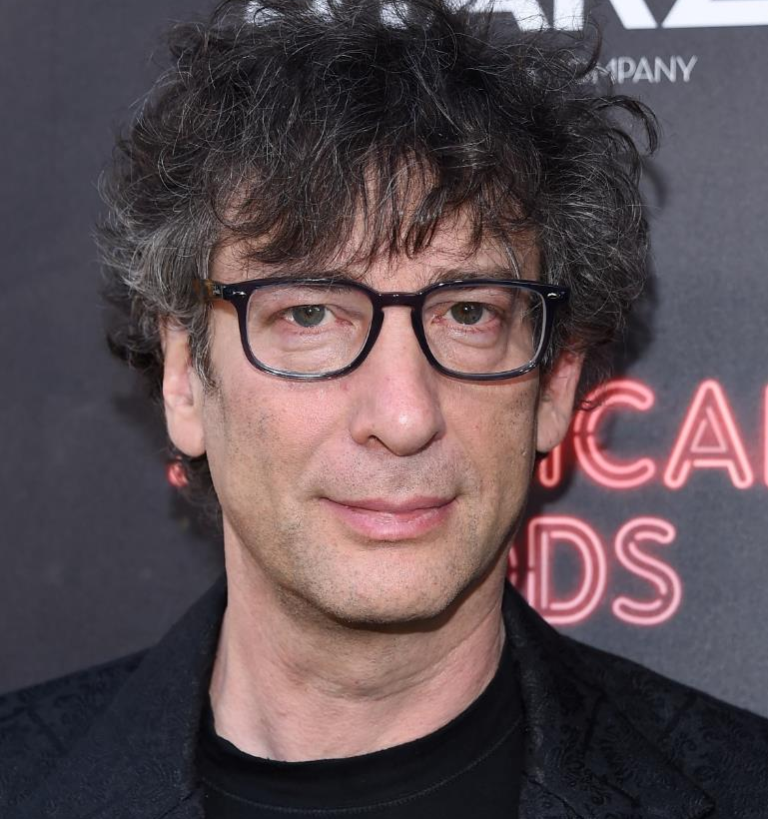
Bestselling author Neil Gaiman has long been one of the top writers in modern comics, as well as writing books for readers of all ages. He has achieved cult status in the world of science fiction with his award-winning, unpatronising writing for young people.
“I hope that in this year to come, you make mistakes.
Because if you are making mistakes, then you are making new things, trying new things, learning, living, pushing yourself, changing yourself, changing your world.
You're doing things you've never done before, and more importantly, you're Doing Something.”
Image: DFree/Shutterstock.com

Slide 4
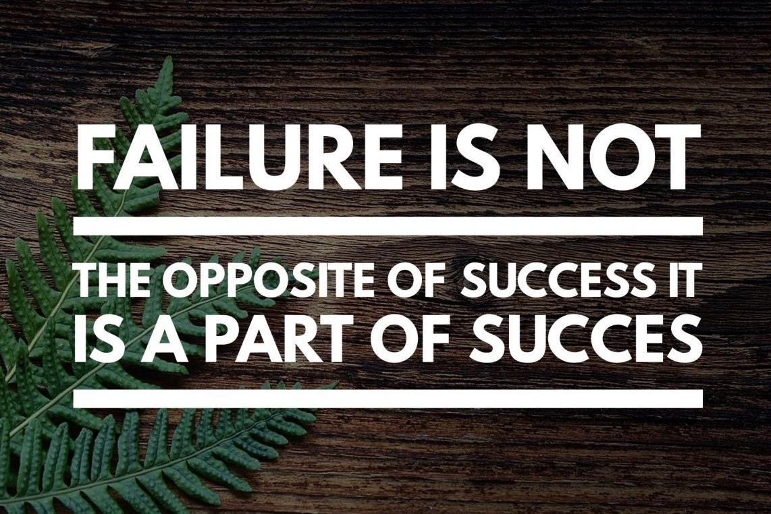

Slide 5
Considered one of the greatest basketball players of all time, Michael Jordan was devastated when he was cut from the school basketball team during his sophomore year in high school.
“I have missed more than 9,000 shots in my career. I have lost almost 300 games. On 26 occasions I have been entrusted to take the game-winning shot and I missed. I have failed over and over and over again in my life. And that is why I succeed.”

Slide 6
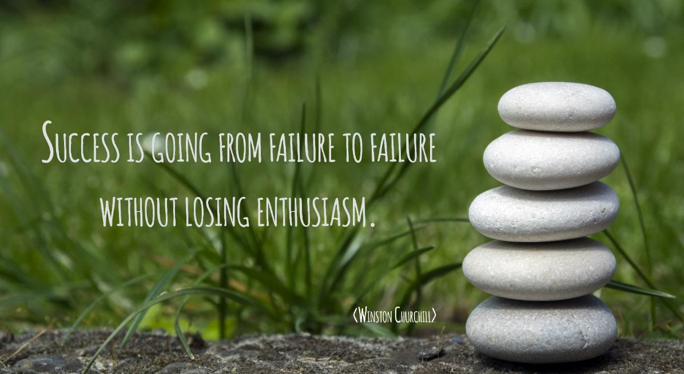

Slide 7
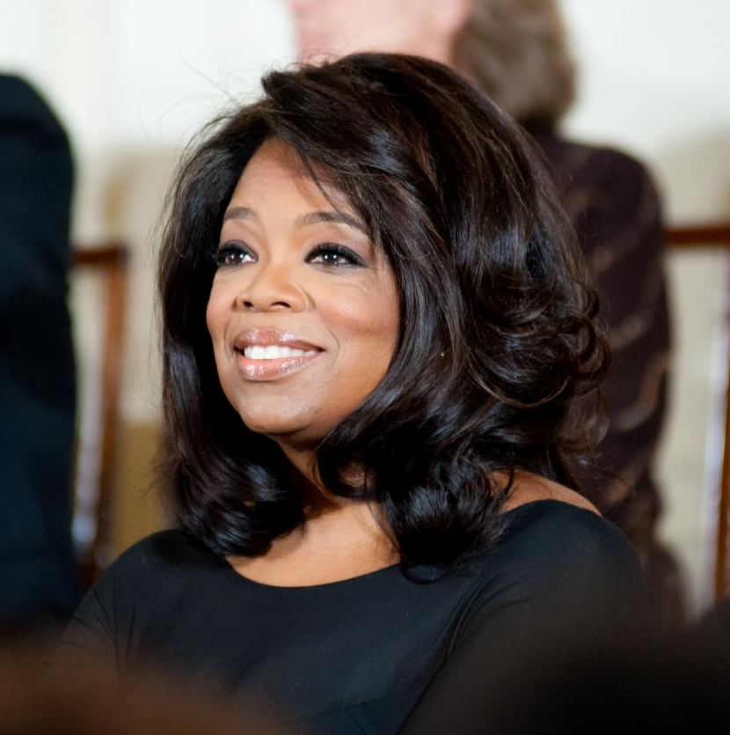
Known globally for her work in entertainment and philanthropy, Oprah Winfrey was publicly fired from her first job as a news anchor for getting ‘too emotionally invested in her stories.’
“It doesn't matter how far you might rise. At some point you are bound to stumble. If you're constantly pushing yourself higher and higher the law of averages predicts that you will at some point fall. And when you do I want you to remember this: There is no such thing as failure. Failure is just life trying to move us in another direction.”
Image: Rena Schild/Shutterstock.com

Slide 9
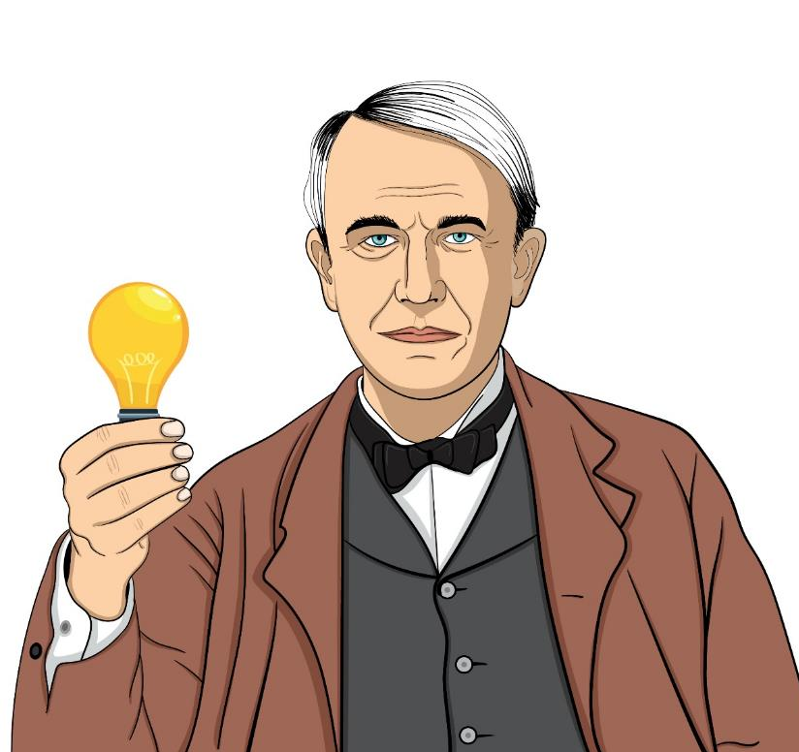
Thomas Alva Edison was a famous American inventor. He is best known for inventing the ‘domestic’ lightbulb to go in our homes, and the electric power system that allowed them to work. He produced over 1,000 successful inventions in his lifetime.
He was fired from his first two jobs for being ‘non-productive’. As an inventor, Edison made 1,000 unsuccessful attempts at inventing the light bulb. When a reporter asked, ‘How did it feel to fail 1,000 times?’ Edison replied,
‘I didn’t fail 1,000 times. I just found 1,000 ways not to do it.’
Image: Madjembe/Shutterstock.com

Slide 10
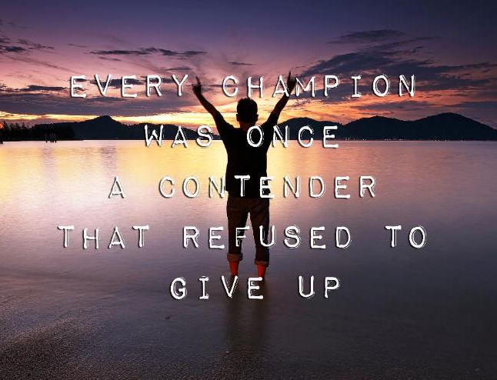
Activity
In pairs, find a successful individual you would like to research who experienced failure on their journey to success.
In what ways did they experience failure and what lessons did they learn that fuelled their future success? Present your research to the class.

