Slide 1
SELF-ESTEEM
WINNING WELLBEING

Slide 2
Self-Esteem
Self-esteem begins to form in early childhood. Factors that can influence self-esteem include:
Your thoughts and perceptions
How other people react to you
Experiences at home, at school and in the community
Illness, disability or injury
Age
Media messages
Relationships with those close to you — parents, siblings, peers, teachers and other important contacts — are important to your self-esteem.

Slide 3
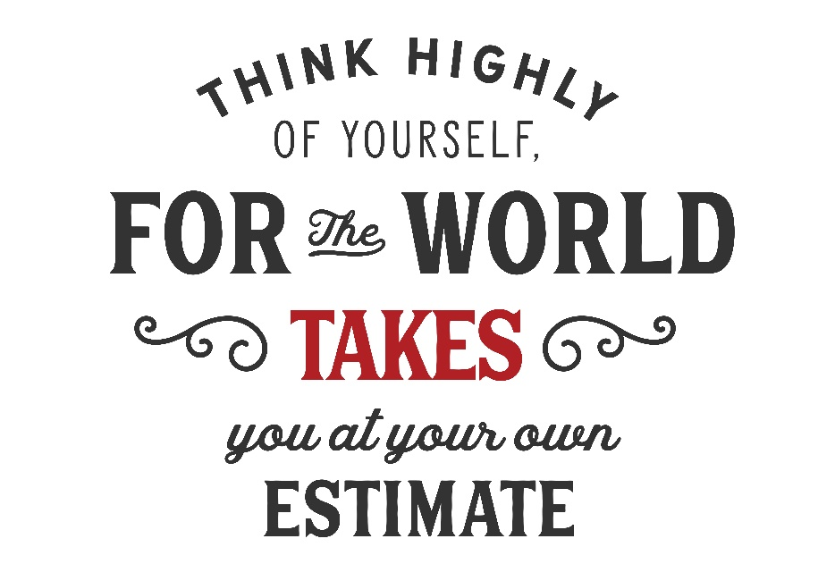
Self-esteem tends to fluctuate, depending on your circumstances. It's normal to go through stages when you feel down about yourself and times when you feel good about yourself. Generally, however, self-esteem stays in a range that reflects how you feel about yourself overall and increases slightly with age.

Slide 4
Low Self-Esteem
When you have low self-esteem, you tend to put very little value on your ideas and opinions. You focus on your perceived faults and weaknesses. You give yourself very little credit for your skills and assets. You can tend to think that others are more successful or capable than you.
“Self-respect
IS
the best respect”
Accepting positive feedback can be difficult. You might also fear failure, which can hold you back from succeeding in school.

Slide 5
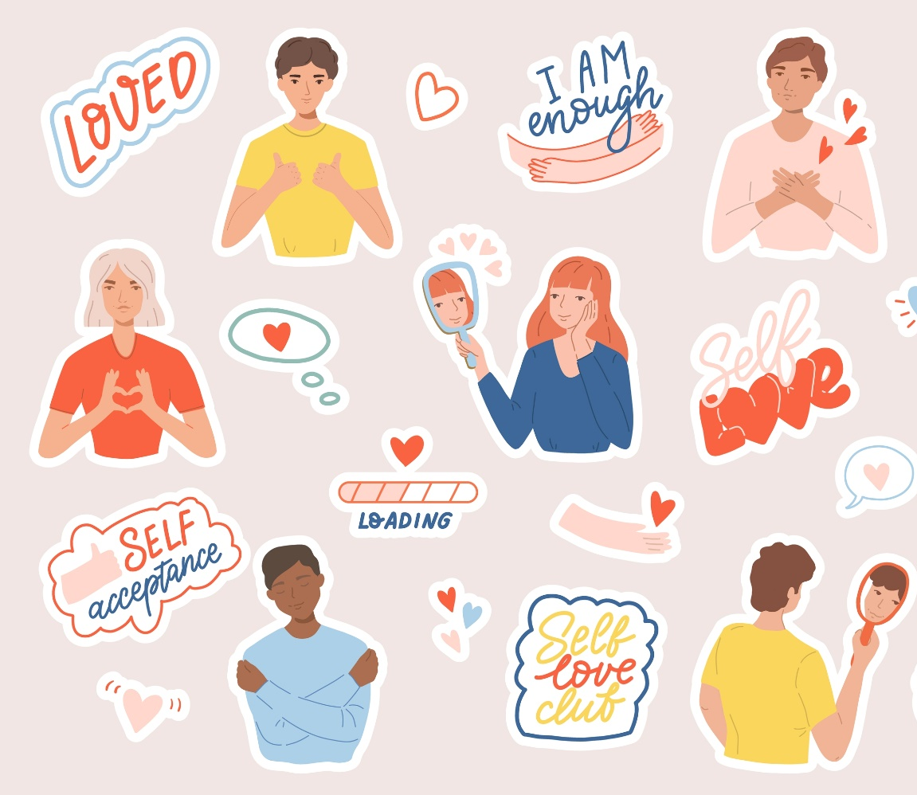
Healthy Self-Esteem
When you have healthy self-esteem, it means you have a balanced and positive view of yourself.
For example, you have a good opinion of your abilities, but you also recognise that you have flaws just like everyone else.

Slide 6
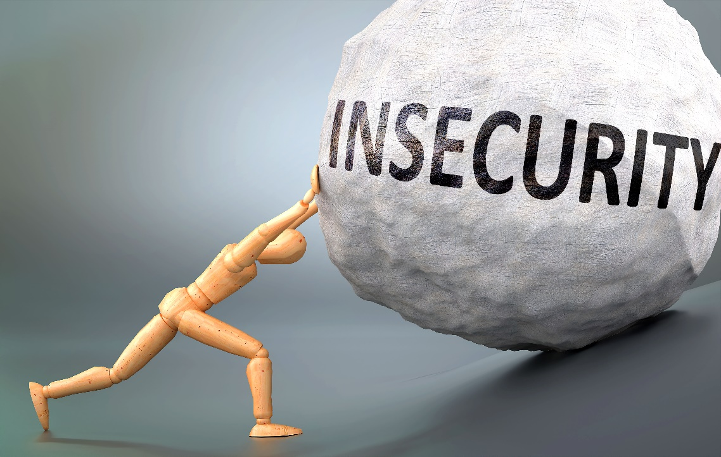
Interesting Fact: Feeling superior to others and being boastful are usually not a sign of too much self-esteem.
In fact, psychologists believe that it is more likely a sign of insecurity and low self-esteem.

Slide 7
Benefits of Healthy Self-Esteem
When you value yourself and have healthy self-esteem, you feel worthwhile and secure. Your relationships with others are generally positive and you feel confident about your abilities. You’re also open to feedback and learning, which can help you obtain and master new skills.
With healthy self-esteem, you are:
Able to express your needs and opinions in an assertive way
Confident in your ability to make decisions
Able to form secure relationships and generally less likely to stay in unhealthy ones
Realistic in your expectations
Not as overcritical of yourself and others
More resilient
Able to handle stress and setbacks in a better way

Slide 8
Benefits of Improving Self-Esteem
Overall happiness
Believing that you are more deserving of good things in life
Less chance of self-sabotage
You do not constantly need to seek validation from others.
You start truly believing that you are enough just as you are – flaws and all.

Slide 9
How to Improve Your Self-Esteem
Refocus your thoughts to something more constructive.
Avoid the comparison trap with others, including online.
Focus on things you like to do.
Appreciate yourself.
Replace perfectionism with ‘good enough’.
Remind yourself of the benefits of having healthy self-esteem.

Slide 10
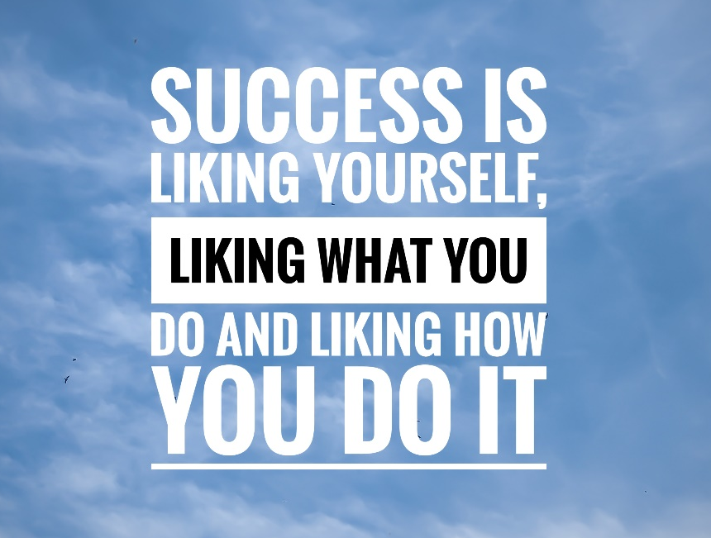
Self-esteem affects virtually every area of your life. Having a healthy, realistic view of yourself is not about boasting and thinking you are superior. It’s about learning to like and respect yourself — faults and all.

Slide 11
Confidence mind-mapping
This activity is about creating a personal confidence mind map.
Paying attention to your positive sides will allow you to see that you are an exceptional person and will hopefully boost your confidence and self-esteem.
Instructions: First, draw your mind map, and in the centre, write ‘Why I am great’.
Then indicate on each arm why you are:
1. A great person 3. A great team player
2. A great friend 4. A great classmate

