Slide 1
Strand 1
Chapter 1
Beliefs of the Major World Religions

Slide 2
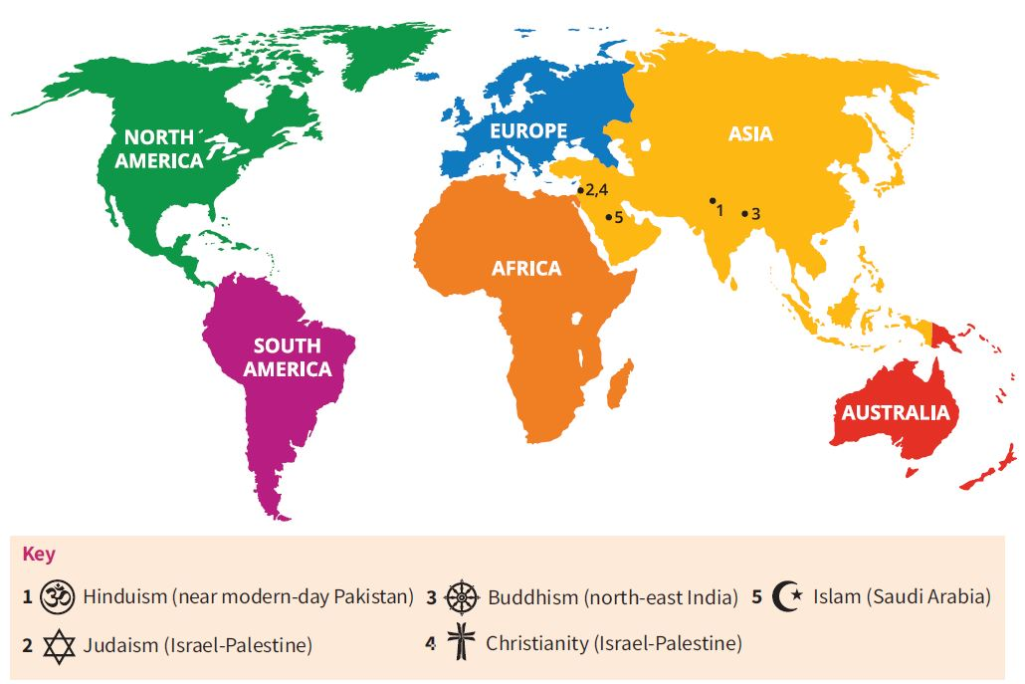
Beliefs of the Major World Religions
The Names of the Five Major World Religions
There are many different religions in the world.
There are five major world religions, which were founded at different times in different parts of the world. They are:
Hinduism, founded c. 2500 BCE
Judaism, founded c. 1850 BCE
Buddhism, founded c. 560 BCE
Christianity, founded c. 30 CE
Islam, founded c. 622 CE

Slide 3
Beliefs of the Major World Religions
Symbols of the Five Major World Religions
The Aum
The Eight-Spoked Wheel
The Cross
The Star of David
The Star and Crescent Moon

Slide 4
Beliefs of the Major World Religions
Monotheism
Polytheism
Monotheism means the belief in one God.
Judaism, Christianity and Islam are monotheistic faiths.
Polytheism is the belief in more than one God.
Hinduism is a polytheistic faith.

Slide 5
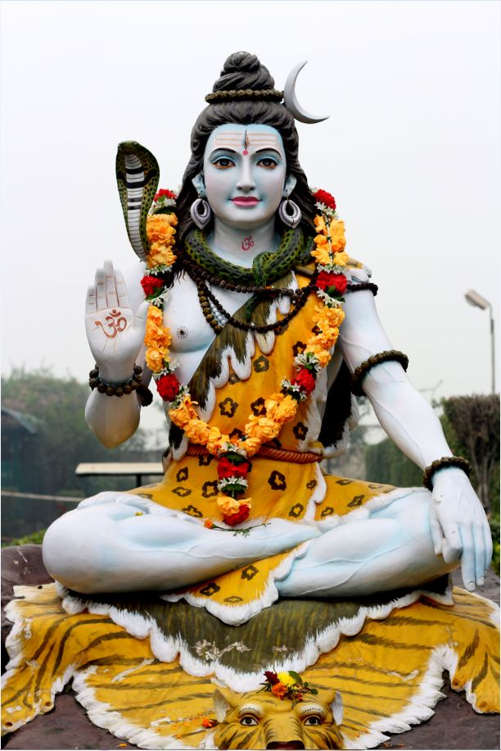
Beliefs of the Major World Religions
Hinduism
Hinduism is the oldest of the five major world religions.
It originated in north-west India.
Hindus believe in reincarnation.
The three main Gods of Hinduism are known as the Trimurti.
These are Brahma, Vishnu and Shiva.
The Hindu God Shiva

Slide 6
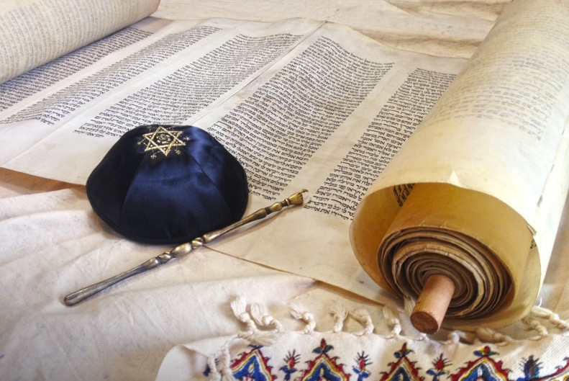
Beliefs of the Major World Religions
Judaism
Judaism is the oldest monotheistic religion.
Judaism is an Abrahamic faith. Abraham started the belief in one God.
Abraham, Isaac and Jacob are the three founding fathers of Judaism.
Jews believe in a covenant, or agreement, between the people and God.
Jews believe the Torah, or law, was given to them by God through Moses.
A Torah scroll

Slide 7
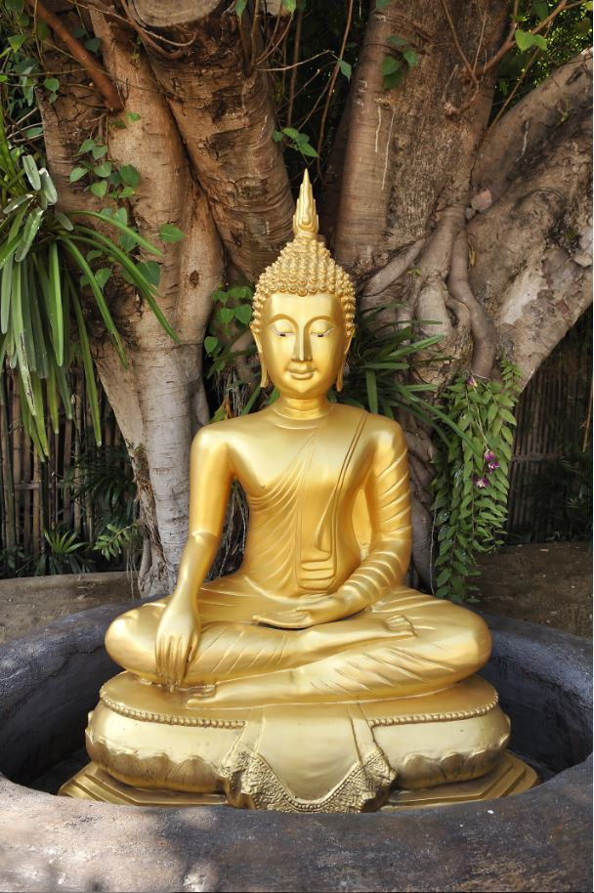
Beliefs of the Major World Religions
Buddhism
Buddhism was founded in north-east India.
It was founded by Prince Siddhartha Gautama.
Buddha means ‘enlightened one’.
Buddhists do not worship a God or Gods.
Buddhist want to reach a state of enlightenment known as nirvana.
The Buddha

Slide 8
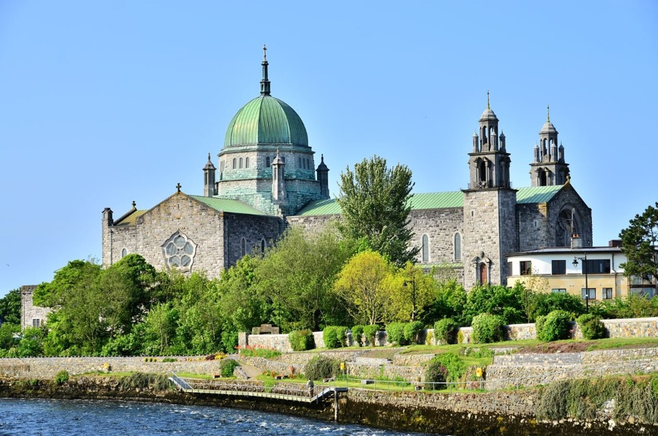
Beliefs of the Major World Religions
Christianity
Christianity was founded by Jesus of Nazareth.
Jesus was crucified by the Romans.
Christians believe in one God.
The Christian holy writings are known as the Bible.
There are three main branches of Christianity: these are Orthodox, Roman Catholic and Protestant.
Galway Cathedral

Slide 9
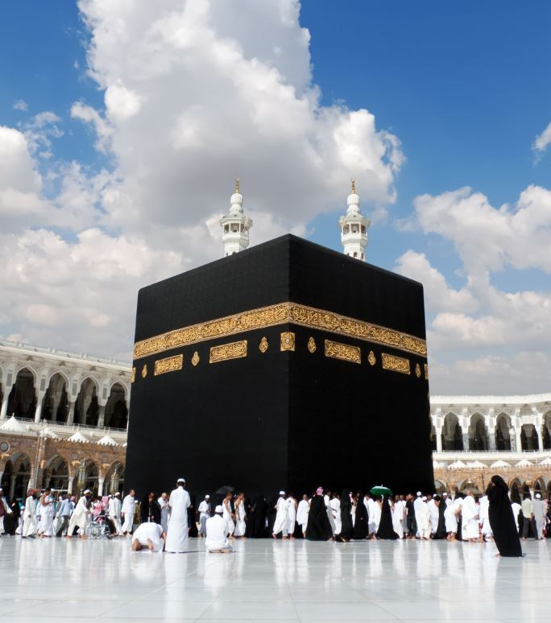
Beliefs of the Major World Religions
Islam
Islam was founded in what is now Saudi Arabia by the Prophet Muhammad.
The followers of Islam are known as Muslims.
The holy book of Islam is called the Quran.
Muslims follow the Five Pillars of Islam.
The holiest place for Muslims is a building called the Kaaba in Mecca.
The Kaaba, Mecca, Saudi Arabia

Slide 10
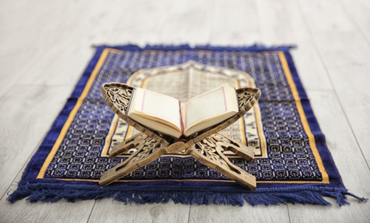
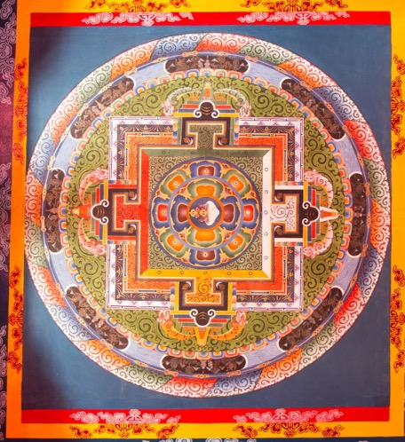
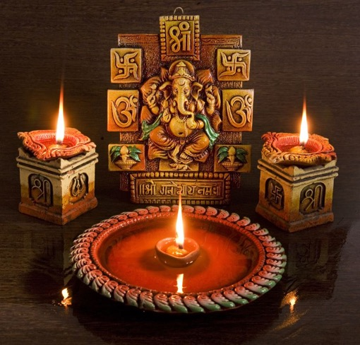
Beliefs of the Major World Religions
Objects from Each of the Five Major World Religions

