Slide 1
Strand 2
Chapter 5
Stories of Origin

Slide 2
Stories of Origin
The World

Slide 3
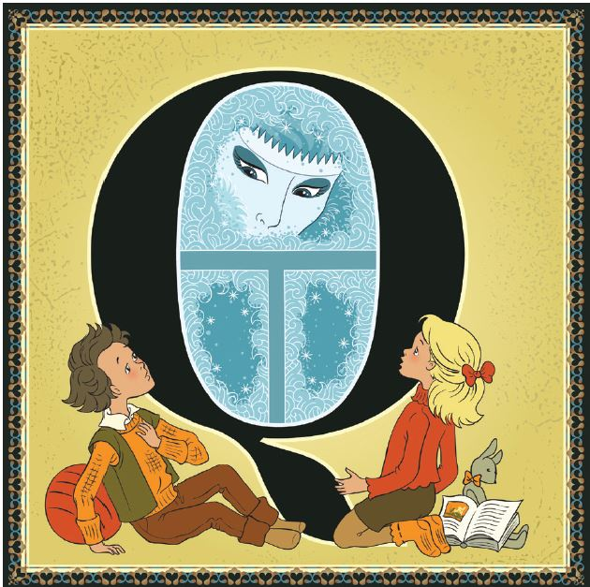
Stories of Origin
What Is a Story?
Discuss how stories can teach people things.

Slide 4
Stories of Origin
Definition of a Story
A story is a description of events that happened or that are invented.
Stories can be symbolic.
Stories can be interesting.
What stories do you know?

Slide 5
Stories of Origin
Myths
A myth is a story full of symbols.
Myths were often used in ancient times to teach people important things.
They were used to transmit important ideas from one generation to the next in ancient societies.
They had a special significance for the people who told them.

Slide 6
Stories of Origin
Questions that Creation Stories Aim to Answer
Why was the world made?
Why are there people in the world?
What responsibility do people have for the world?

Slide 7
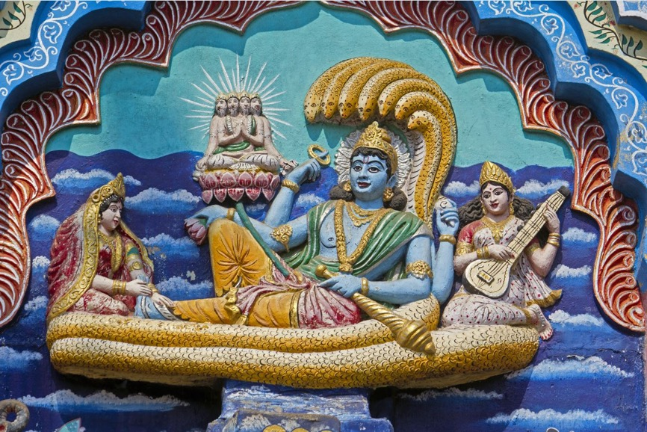
Stories of Origin
The Hindu Creation Story
The Hindu creation story is found in the sacred writings of Hinduism.
It tells of the beginning of the world when there was a vast ocean.
The Gods Vishnu, Brahma and Shiva feature in the story.
The story teaches about the origins of the world and also about the Gods and their different roles.
It also teaches the importance of taking care of the earth.
The God Vishnu features in the Hindu creation story.

Slide 8
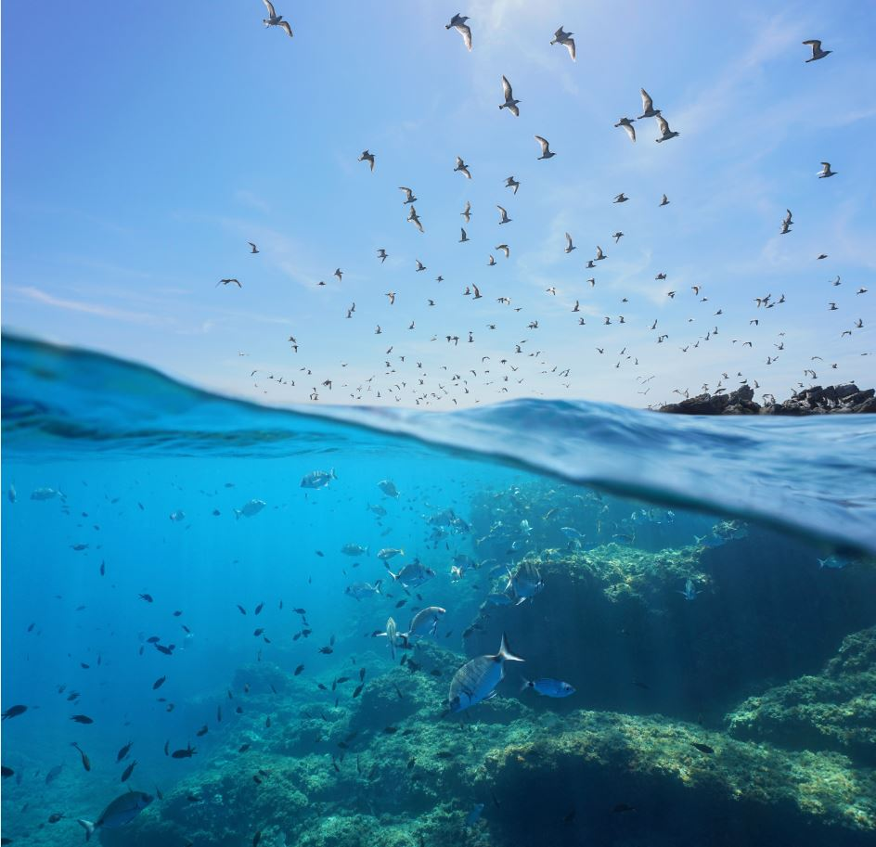
Stories of Origin
The Jewish Creation Story
The Jewish creation story is found in the first book of the Torah, called the Book of Genesis.
The story was used to teach about the origins of the world and of God as creator.
The story teaches that the world as created by God was good.
The story teaches that people were given the responsibility of taking care of the earth on behalf of God.

Slide 9
Stories of Origin
Relevance for Followers Today
Each story contains important lessons for followers today.
In both stories, humans are the final part of the process of creation.
In both stories, humans have a responsibility to take care of the natural world and all living creatures.

Slide 10
Stories of Origin
An Alternative Creation Story
There are many creation stories throughout the world.
They are found in different countries and cultures.
Explore a creation story! Choose one of the following and find out more about it:
A Native American creation myth
A Maori creation myth
A Norse creation myth

Slide 11
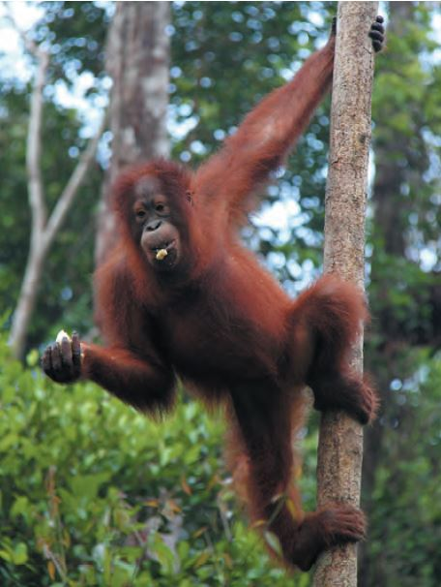
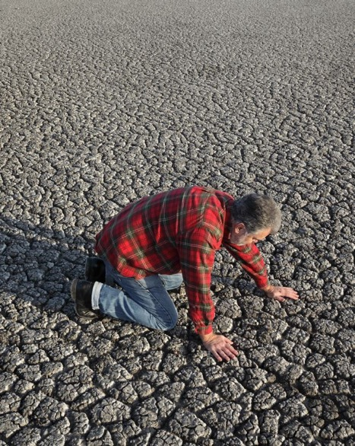
Stories of Origin
Problems Facing the Natural World
Topic for discussion: Are people taking care of the earth?
There are many problems facing the natural world. These include:
Global warming
Extinction of species
Loss of habitat
Pollution
Deforestation
Many species are threatened with extinction because of human activities.
Many environmental problems occur because we do not look after the earth.

